Slide 1
Test #4 (Tuesday, 7:30am)
Topics:
Our Milky Way Galaxy
Galaxies, Normal and Active
Cluster of Galaxies and Large Scale Structures
Cosmology, the Beginning and The End of the Universe
Life in the Universe
Methods
Conceptual Review and Practice Problems Chapters 14 - 18
Review lectures (on-line) and know answers to clicker questions
Try practice quizzes on-line
Bring:
Two Number 2 pencils
Simple calculator (no electronic notes)

Slide 2
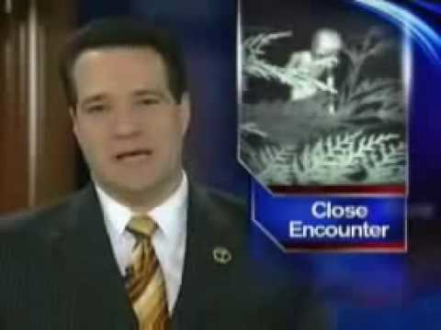
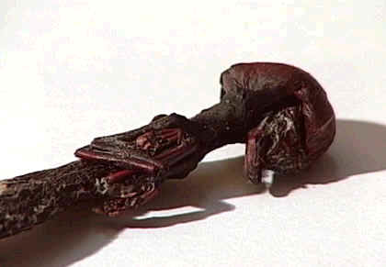
Life in the Universe
Is there anybody out there? What might other forms of life look like? What about intelligent life? What do we mean by “living”? What do we mean by “intelligent”?

Slide 3
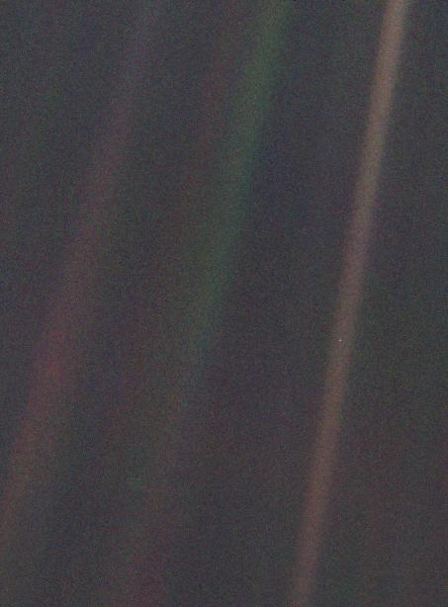
Pale Blue Dot
Earth as seen from Voyager 1, when it was 6 billion km from home.
Notes:
Light bands: bands of sunlight scattered by the optic in the camera

Slide 4
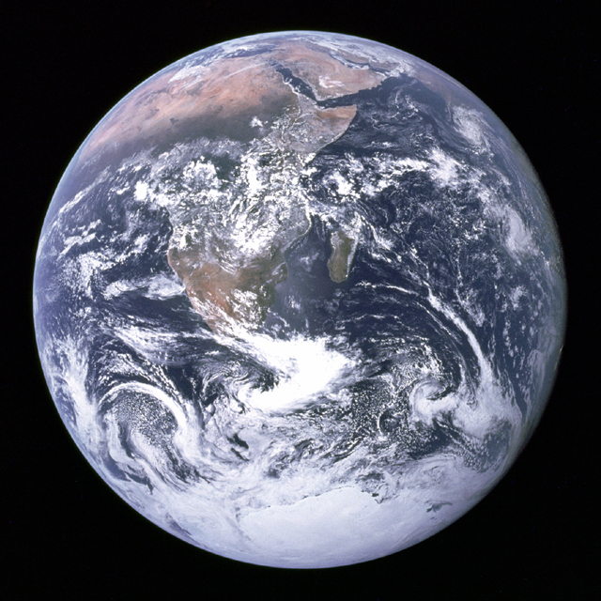
View from Apollo 17

Slide 5
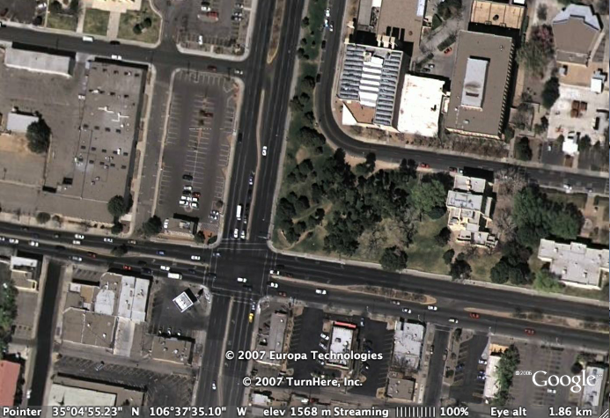
View from overhead (courtesy google Earth)
What does the dominant life form look like?

Slide 6
What is Life?
Seven tests for life
Complex Organization
Convert food to energy
Reproduce
Growth and Development
Respond to stimuli
Adapt to Environment
Show individual variation
Now Define Intelligent Life
Intelligent Life:
Ability to use tools
Language
Ability to learn
Notes:
Working definitions. Arguable, subjective. Molecular and cellular organization: forms into specific functions (tissues, organs, organ system, organism)
Growth: reproduces cells, divide cells etc.
Adaptions are traits giving advantage in a certain environment.

Slide 7
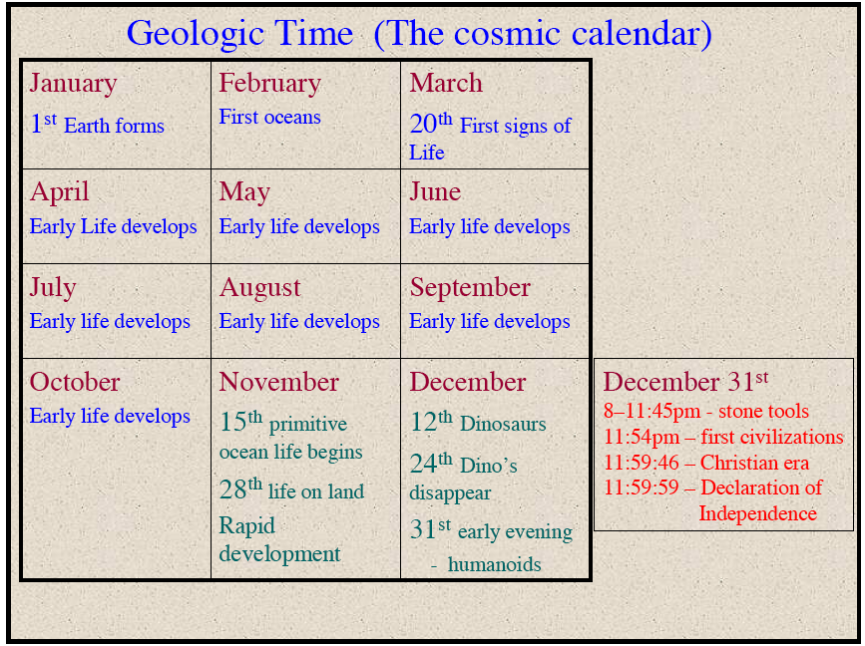

Slide 8
Clicker Question:
Which land animal on Earth is or was the dominant species for 150 million years?
A: man and other hominids
B: dogs and other canines
C: dinosaurs
D: insects
Notes:
dinosaurs, about 225-60 million years. insects for more like 500 million years.

Slide 9
Question:
Which of the following is NOT necessarily a sign of intelligent life?
A: ability to communicate (use language)
B: ability to learn
C: ability to reproduce
D: ability to use tools

Slide 10
Question:
Are there other intelligent life forms in our Galaxy that we could communicate with?
A: No, just 1 advanced civilization in the whole Milky Way
B: Yes, a few perhaps 100 in the Milky Way
C: Yes, many, 10000 in the Milky Way
D: Yes, lots, 1 million in the Milky Way

Slide 11
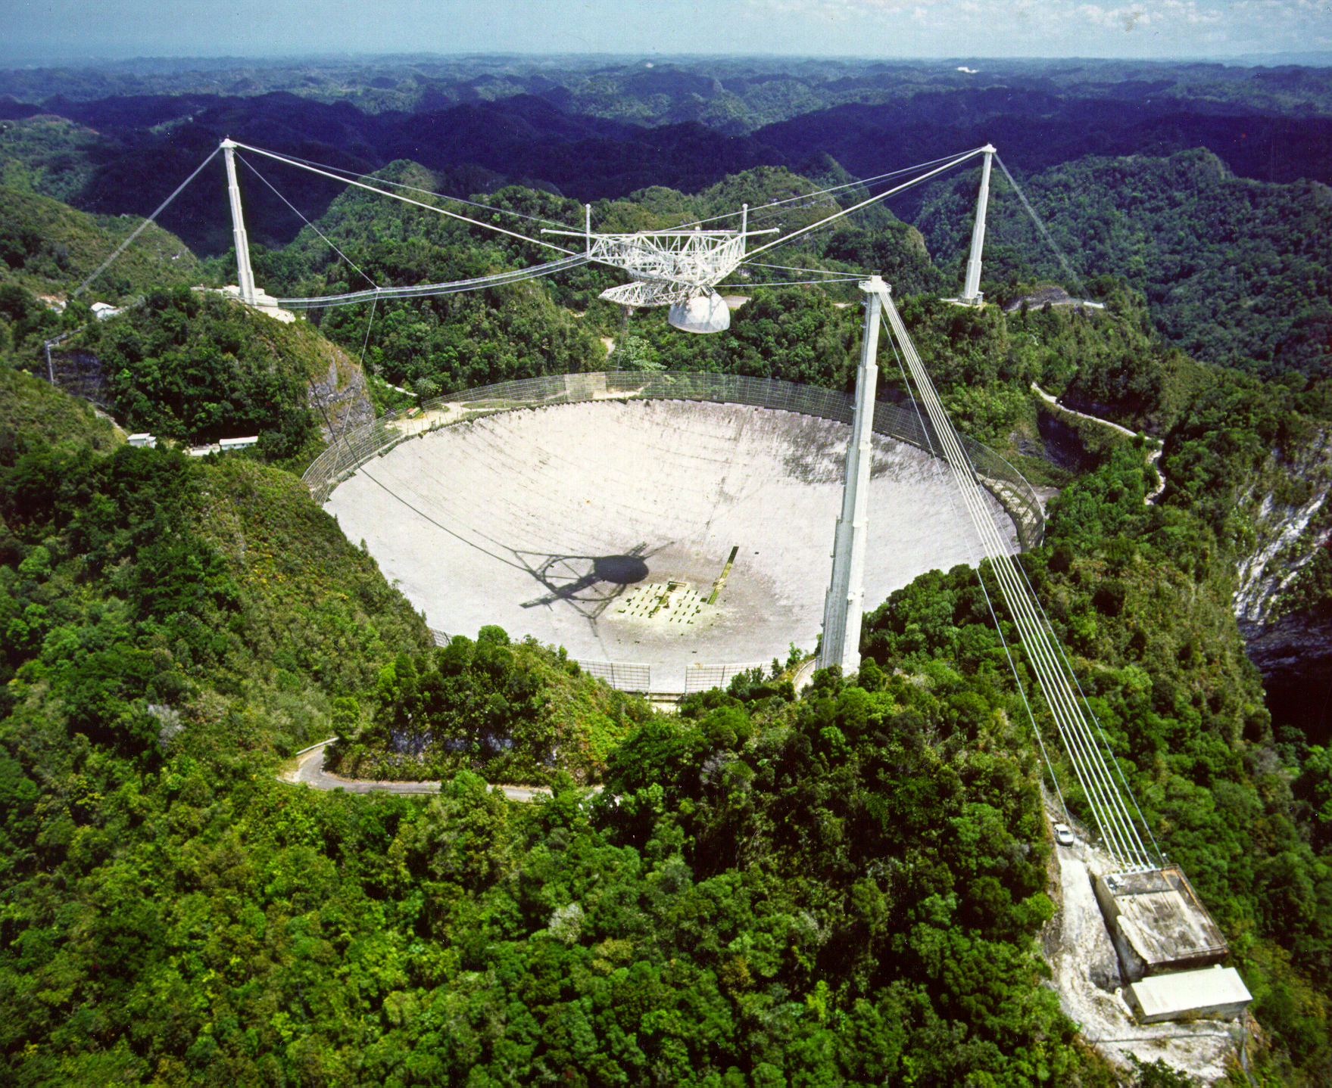
The Drake Equation N = R*f_{p}n_{e}f_{l}f_{i}f_{c}L
the number of civilizations in the Galaxy that can communicate across stellar distances

Slide 12
N = R*f_{p}n_{e}f_{l}f_{i}f_{c}L
The Drake Equation
number of technological, intelligent civilizations in the Milky Way
rate at which new stars are formed
fraction of stars having planetary systems
average number of habitable planets within those planetary systems
x
x
=
fraction of those habitable planets on which life arises
fraction of those life-bearing planets on which intelligence evolves
fraction of those planets with intelligent life that develop technological society
average lifetime of a technological civilization
x
x
x
x
Each term is less certain than the preceding one!

Slide 13
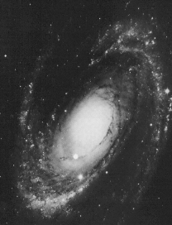
N = R*f_{p}n_{e}f_{l}f_{i}f_{c}L
the rate at which suitable new stars are forming each year in
the Galaxy
The Galaxy has ~10¹¹ stars, which are forming, living, and dying in billion year cycles-
Stars are the fundamental platforms and energy sources for life…
Location
of Sun
Notes:
basically all stars “suitable” since long-lived ones dominate and most have probably habitable environments.

Slide 14
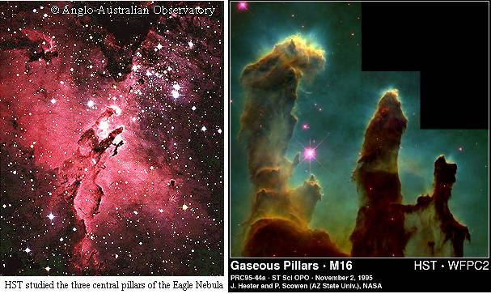
N = R*f_{p}n_{e}f_{l}f_{i}f_{c}L
Stars being born…

Slide 15
N = R*f_{p}n_{e}f_{l}f_{i}f_{c}L
R* is pretty well known because
astronomical technology is up to the task of measuring it…
R* ~ 10 stars per year

Slide 16
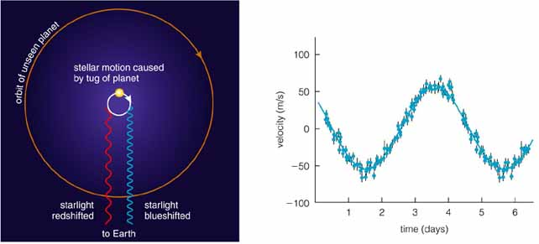
N = R*f_{p}n_{e}f_{l}f_{i}f_{c}L
the fraction of suitable new stars
around which planets form

Slide 17
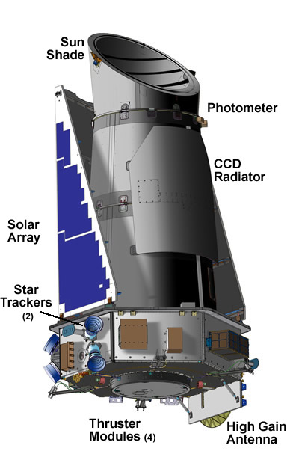
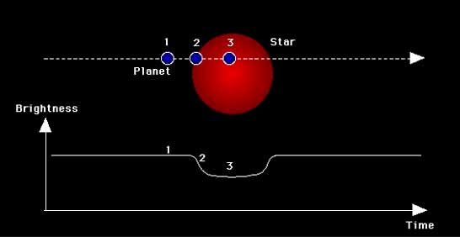
N = R*f_{p}n_{e}f_{l}f_{i}f_{c}L
Kepler
Another way to find planets…

Slide 18
N = R*f_{p}n_{e}f_{l}f_{i}f_{c}L
f_{p} is becoming better known as we speak… long term Doppler programs and future space mission like TPF and Darwin will increase our knowledge.
f_{p} ~ 0.5

Slide 19
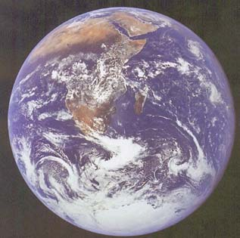
N = R*f_{p}n_{e}f_{l}f_{i}f_{c}L
the number of planets residing in an ecosphere, the shell of life
Direct energy: light from star
Proximity to star (not too close, not too far, just right)
Atmosphere of planet (climatic evolution)
Ozone layer protects us from harmful UV-rays
Indirect energy: localized
Solar wind + local magnetosphere
Geothermal (radioactive decay)
Central Planet (tidal forces on moons)
Requires stability for billions of years
Notes:
includes idea of habitable zone

Slide 20
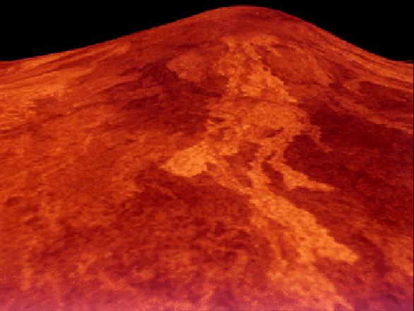
N = R*f_{p}n_{e}f_{l}f_{i}f_{c}L
Venus
Too close to the Sun
Venus suffers from a runaway
Greenhouse effect, in which
light energy from the star is
trapped as heat by the atmosphere.

Slide 21
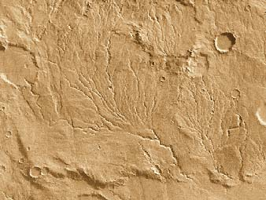
N = R*f_{p}n_{e}f_{l}f_{i}f_{c}L
Mars
Too far from the Sun
Mars suffers from a runaway
Ice Catastrophe, in which
light energy from the star is
reflected back into space.

Slide 22
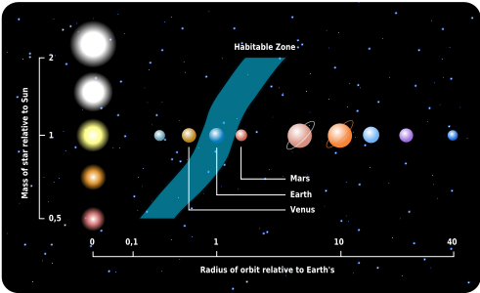
N = R*f_{p}n_{e}f_{l}f_{i}f_{c}L
In the zone …

Slide 23
N = R*f_{p}n_{e}f_{l}f_{i}f_{c}L
n_{e} probably is zero in some planetary systems and is a few to several in others (ours?). We need to know what n_{e} is on average, its typical value.
n_{e} uncertain (~ 2?)
Notes:
Now estimate about 20% of stars have a planet in habitable zone, although not all those may be habitable.

Slide 24
N = R*f_{p}n_{e}f_{l}f_{i}f_{c}L
the fraction of ecosphere planets on which life arises
Key Question: how readily does life arise?

Slide 25
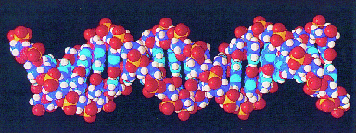
N = R*f_{p}n_{e}f_{l}f_{i}f_{c}L
All life (as we know it) is made of carbon based molecular chains
Only 30 complex molecules comprised of only five (5) basic elements
Urey-Miller experiment in 1953 showed that we could build amino acids
C = carbon
H = hydrogen
N = nitrogen
O = oxygen
P = phosphorous
DNA molecule
Notes:
amino acids build proteins. Nucleotide bases build genes and dna. Urey Miller – primordial soup of water, methane, CO2, ammonia, energized it with discharge. After a few days, amino acids formed. 10 yrs later, another expt made nucleotide bases.

Slide 26
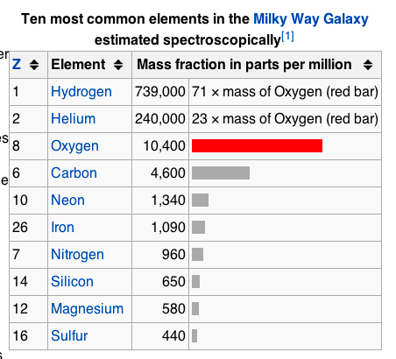
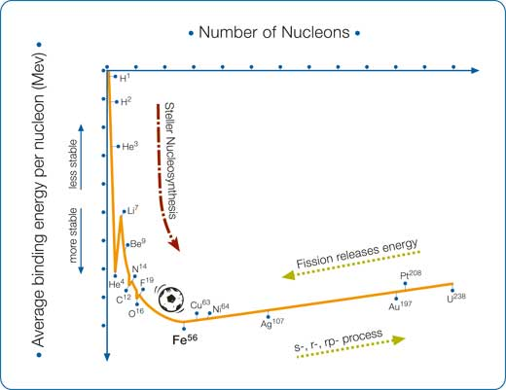
Binding Energy per nucleon

Slide 27
N = R*f_{p}n_{e}f_{l}f_{i}f_{c}L
C, H, N, and O are among the seven most abundant elements is the universe
The five elements of life are created in stars and supernovae explosions distributed them throughout the interstellar medium
Organic molecules, such as amino acids, are commonly found in interstellar, molecular gas clouds, and in comets and meteorites
Notes:
Amino acids: complex molecules that make up the building blocks of our cells and muscles: makes the PROTEIN

Slide 28
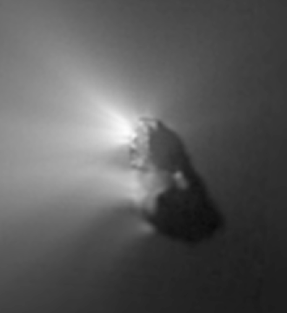
N = R*f_{p}n_{e}f_{l}f_{i}f_{c}L
Comets, such as Halley, contain water ice and organic molecules, which are evaporated into interplanetary space
Building blocks of planets during planet formation epoch
Deposit water and organic molecules on planets
Can alter course of evolution if impacting life bearing planet
Notes:
Organic molecules: chains of carbon atoms

Slide 29
N = R*f_{p}n_{e}f_{l}f_{i}f_{c}L
Just how robust is life?
Life persists in a wide range of terrestrial environments- from the high desert to frozen ice tundra, from the tropics to the black depths of the oceans…
Are there alternatives to photosynthesis?
Life in the ocean depths exploits geothermal energy and survives not on sunlight, but on bacteria that metabolizes sulfuric acid outgasing from thermal vents
Life can arise in a range of environments and can survive on a variety of primary energy sources.

Slide 30
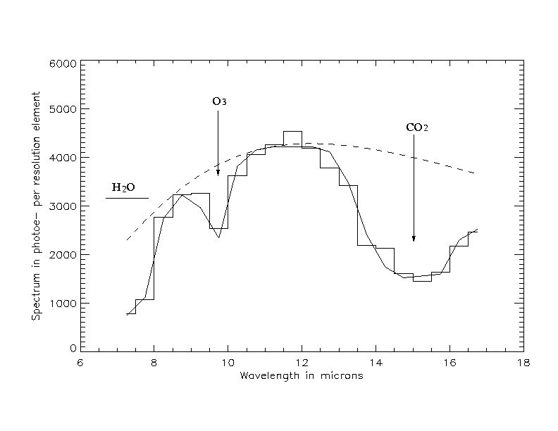
N = R*f_{p}n_{e}f_{l}f_{i}f_{c}L
How will we detect signs of life on extrasolar planets?
Terrestrial Planet Finder will take spectra of earth sized planets up to 30 light years away!
Ozone, water, and carbon dioxide absorption features are indirect indicators of life processes (photosynthetic)
Terrestrial Planet Finder
ozone
carbon dioxide
water
Spectrum of an Earth-like planet

Slide 31
N = R*f_{p}n_{e}f_{l}f_{i}f_{c}L
f_{l} , presently, can be guesstimated only by carefully studying our solar system, and in particular, Earth.
That life is a “language” with a 30 molecule “alphabet” and is comprised of the five most abundant elements is encouraging
f_{l} ~ 0.1-1 (?)
NOTE: f_{l} is likely not vanishingly small, say 10⁻⁸ or so

Slide 32
Clicker Question:
What element is NOT commonly found in your body?
A: H - hydrogen
B: He - helium
C: C - carbon
D: O - oxygen

Slide 33
Clicker Question:
What is the Drake equation used to estimate?
A: The number of stars in the Galaxy
B: The number of intelligent civilizations in the Galaxy
C: The number of habitable planets in the Universe
D: The number of life forms on Earth

Slide 34
N = R*f_{p}n_{e}f_{l}f_{i}f_{c}L
the fraction of life bearing planets upon which intelligence arises
How to define intelligence?
(especially if you can’t give it
an exam)

Slide 35
N = R*f_{p}n_{e}f_{l}f_{i}f_{c}L
Defining intelligence…
Encephalization Quotient
Encephalization (E) is the ratio of brain mass to body “surface mass”
Brain Mass
E =
(Body Mass)^{2/3}

Slide 36
N = R*f_{p}n_{e}f_{l}f_{i}f_{c}L
Encephalization Quotient
Encephalization Quotient (EQ) measures how “intelligent” a species is relative to other comparable life forms
land mammals
EQ(cows) = 0.2
EQ(dogs) = 1
EQ(chimps) = 4
EQ(humans) = 8
E(actual)
EQ =
E(average)

Slide 37
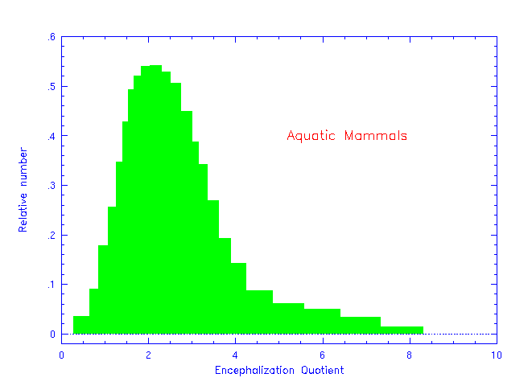
N = R*f_{p}n_{e}f_{l}f_{i}f_{c}L

Slide 38
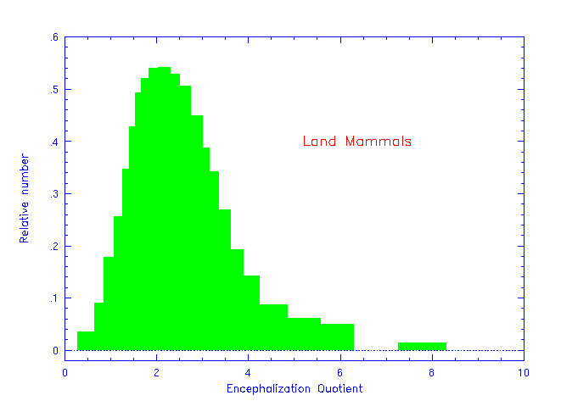
N = R*f_{p}n_{e}f_{l}f_{i}f_{c}L

Slide 39
N = R*f_{p}n_{e}f_{l}f_{i}f_{c}L
Were some dinosaurs smart?
They evolved over 160 million years, whereas humans have been around only 200 thousand years… what was different?

Slide 40
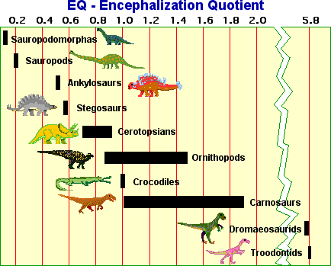
N = R*f_{p}n_{e}f_{l}f_{i}f_{c}L
In fact, some dinosaurs were “intelligent”, with EQ ~ 6 !

Slide 41
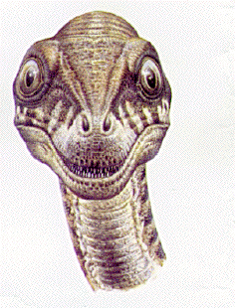
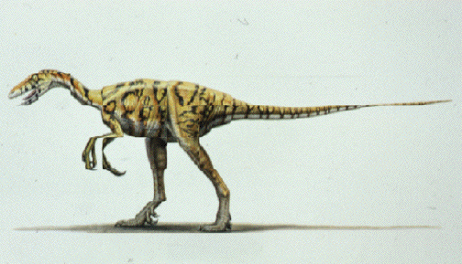
N = R*f_{p}n_{e}f_{l}f_{i}f_{c}L
..
Troodon
Binocular Vision
Stereoscopic Hearing
Dexterous “Hands”
Omniverous
Largest EQ of dinosaurs

Slide 42
N = R*f_{p}n_{e}f_{l}f_{i}f_{c}L
f_{i} can only be studied via the history of intelligence on Earth
intelligence has always steadily increased with time, even with the repeated mass extinctions
f_{i} ~ 0.1-1 (?)
NOTE: f_{i} is likely not vanishingly small, say 10⁻⁸ or so except maybe on the Hill

Slide 43
N = R*f_{p}n_{e}f_{l}f_{i}f_{c}L
the fraction of planets hosting intelligent life where a technological civilization arises at least once
Must be able to communicate across stellar distances
Must be fast : Must be economical
electromagnetic radiation

Slide 44
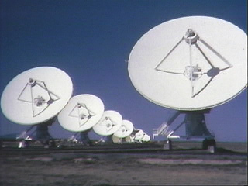
N = R*f_{p}n_{e}f_{l}f_{i}f_{c}L
Technology. In the form of electromagnetic transmitters…
The physics is the same everywhere and is easily understood/developed
This simple technology was conceived and built only 5000 yrs after the pyramids and 10,000 yrs after writing appeared
The Very Large Array

Slide 45
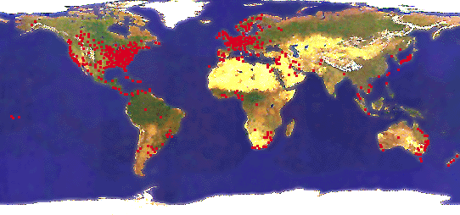
Hello, Earth calling…
Powerful broadcast transmissions began ~ 1945
By 2016, the sphere has a 71 light year radius and has illuminated ~2300 stars!
Locations of TV transmissions

Slide 46
N = R*f_{p}n_{e}f_{l}f_{i}f_{c}L
The road to technology…
Ecological competitiveness and aggressive domination of habitat; frees species from “survive or die” centered consciousness
Living and working in groups; leads species to higher socialization stratification and communication skills
Control of fire (a technology)
Settlements and migrations; a ceasing of previous nomadic lifestyles
Development of agriculture and food storage

Slide 47
N = R*f_{p}n_{e}f_{l}f_{i}f_{c}L
Why not dinosaurs?
Dinosaurs dominated Earth for 165 million years… why did they not develop radios and TVs?
No single type of dinosaur ever had complete dominion over its habitat in the way that modern humans have for some 30,000 years now.
Dinosaurs never surpassed a “survive or die” centered consciousness level, even though some were quite intelligent.

Slide 48
N = R*f_{p}n_{e}f_{l}f_{i}f_{c}L
f_{c} can only be understood in terms of the human experience of technological development
once humans dominated their habitat, the development of technology took only ~10,000 years, or 500 generations
f_{c} ~ 0.1-1 (?)

Slide 49
N = R*f_{p}n_{e}f_{l}f_{i}f_{c}L
the average lifetime (in years), that technological civilizations remain in a communicative or detectable state
Do civilizations quickly destroy themselves, run out of natural resources, or after a brief time become quiet (i.e., dismantle or baffle their technology), or remain detectable for millions of years?

Slide 50
N = R*f_{p}n_{e}f_{l}f_{i}f_{c}L
Evaluating N…
R*
f_{p}
n_{e}
f_{l}
f_{i}
f_{c}
=
=
=
=
=
=
5-10
0.5
2
0.1-1
0.1-1
0.1-1
Maximum
N = 10 L
Moderate
N = L
Minimum
N = 0.005 L
N ~ L
Take L ~ 10000, 1 civilization every 400 pc in the Milky Way

Slide 51
Question:
Are there other intelligent life forms in our Galaxy that we could communicate with?
A: No, just 1 advanced civilization in the whole Milky Way
B: Yes, a few perhaps 100 in the Milky Way
C: Yes, many, 10000 in the Milky Way
D: Yes, lots, 1 million in the Milky Way

Slide 52
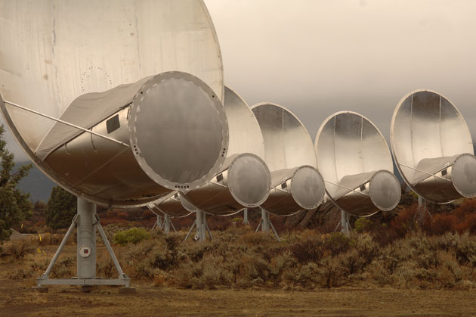
SETI: Search for Extraterrestrial Intelligence
Where the universe is quiet, of course!
where cosmic noise is minimal at ~3 gigahertz; we exploit this window for our TV and satellite transmissions. ATA began operating Oct 2007

Slide 53
Life in Astro 101

Slide 54
Life in Astro 101

