Slide 1
The Earth

Slide 2
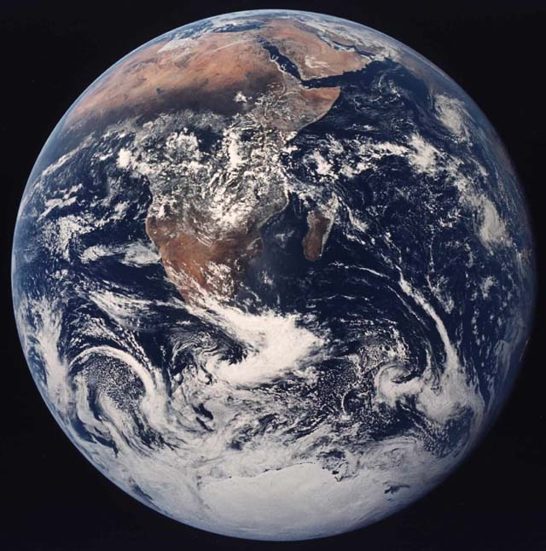
General Features
Mass: M_{Earth} = 6 x 10²⁷ g
Radius: R_{Earth} = 6378 km
Density: ρ = 5.5 g/cm³
Age: 4.6 billion years

Slide 3
Earth's Internal Structure
How do we know? Earthquakes. See later
Crust: thin. Much Si and Al
(much granite). Two-thirds covered by oceans.
Mantle is mostly solid, mostly basalt (Fe, Mg, Si). Cracks in mantle allow molten material to rise => volcanoes.
Core temperature is 6000 K. Metallic - mostly iron (some nickel). Outer core molten, inner core solid.

Slide 4
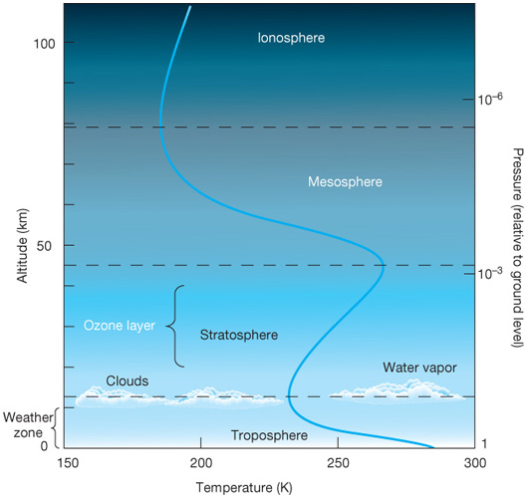
Earth's Atmosphere
78% Nitrogen
21% Oxygen
Original gases disappeared. Atmosphere is mostly due to volcanoes!
gas is ionized by solar radiation
ozone is O₃ , which absorbs solar UV efficiently, thus
heating stratosphere
commercial jet altitudes
room temperature

Slide 5
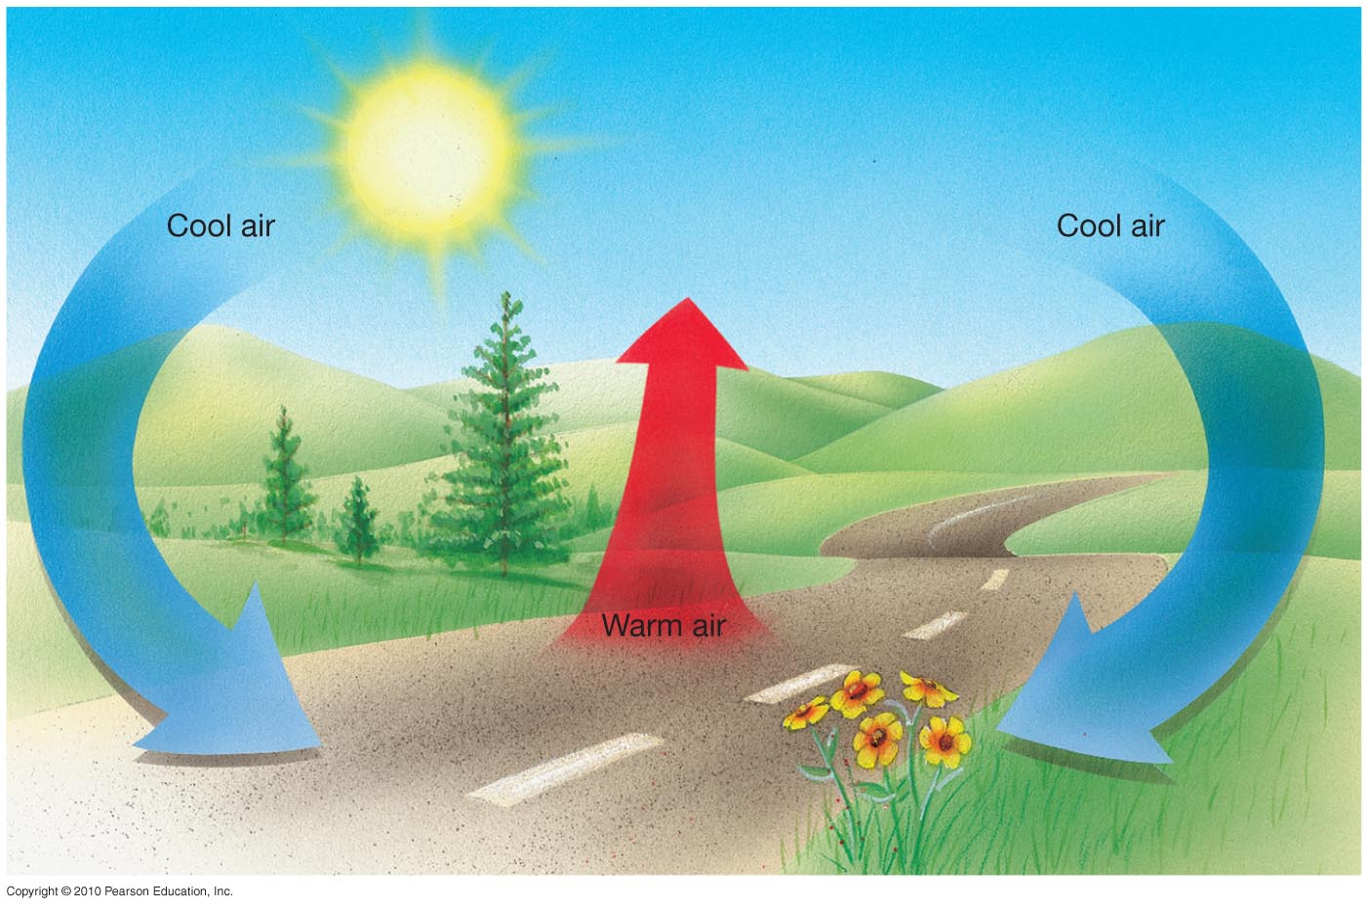
Convection
Earth's surface heated by Sun. What would happen if it couldn't get rid of the energy as fast as it gets it?
Convection also occurs when you boil water, or soup. Think of Earth's surface as a boiling pot!
Convection causes both small-scale turbulence and large scale circulation patterns. It also occurs within Earth, on other planets, and in stars.

Slide 6
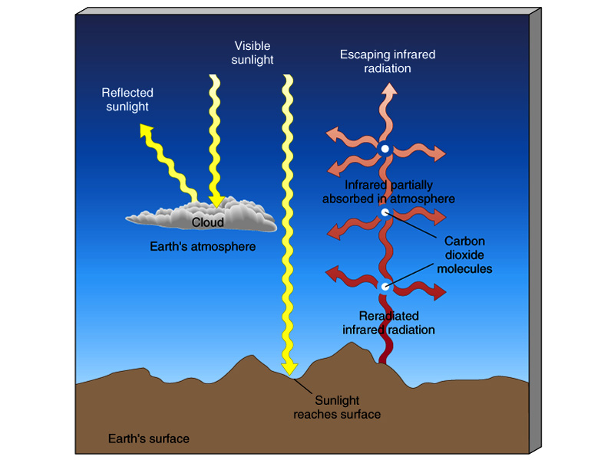
The Greenhouse Effect
Main greenhouse gases are CO₂ and H₂O .
If no greenhouse effect, surface would be 40 ºC cooler!

Slide 7
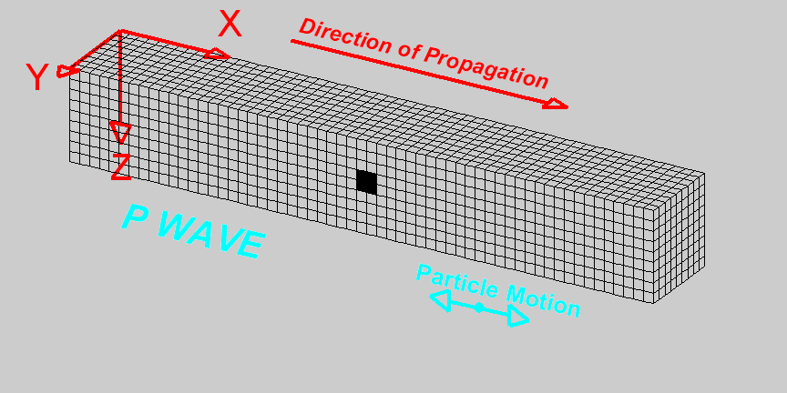
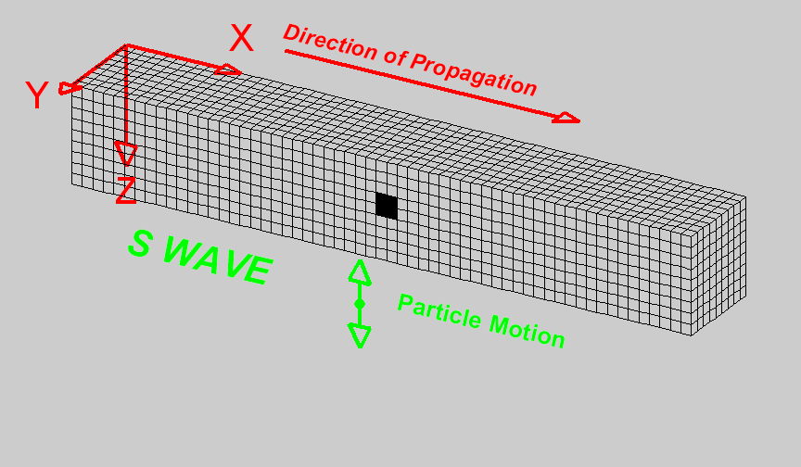
Earthquakes
They are vibrations in the solid Earth, or seismic waves.
Two kinds go through Earth, P-waves ("primary") and S-waves ("secondary"):

Slide 8
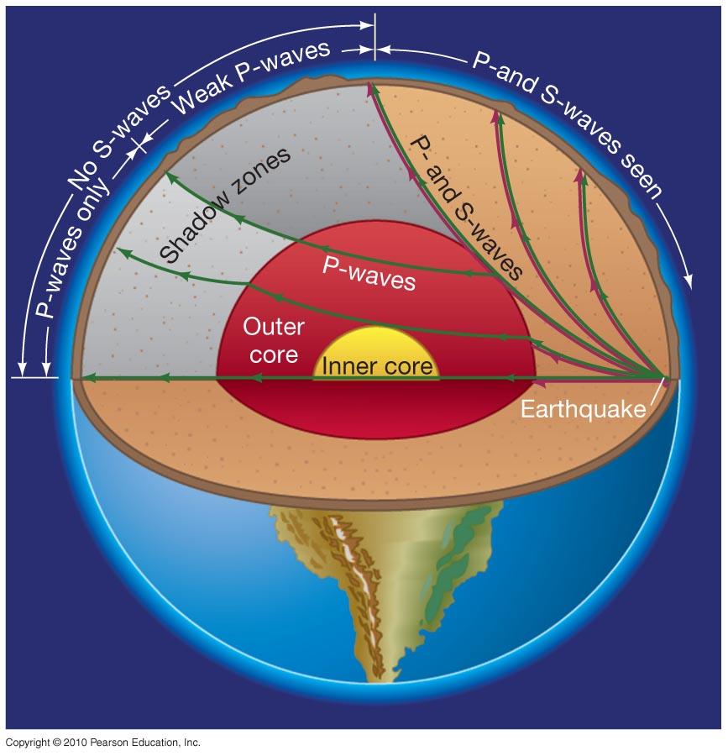
Like all waves, seismic waves bend when they encounter changes in density. If density change is gradual, wave path is curved.
S-waves are unable to travel in liquid.
Thus, measurement of seismic wave gives info on density of Earth's interior and which layers are solid/molten.
Zone with no S waves: must be a liquid
core that stops S waves.
Sharp bend in P waves
at core boundary
But faint P waves
seen in shadow zone,
refracting off dense
inner core
Curved paths of P and
S waves: density must
slowly increase with
depth

Slide 9
Earth's Interior Structure
Average density
Crust
Mantle
Core
5.5 g/cm³
3 g/cm³
5 g/cm³
11 g/cm³
Density increases with depth => "differentiation"
Early Earth must have been molten. When it started to
cool and solidify, denser material sank. Densities deep
down also higher due to gravitational compression.

Slide 10
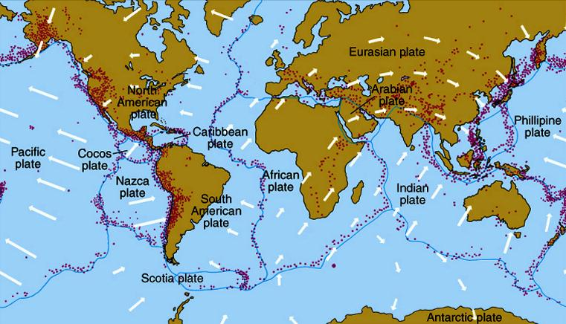
Earthquakes and volcanoes are related, and don't occur at random places. They outline plates.
Plates moving at a few cm/year. "Continental drift" or "plate tectonics"

Slide 11
When plates meet...
1) Head-on collision
(Himalayas)
2) "Subduction zone"
(one slides under the other)
(Andes)
3) "Rift zone"
(two plates moving apart)
(Mid-Atlantic Ridge, Rio Grande)
4) They may just slide past each other
(San Andreas Fault)
side view
top view
=> mountain ranges, trenches, earthquakes, volcanoes

Slide 12
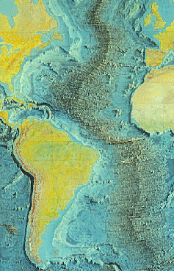
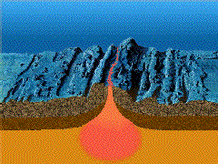
The Mid-Atlantic Ridge is a rift zone.

Slide 13
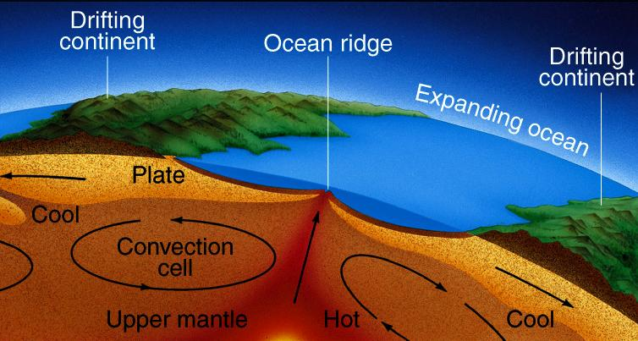
What causes the drift?
Convection! Mantle slightly fluid and can support convection. Plates ride on top of convective cells. Lava flows through cell boundaries. Earth loses internal heat this way.
Cycles take ~10⁸ years.
Plates form lithosphere (crust and solid upper mantle).
Partially melted, circulating part of mantle is asthenosphere.

Slide 14
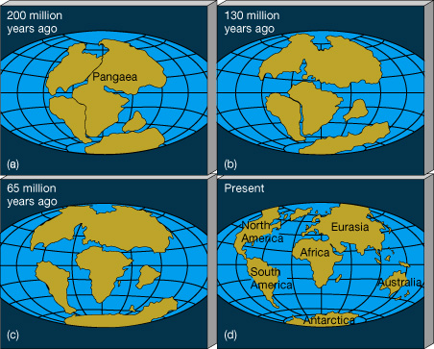
200 million years ago, all the continents were together!

Slide 15
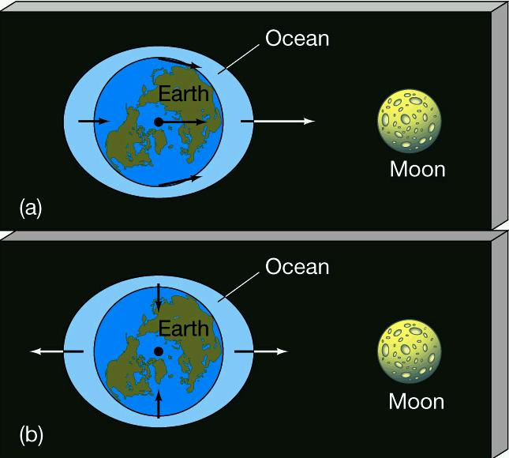
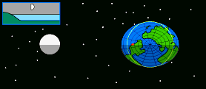
Tides
A feature of oceans (but solid material has small tides too).
Two high and two low tides per day.
Tides are due to Moon's gravitational pull being stronger on side of Earth closest to it (Sun causes smaller tides).
Earth-Moon gravity keeps them orbiting each other. But side of Earth closest to Moon has slightly stronger pull to Moon => bulges towards it. Other side has weaker pull => bulges away compared to rest of Earth.
The Earth spins once a day while the bulge always points towards and away from the Moon => high and low tides.

Slide 16
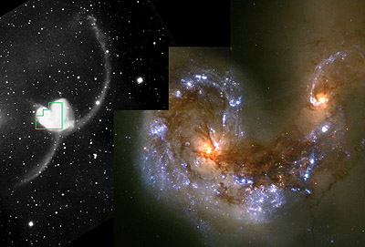
This is an example of the "tidal force". Can be important for other planets, moon and pairs of stars or galaxies.
"The Antennae" used to be two normal spiral galaxies, but tidal forces distorted their shapes badly.

Slide 18
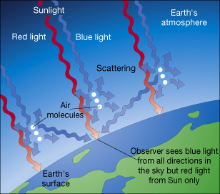
Why is the Sky Blue?
Air molecules tend to let reddish light through while scattering blueish light in all directions, from where it gets scattered again to your eye.
Consequently, Sun is slightly on green side of yellow!

