Slide 1
Mars
Mass = 0.11 M_{Earth}
Radius = 0.53 R_{Earth}
Density = 3.9 g/cm³
Average distance from Sun = 1.52 AU
eccentricity = 0.093
Range in distance from Sun = 1.38 - 1.66 AU
Spin Period = 24.6 hours
Orbital Period = 687 days

Slide 2
The Martian Atmosphere
- 95% CO₂
- Surface Pressure 0.006 that of Earth's atmosphere (thin air!)
- Surface Temperature 250 K.
- Dust storms sometimes envelop most of Mars, can last months.
A “Reverse Runaway Greenhouse Effect”?
During volcanic phase (first two billion years), thicker CO₂ atmosphere, warmer surface, possibly oceans. Gradually most CO₂ dissolved into surface water and combined with rocks, then atmospheric and surface water froze (creating ice caps and probable permafrost layer).

Slide 3
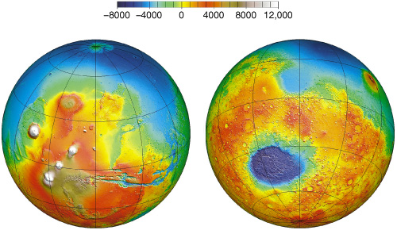
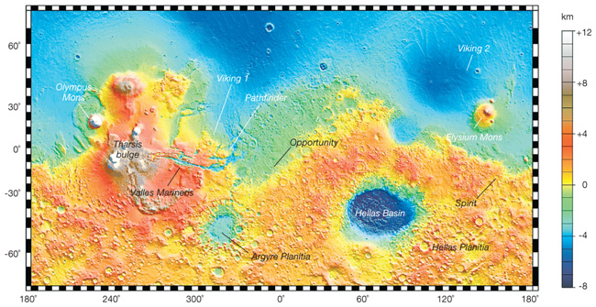
The Martian Surface
Olympus Mons
Tharsis Bulge
Valles Marineris
Southern Hemisphere ~5 km higher elevation than Northern, and more heavily cratered.
South is like lunar highlands, surface
~4 billion years old, North like maria, ~3 billion years old.
Tharsis Bulge - highest (10 km) and youngest (2-3 billion years) region.
(Mars Global Surveyor laser altimeter data)
Valles Marineris - 4000 km long, up to 7 km deep. Ancient crack in crust. Reasons not clear.
Olympus Mons - shield volcano, highest in Solar System, 3x Everest in height. 100 km across.

Slide 4
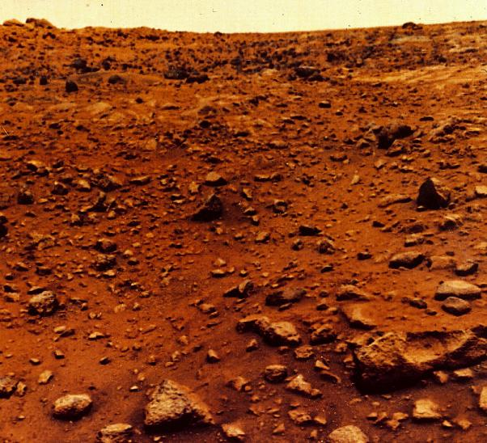
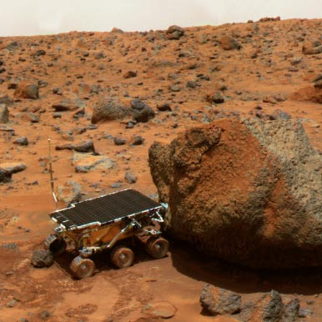
View From the Surface
Dry, desert-like. Red => high iron content. Mars didn't differentiate as completely as Earth. Sky has butterscotch hue due to dust.
Viking 1 site (1976)
Sojourner robot from Pathfinder (1997)

Slide 5
Opportunity panorama: inside Victoria Crater
Deepest crater explored by far (230 feet) => apparently it was the top of an underground water table. Has now reached bigger Endeavour Crater.

Slide 6
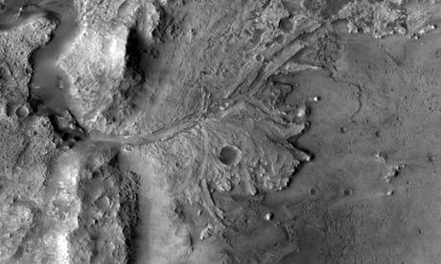
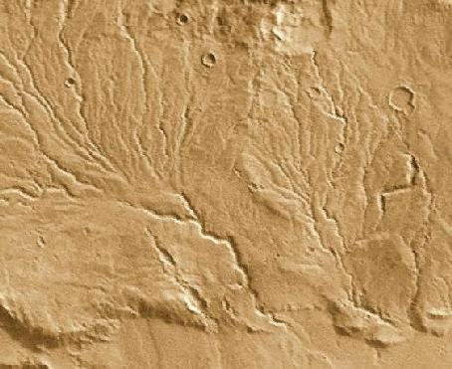
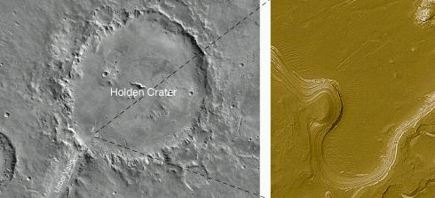
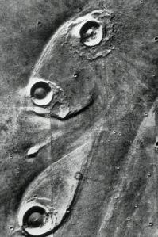
Evidence for Past Surface Water
"runoff channels" or dry rivers
"outflow
channels"
South
North
teardrop "islands" in outflow channels
standing water erosion in craters?

Slide 7
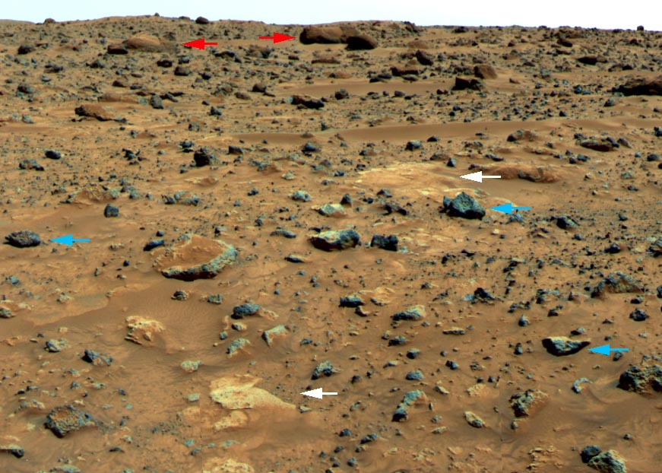
Pathfinder (1997) site was an outflow channel
Red arrows: rounded boulders indicating water erosion?
White arrows: "conglomerate" rock, like in Earth's riverbeds?
Blue arrows: sharp-edged boulders, volcanic rock?

Slide 8
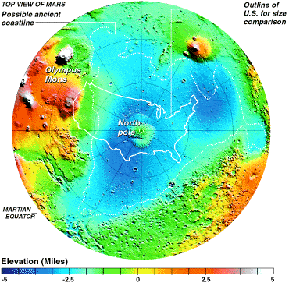
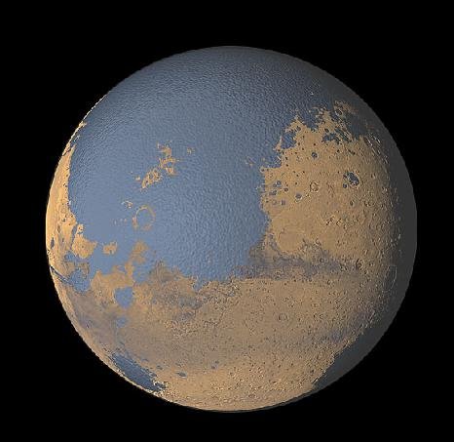
Did Mars once have a huge ocean?
Long stretches along border are very even in elevation, like a coastline
Ocean fed by outflow channels from
higher elevation southern hemisphere?
Recent evidence suggests, cold, glacial ocean.

Slide 9
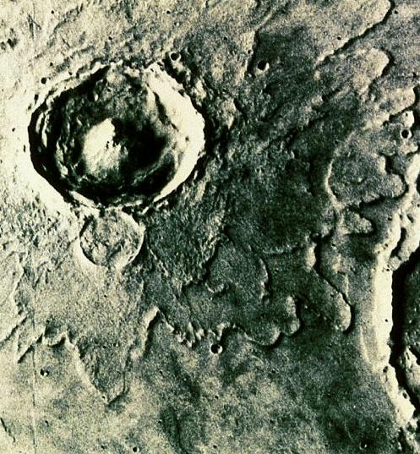
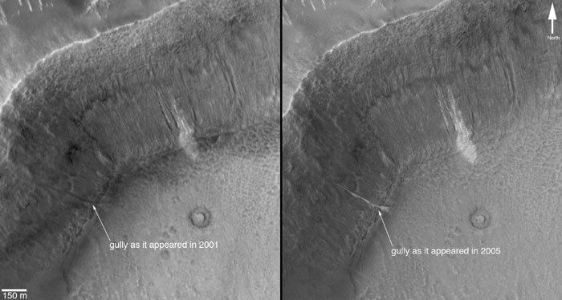
Evidence for "Permafrost" layer beneath surface
"Splosh" craters suggesting
liquefied ejecta.
Something flowed in this crater wall between 2001 and 2005

Slide 10
Mars' History
Smaller than Earth, Mars cooled faster.
Atmosphere and surface water in first 1.5 billion years. Life?
Most volcanic activity ended two billion years ago.
No evidence for plate tectonics.
Atmosphere mostly froze out into subsurface ice, polar ice
caps and surface rocks.

Slide 11
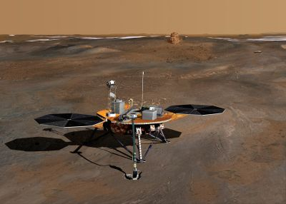
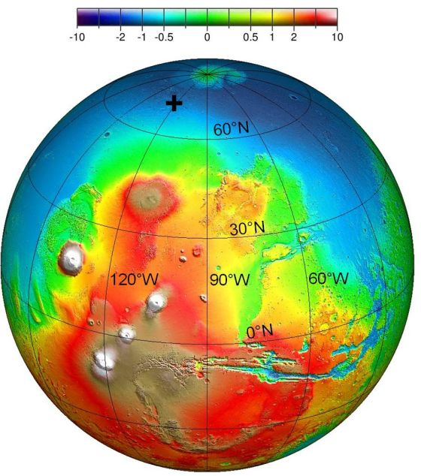
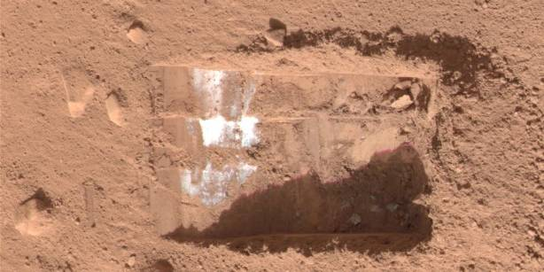
Phoenix mission – icy soil at the poles!
Phoenix analyzing scooped up
dirt – was Mars ever favorable
for microbial life? Organic
compounds?

Slide 12
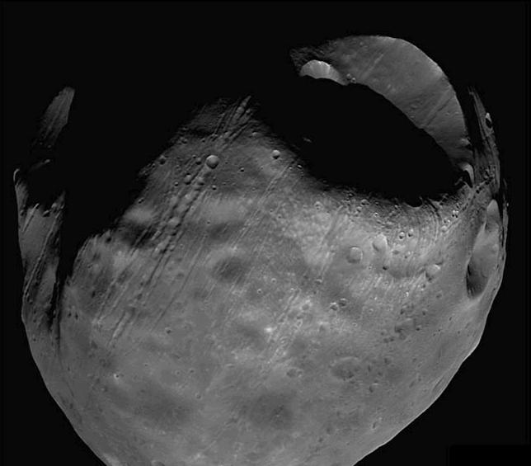
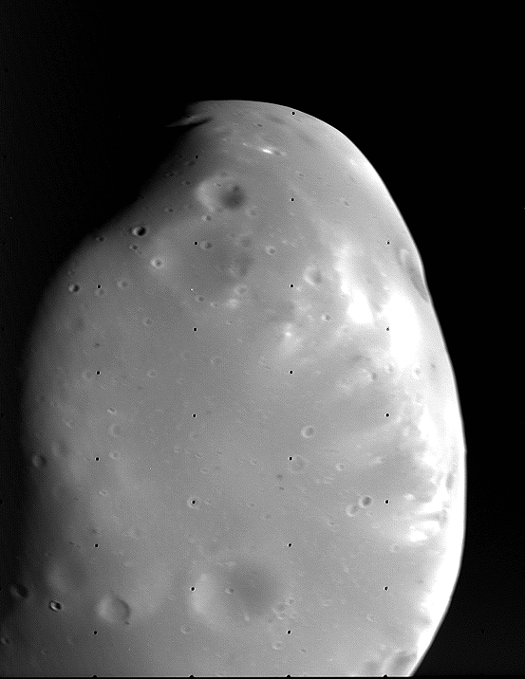
Mars' Moons Phobos and Deimos
Phobos: 28 x 20 km
Deimos: 16 x 10 km
Properties similar to asteroids. They are probably asteroids captured into orbit by Mars' gravity.

Slide 13
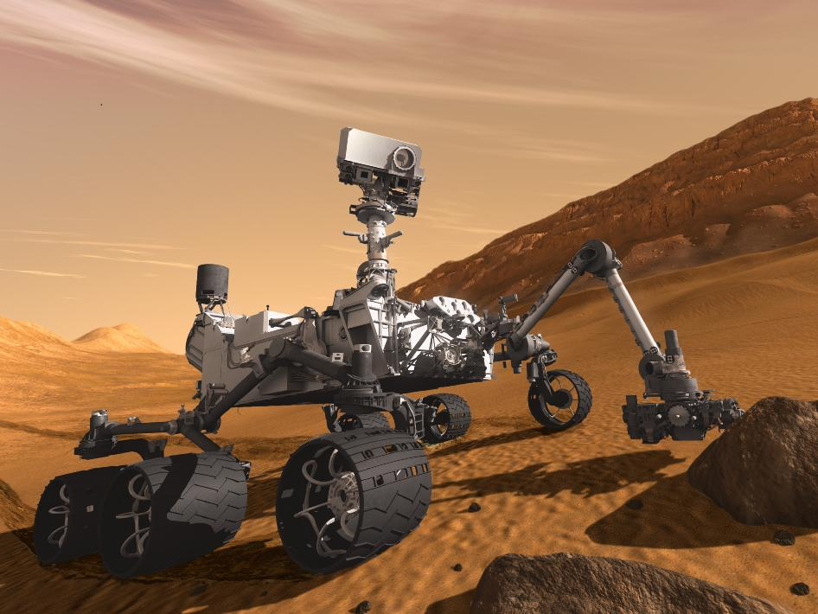
Next mission – Mars Science Laboratory – Nov-Dec 2011 launch

Slide 14
Mars' History
Smaller than Earth, Mars cooled faster.
Most volcanic activity ended two billion years ago.
Differentiation less complete than on Earth.
No evidence for plate tectonics.
Atmosphere mostly froze out into subsurface ice, polar ice
caps and surface rocks.
Valles Marineris flyover movie

