Slide 1
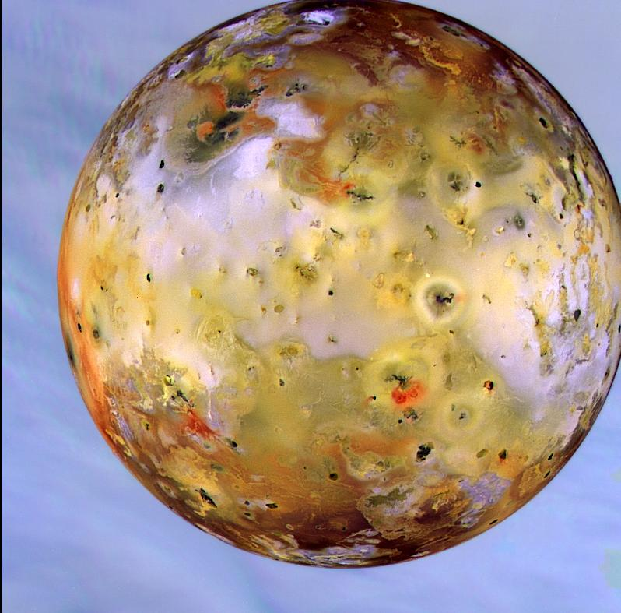
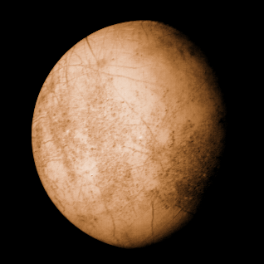
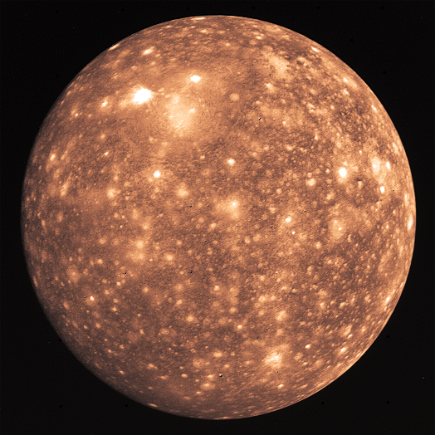
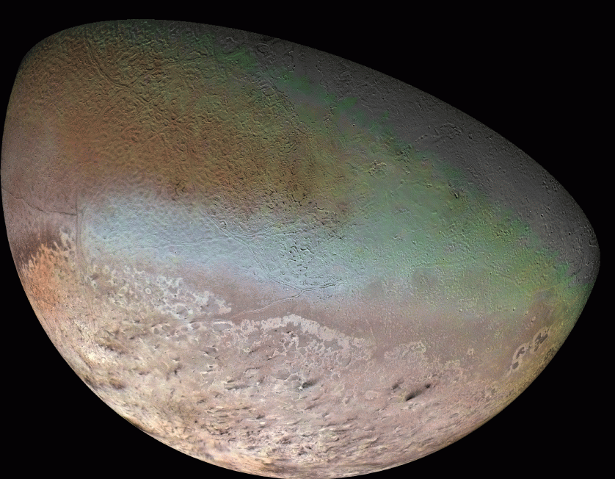
Moons of Jovian Planets

Slide 2
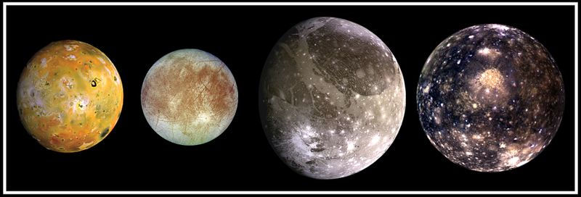
The Galilean Moons of Jupiter
(sizes to scale)
Io
Europa
Ganymede
Callisto
Closest to Jupiter
Furthest from Jupiter
Radii: 1570 km (Europa, slightly smaller than our Moon), to 2630 km (Ganymede - largest moon in Solar System).
Orbital periods: 1.77 days (Io) to 16.7 days (Callisto). All tidally locked.
The closer to Jupiter, the higher the moon density: from 3.5 g/cm³ (Io) to 1.8 g/cm³ (Callisto). Higher density indicates higher rock/ice fraction.

Slide 3
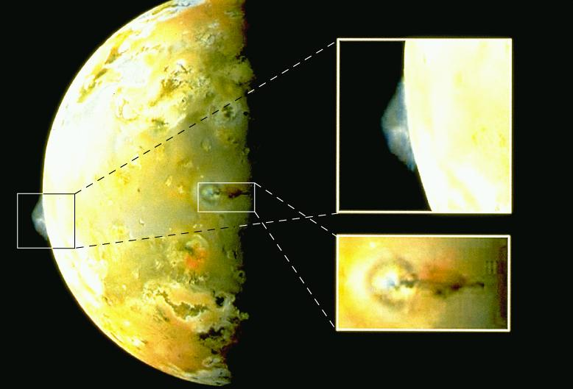
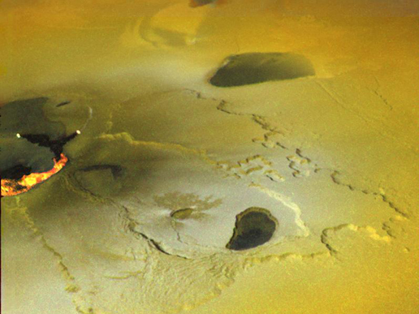
Io's Volcanism
More than 150 have been observed. Can last months or years.
Ejecta speeds up to 1 km/s. Each volcano ejects about 10,000 tons/s
Rich in S, SO₂. S can be yellow, orange, red, black depending on temperature. Frozen SO₂ snowflakes are white.

Slide 4
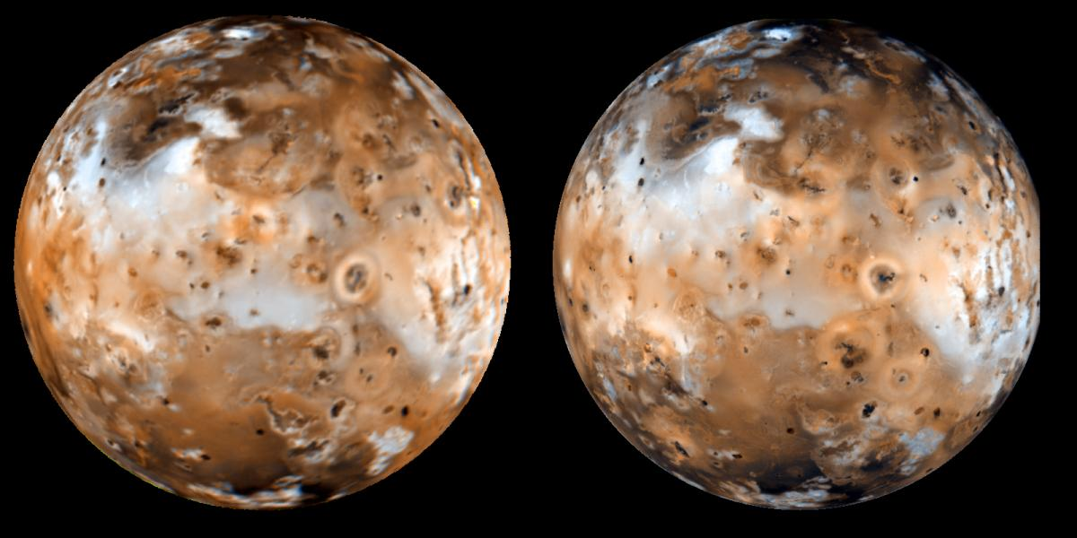
Activity causes surface to slowly change over the years:
Voyager 2 (1979) Galileo (1996)

Slide 5
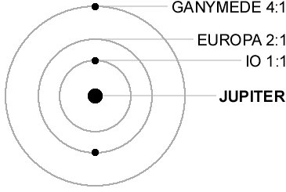
Volcanic activity requires internal heat. Io is a small body. Should be cold and geologically dead by now. What is source of heat?
First, Io and Europa are in a "resonance orbit":
Europa “pulls Io outward” here.
The periodic pull on Io by Europa makes Io's orbit elliptical.

Slide 6
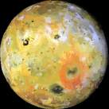
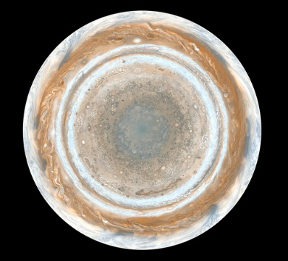
backup link
orbital speed slower
orbital speed faster
Io
(exaggerated ellipse)
- Io “tidally locked” like our Moon. Tidal bulge always points to Jupiter. So angle of bulge changes faster when Io is closer to Jupiter.
But Io spins on its axis at a constant rate.
- So bulge moves back and forth across surface => stresses => heat => volcanoes

Slide 7
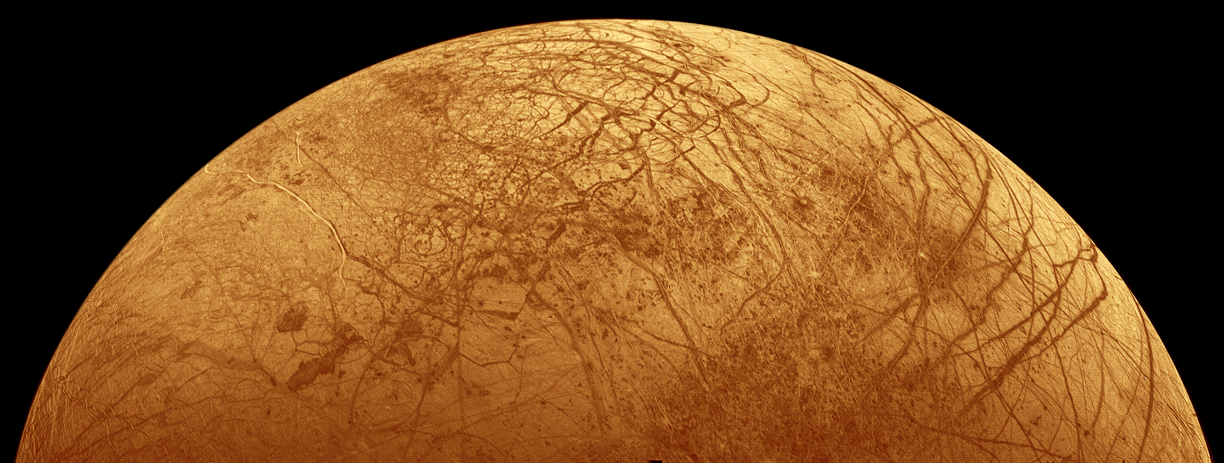
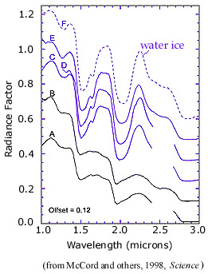
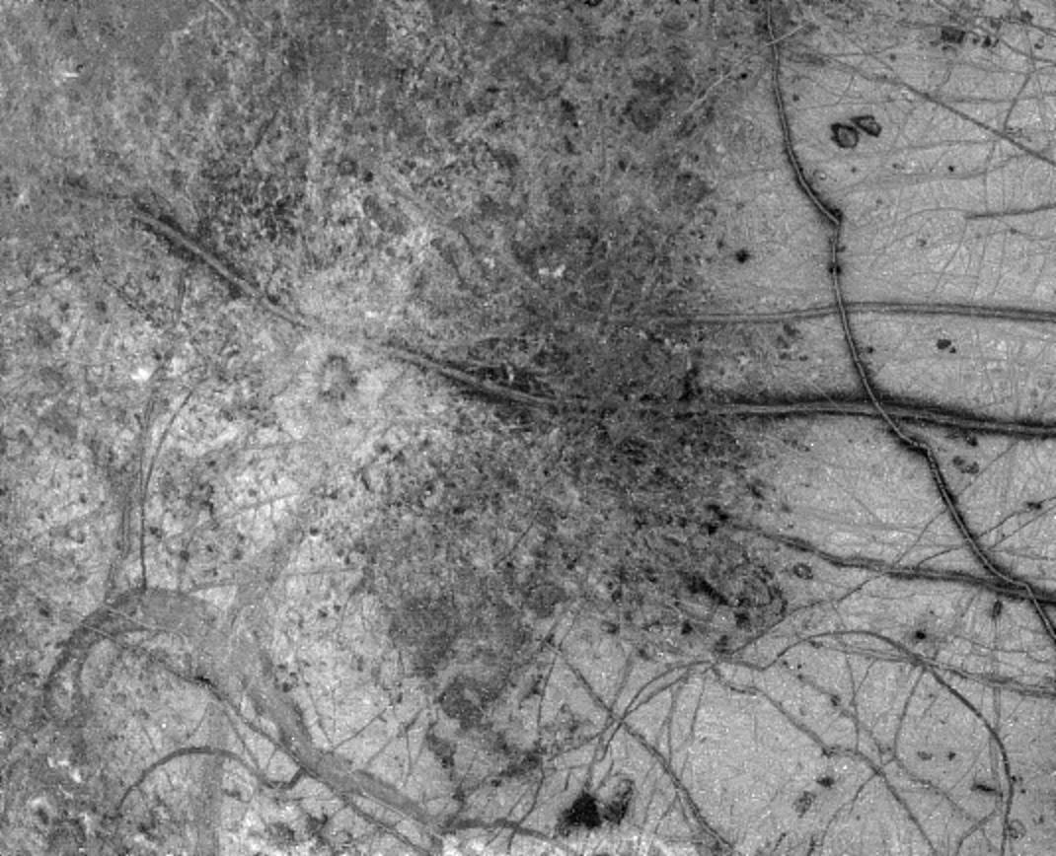
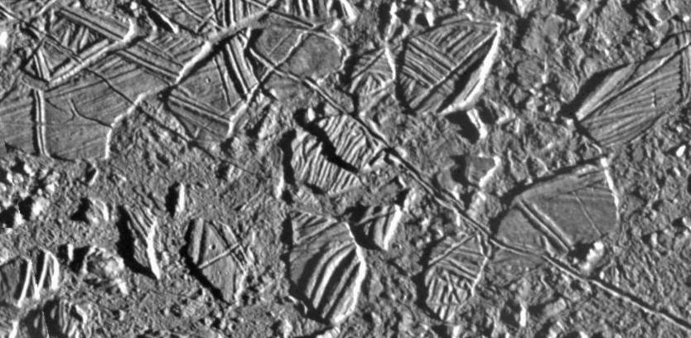
Europa may have Warm Water Ocean beneath Icy Surface
Fissures suggest tidal stresses.
Hardly any impact craters.
860 km
Dark deposits along cracks suggest eruptions of water with dust/rock mixed in (Europa’s density => 90%
rock, 10% ice).
42 km
Icebergs or "ice rafts" suggest broken and reassembled chunks.

Slide 8
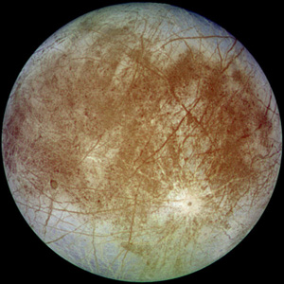
Io pulls Europa inward here.
Ganymede pulls Europa outward here.
What is source of heat? Same as Io: resonant orbits with Ganymede and Io make Europa's orbit elliptical => varying tidal stresses from Jupiter => heat.
Warm ocean => life?
Further down: rocky/metallic layers

Slide 9
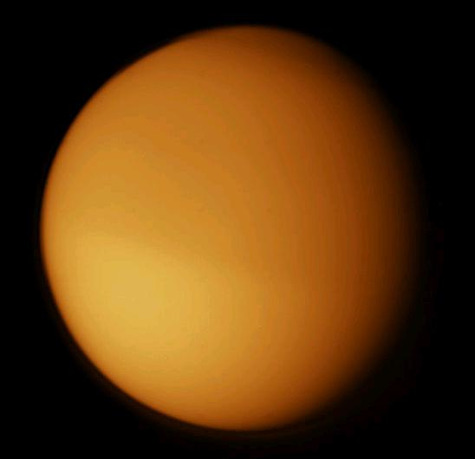
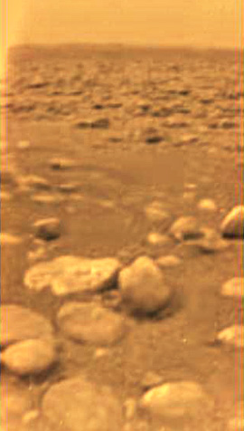
Saturn's Titan: A Moon with a Thick Atmosphere
Taken during Huygens’ descent
From Cassini-Huygens mission
Surface from Huygens probe
Surface pressure is 1.6 times Earth’s, T=94 K. Atmosphere 98% Nitrogen,
also methane, ethane, benzene, propane, etc. Evidence for methane rain, a few methane lakes, drainage channels, liquid-eroded rocks, icy volcanoes (active? replenishing the methane?). Mostly dry now – rain and liquid flow may be episodic (centuries?).
Origin of atmosphere: internal heat from natural radioactivity may escape surface through volcanoes. Atmosphere trapped by Titan’s cold temperature and relatively high gravity. Interior: rocky core and water mantle.

Slide 10
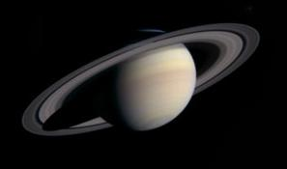
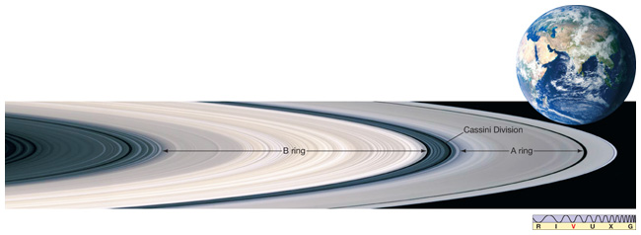
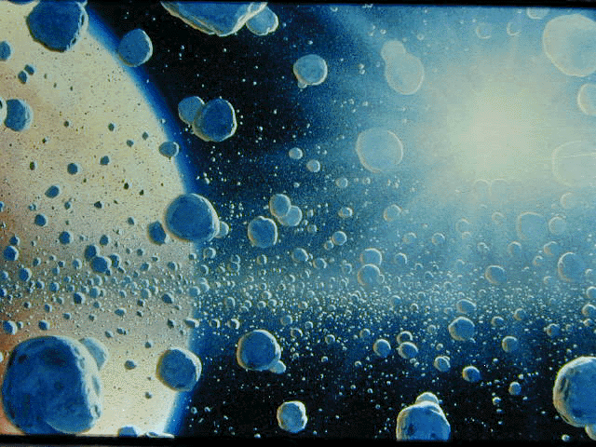
Saturn's Rings (all Jovians have ring systems)
- Inner radius 60,000 km, outer radius 300,000 km. Thickness ~100 m!
- Composition: icy chunks, <1 mm to >10m in diameter. Most a few cm.
- A few rings and divisions distinguishable from Earth. Please read how the gaps form.

Slide 11
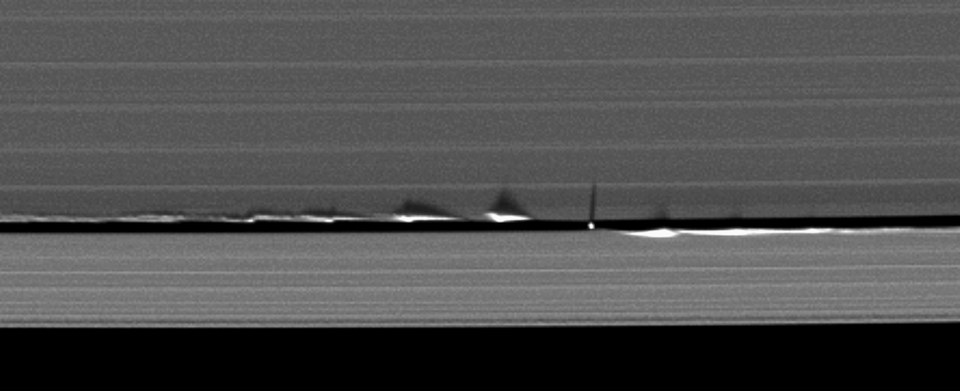
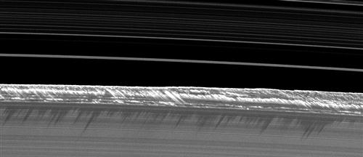

Slide 12
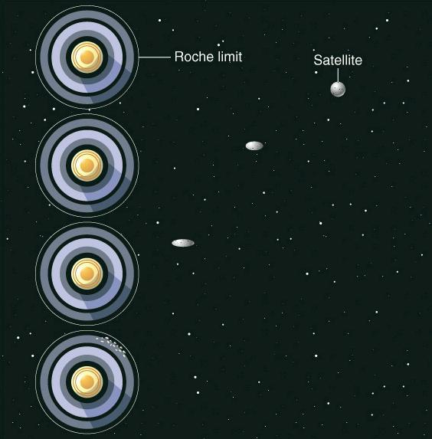
Origin?
Unclear. Total mass of ring pieces equivalent to 250 km moon. Perhaps leftover debris from moon building? A shattering collision? A captured object? Regardless, a large moon could not survive so close to Saturn:
If a large moon, held together by gravity, gets too close to Saturn, tidal force breaks it into pieces, at a radius called the Roche Limit. Rings inside Roche Limit => pieces can’t reassemble into moon.
Not clear whether rings are as
old as Saturn or much younger
(about 50 million years).

Slide 13
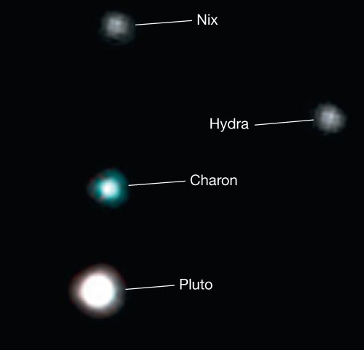
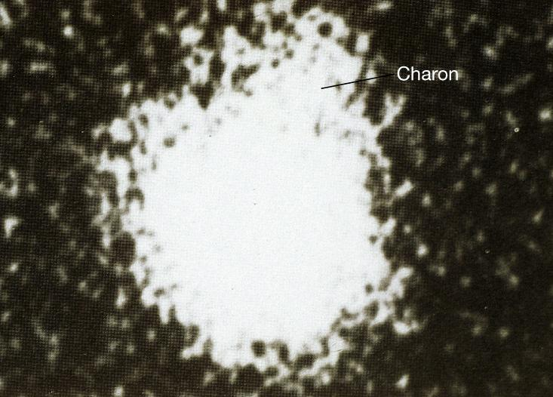
Pluto
Predicted to exist by remaining irregularities in Uranus' orbit.
Discovered in 1930 by Clyde Tombaugh (1905-1997). Semi-major axis 39.3 AU.
Irregularities later found to be incorrect!
Model created from Hubble images. This is the most detail we have.
Two more moons found in 2005
with the Hubble. Now five known.
Discovery image of Pluto's moon Charon (1978)

Slide 14
Basic Properties of Pluto
Mass 0.0025 M_{Earth} or 0.2 x mass of Moon
Radius 1150 km or 0.2 R_{Earth}
Density 2.0 g/cm³ (between Terrestrial and Jovian densities. More like a Jovian moon)
Icy/rocky composition
Moons: Charon: radius 590 km.
Pluto and Charon tidally locked. Nix and Hydra 30-100 km.
Origin of Pluto
Now known to be just the largest known of a class of objects in the outer reaches of the Solar System. These objects are:

Slide 15
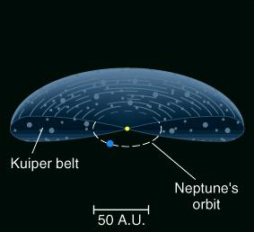
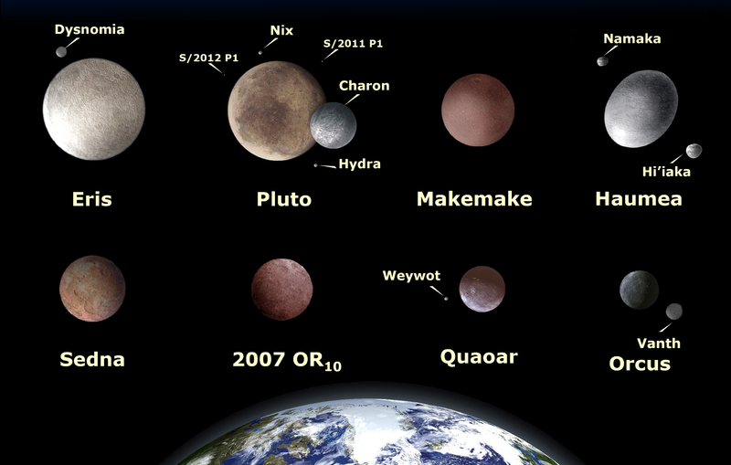
The Kuiper Belt Objects
Over 1000 found since 1992. Probably 10,000's bigger than 100 km exist.
Icy/rocky.
Orbits tend to be more tilted, like Pluto's.
Leftover planetesimals from Solar System formation?
Pluto and other
large KBOs

Slide 16
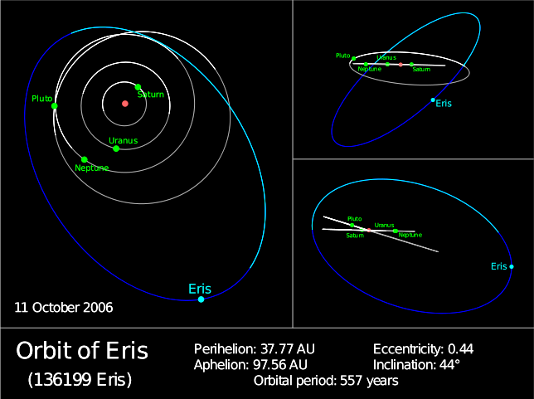
The New “Dwarf Planet” Eris
Radius 1200 ± 50 km or at least as big as Pluto. Icy/rocky composition, like Pluto. Too distant to be part of Kuiper Belt.
It too has a moon,
Dysnomia
(Keck telescope)

Slide 17
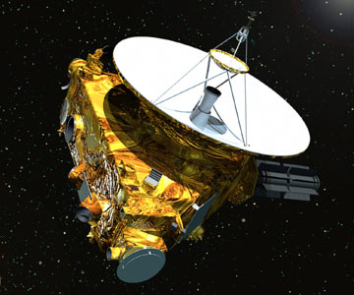
New Horizons mission
Launched 2006, arrives 2015.
Study surface of Pluto and Charon. Morphology, composition, temperature, geology, faint atmosphere. Search for rings and additional satellites.
Do same for at least one other KBO.
Cost $700 million

Slide 18
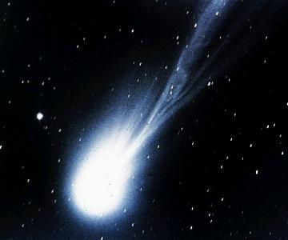
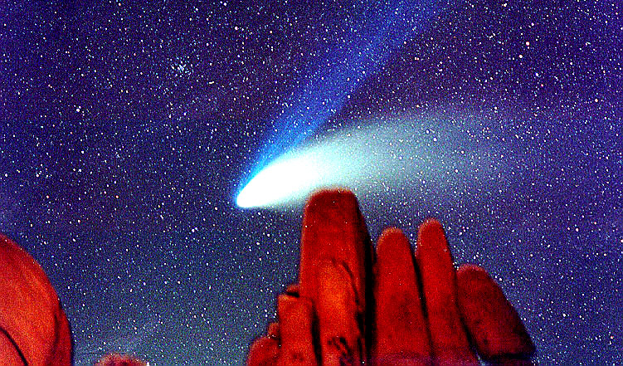
More Solar System Debris
Comets
Comet Halley (1986)
Comet Hale-Bopp (1997)
Short Period Comets
Long Period Comets
50-200 year orbits
Orbits prograde, close to plane of Solar System
Originate in Kuiper Belt
Few times 10⁵ or 10⁶ year orbits
Orbits have random orientations and high ellipticities
Originate in Oort Cloud

Slide 19
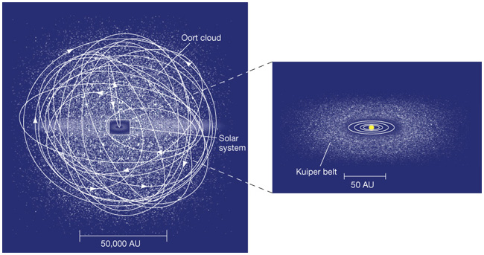
If a Kuiper Belt object's orbit takes it close to, e.g., Neptune, its orbit may be changed and it may plunge towards the inner Solar System and become a short-period comet.
Oort Cloud is a postulated huge, roughly spherical reservoir of comets surrounding the Solar System. ~10⁸ objects? Ejected planetesimals.
A passing star may dislodge Oort cloud objects, plunging them into Solar System, where they become long-period comets.

Slide 20
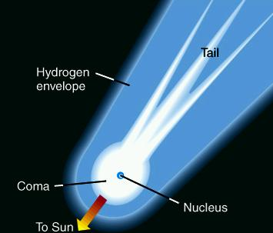
Comet Structure
Nucleus: ~10 km ball of ice, dust
Coma: cloud of gas and dust around nucleus (~10⁶ km across)
Tail: can have both gas (blue) and dust tails (~10⁸ km long). Always points away from Sun.
Coma and tail due to gas and dust removed from nucleus by Solar radiation and wind.
Far from Sun, comet is a nucleus only.

Slide 21
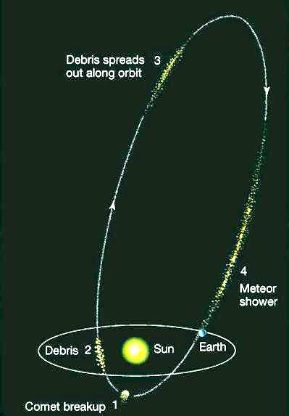
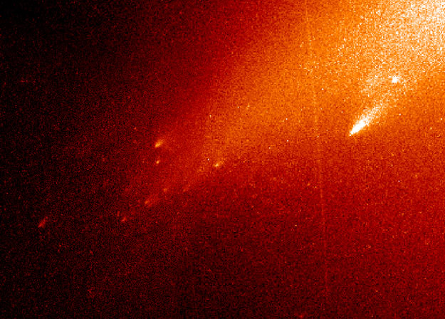
Meteor Showers
Comets slowly break up when near Sun, due to Solar radiation, wind and tidal force.
e.g. Halley loses 10 tons/sec when near Sun. Will be destroyed in 40,000 years.
Fragmentation of
Comet LINEAR
Debris spreads out along comet orbit.
IF Earth's orbit crosses comet orbit, get meteor shower, as fragments burn up in atmosphere.

Slide 22
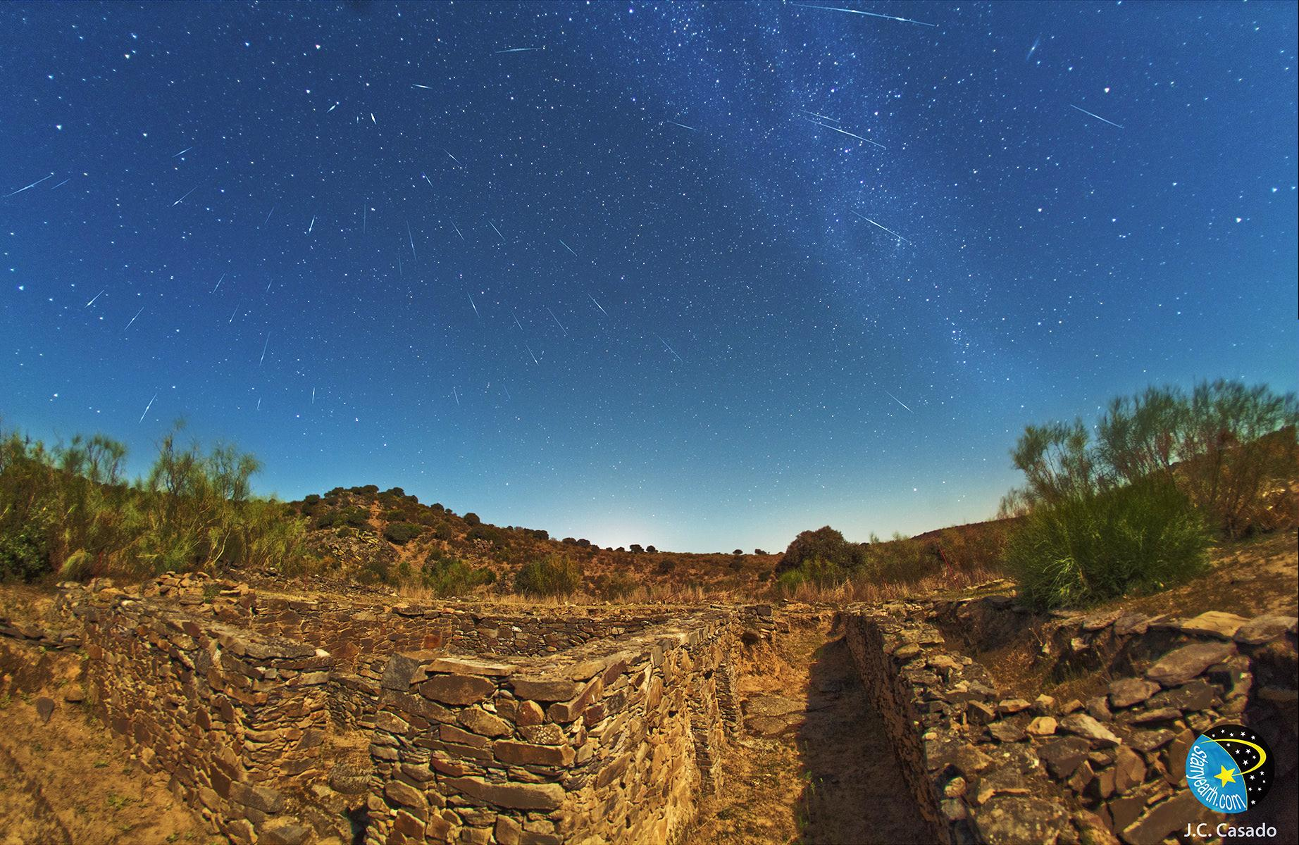
Draconid meteors over Spain – Oct 8, 2011

Slide 23
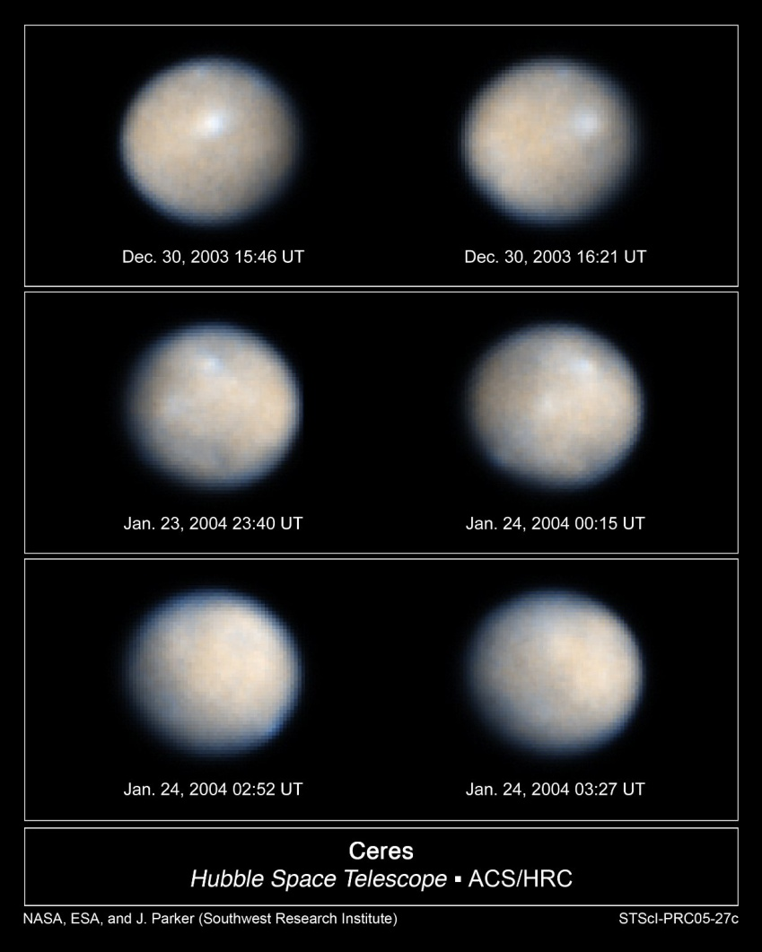
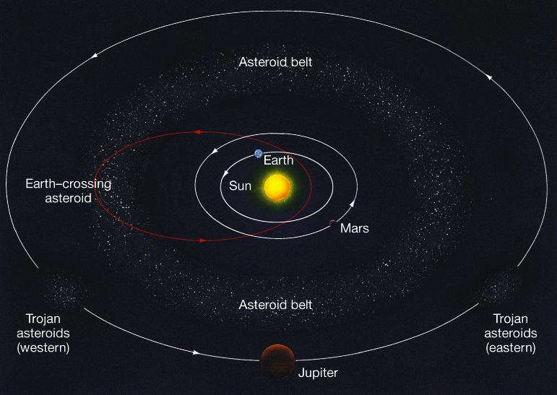
Asteroids
Rocky fragments ranging from 940 km across (Ceres) to < 0.1 km. 100,000 known.
Most in Asteroid Belt, at about 2-3 AU, between Mars and Jupiter. The Trojan asteroids orbit 60 º ahead of and behind Jupiter. Some asteroids cross Earth's orbit. Their orbits were probably disrupted by Jupiter's gravity.

Slide 24
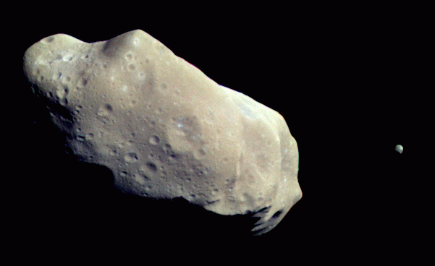
Gaspra
Ida and Dactyl
Total mass of Asteroid Belt only 0.0008 M_{Earth} or 0.07 M_{moon}. So it is not debris of a planet.
Probably a planet was trying to form there, but almost all of the planetesimals were ejected from Solar System due to encounters with Jupiter. Giant planets may be effective vacuum cleaners for Solar Systems.

Slide 25
Meteoroids
Even smaller rocky pieces left over from Solar System formation.
If one lands on Earth, called a Meteorite.
Note: Meteor is only the name of the visible streak as the rock burns in atmosphere.

Slide 27
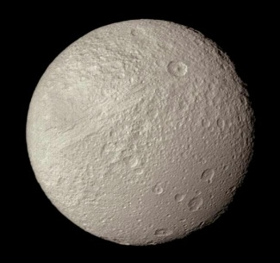
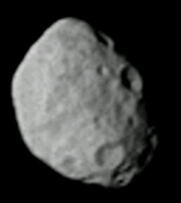
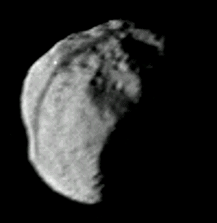
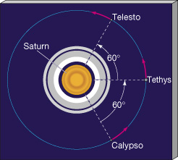
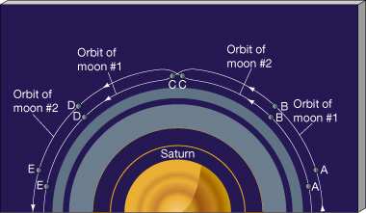
Bizarre Orbits of some of Saturn's Moons
Tethys
Janus and Epimethius
Telesto and Calypso share orbit with Tethys, and are always 60 deg. ahead and behind it! They stay there because of combined gravity of Saturn and Tethys.
Janus and Epimethius are in close orbits. When the approach each other, they switch orbits!

Slide 28
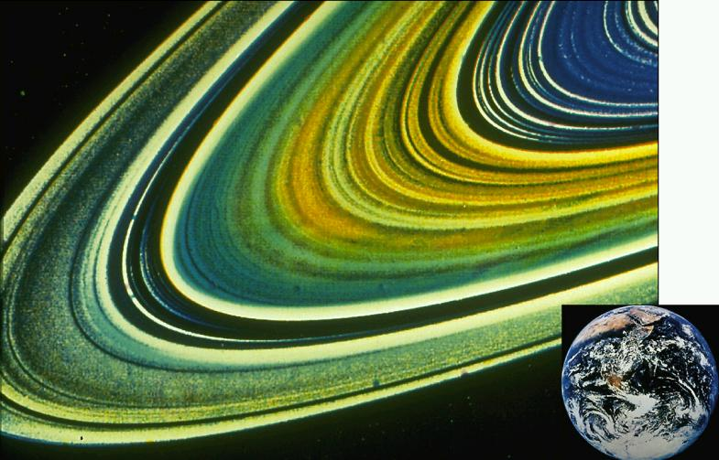
Voyager probes found that rings divide into 10,000's of ringlets.
Structure at this level keeps changing. Waves of matter move like ripples on a pond.

Slide 29
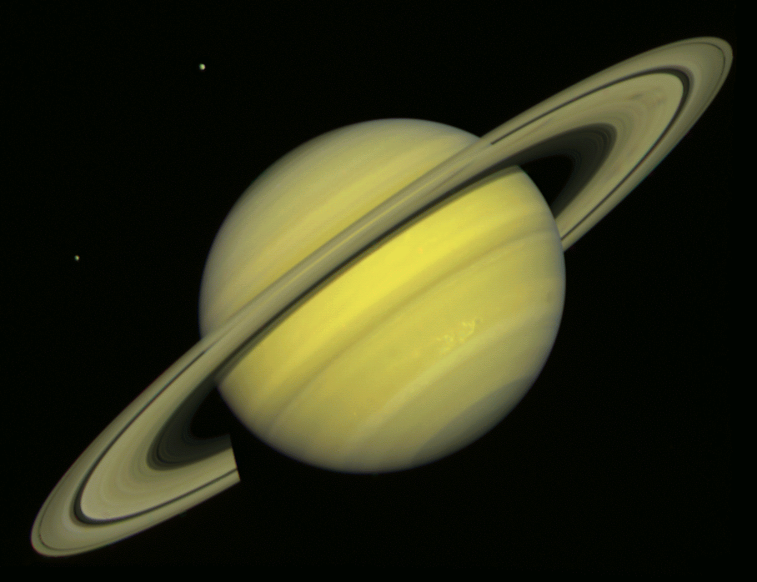
Origin of Cassini Division: another resonance orbit
Approximate radius of Mimas' orbit
Mimas' orbital period is twice that of particles in Cassini division. Makes their orbits elliptical. They collide with other particles and end up in new circular orbits at other radii. Cassini division nearly swept clean.
Other gaps have similar origins.

Slide 30
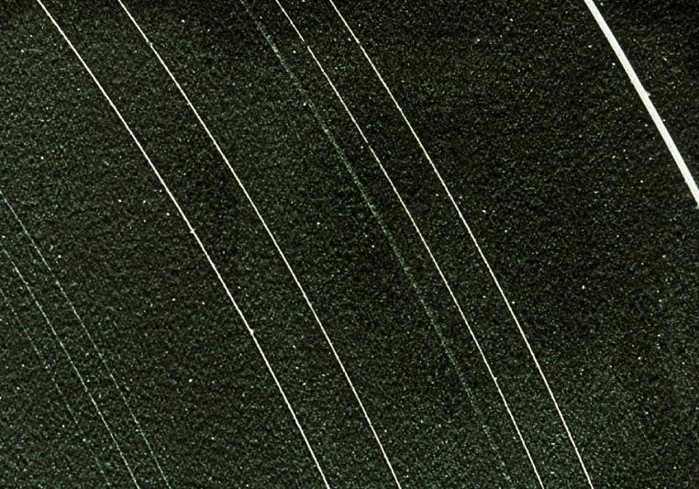
Rings of other Jovian Planets
The rings of Uranus.
Discovered by "stellar occultation".
Jupiter, Uranus, Neptune rings much thinner, much less material. Formed by breakup of smaller bodies? Also maybe "sandblasting" of material off moon surfaces by impacts.
Given rings have short lifetime and all Jovian planets have them, their formation must be common.
Neptune's moon Triton is spiraling in to the planet and should produce spectacular ring system in 100 million years.

Slide 31
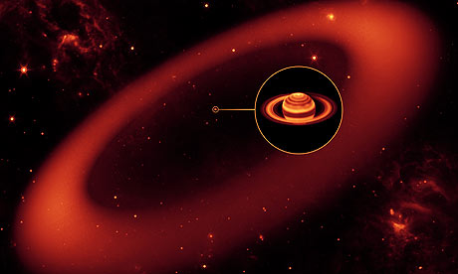
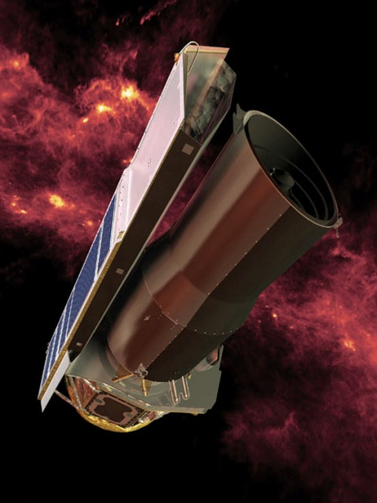
Just yesterday, discovery of a new giant ring was announced.
Seen in infrared with Spitzer Space Telescope. Not fully mapped
out. No visible counterpart known yet. Thought to be impact debris
from moon Phoebe whose orbit ring envelops.

Slide 32
What is source of heat? Similar to Io: resonant orbits with Ganymede and Io make Europa's orbit elliptical => varying tidal stresses from Jupiter => heat.
Warm ocean => life?
Europa
Io
Jupiter
Jupiter
Ganymede
Europa
(exaggerated ellipses)

Slide 33
Volcanic activity requires internal heat. Io is a small body. Should be cold and geologically dead by now. What is source of heat?
First, Io and Europa are in a "resonance orbit":
Day 0
Jupiter
Europa “pulls Io outward” here.
Europa
Io
Day 1.77
Jupiter
Io
Europa
Day 3.55
Jupiter
The periodic pull on Io by Europa makes Io's orbit elliptical.
Europa
Io

Slide 34
In other news, LCROSS will crash into a permanently shadowed crater
on the Moon at 5:30 Friday morning, looking for signs of water in the debris.
May see with a >12”
telescope, but better
to watch on NASA TV

