Slide 1
Which of the following is true:
a) The phases of the Moon (new, half, full, etc.) are caused by it passing
into Earth’s shadow
b) The Moon has a permanently dark side
c) The Moon is only visible at night
d) The seasons are due to the changing distance between the Earth and
the Sun
e) A light year is a measure of distance

Slide 2
Which of the following is true:
a) The Sun will explode at the end of its lifetime
b) Comet tails always point away from their direction of motion
c) New Mexico has world class astronomical observatories
d) The Sun is yellow
e) The Sun is burning due to chemical reactions

Slide 3
The best test of a scientific theory is
its success in explaining existing observations and experiments
how well it agrees with other theories
its success in predicting the results of future observations and experiments
how easily it is transcribed into mathematical notation

Slide 4
A kilometer is about how many miles?
0.6
0.1
0.3
1.7

Slide 5
Which of these changes if you go to the Moon?
Your mass
Your weight
Your density
None of the above

Slide 6
What are the numbers one hundred million and one billion
in scientific notation?
10⁵ and 10⁶
10⁵ and 10⁸
10⁸ and 10⁹

Slide 7
Which of the following is the most dense?
a ton of styrofoam
your textbook
the air in this room

Slide 8
If Earth spun on its axis twice as fast as it currently does, but its motion around the sun stayed the same, then which of the following is true:
a) the day would be twice as long
b) the day would be half as long
c) the year would be half as long
d) the year would be twice as long
e) the length of a day would be unchanged

Slide 9
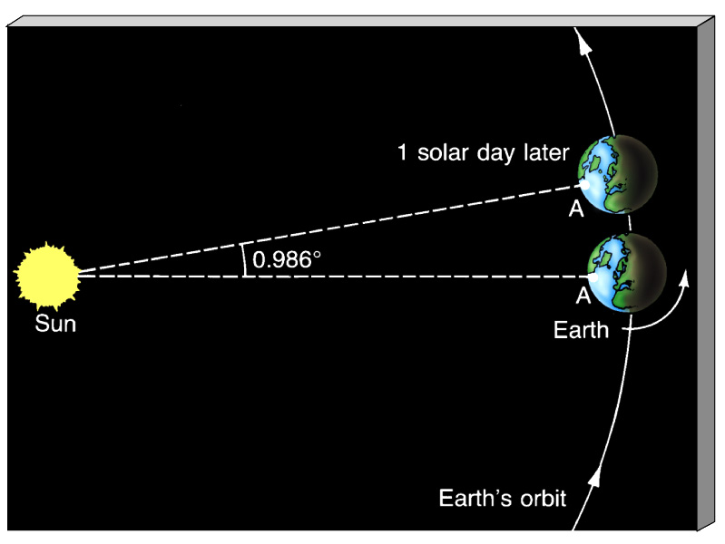
If the Earth spun on its axis in the opposite
sense of its rotation around the Sun,
the solar day would still be longer than the sidereal day
the solar day would be shorter than the sidereal day
the solar and sidereal days would be of equal length

Slide 10
Which of these is NOT a consequence of the precession of the
Earth’s rotation axis?
The year we use is not the time for the Earth to orbit the Sun
Eclipse seasons occur about 20 days earlier each year
Thousands of years from now, Vega will be the pole star

Slide 11
At about what time of day does a new moon rise?
Sunset
Noon
Sunrise
It varies

Slide 12
If the Moon’s orbit were twice as large, then, all else being equal,
we would have no total eclipses
we would have no annular eclipses
we would have no partial eclipses

Slide 13
In a few minutes, we’ll do the “jet-cart” experiment. What will
happen to the cart when the jet of CO2 is fired to the left?
The cart will move to the left
The cart will move to the right
The cart will remain stationary because there are no
forces acting on it.

Slide 14
A flaw in Copernicus’ model for the solar system was:
a) It didn’t help explain retrograde motion.
b) He used circular orbits.
c) The Earth was still at the center.
d) All of the above

Slide 15
Who was the first to use a telescope for astronomical
observations?
Newton
Kepler
Galileo
Brahe

Slide 16
Which of the following is NOT a consequence of
Kepler’s Laws?
The Sun is accelerated by the planets
Planet orbits are elliptical
Planets orbit faster when closer to the Sun

Slide 17
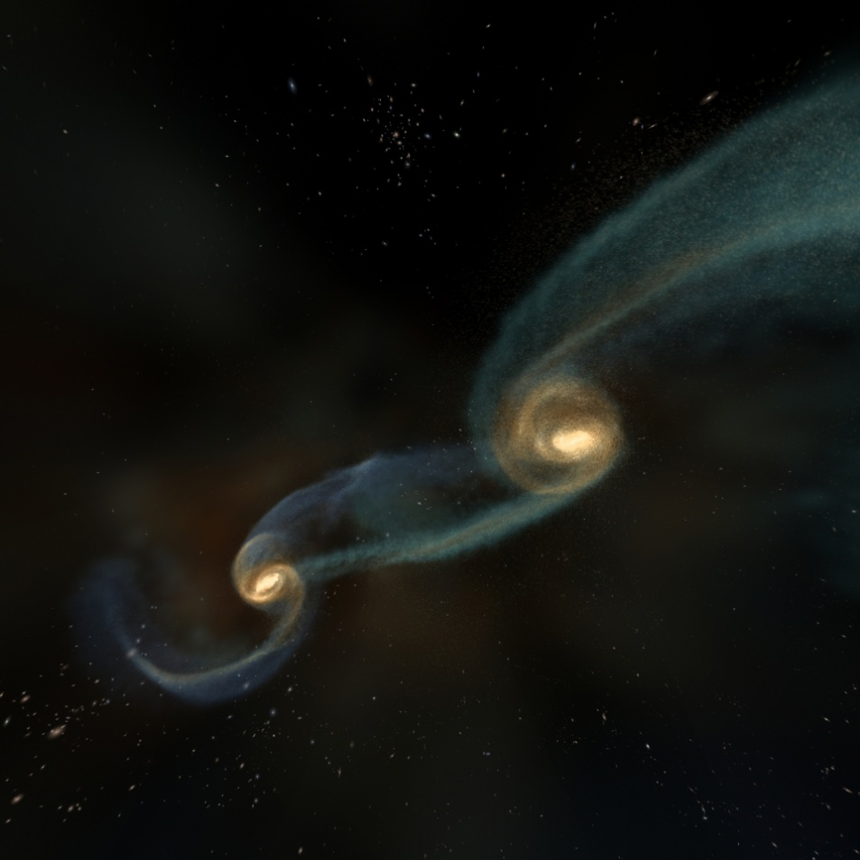
Consider Newton’s laws in the context of two galaxies colliding.
Which of the following is true?
One galaxy can be at rest while the other one collides with it.
Both galaxies can be moving at constant speed in a straight line during the collision.
c) The more massive galaxy will be accelerated less.

Slide 18
Visible light has wavelengths in the range:
centimeters to meters
millimeters
hundreds of nanometers

Slide 19
The inverse square law for light means that for two identical
galaxies, one three times more distant than the other will appear
a) 3 times as faint
b) 3 times brighter
c) 9 times as faint

Slide 20
Which of the following is true?
Infrared radiation has shorter wavelengths than visible light
X-rays have shorter wavelengths than ultraviolet radiation
Radio waves have higher frequencies than visible light

Slide 21
Wien’s law explains why a hot poker:
changes color as it gets hotter
gets brighter as it gets hotter
can be hammered into a different shape if hot enough

Slide 22
Which of the following is true?
a hot, blue star emits no infrared radiation
if the Sun temperature doubled, it would be 16 times more luminous
if the Sun’s radius were doubled, it would be twice as luminous

Slide 23
Stars typically have what kind of spectrum?
continuous
emission line
continuous with absorption lines

Slide 24
Which is not part of an atom?
electron
photon
neutron

Slide 25
Which of the following is true?
an infrared photon has a higher frequency than an X-ray photon
a radio photon has a shorter wavelength than an ultraviolet photon
an optical photon has more energy than an infrared photon

Slide 26
An element is defined by the number of
protons
neutrons
electrons

Slide 27
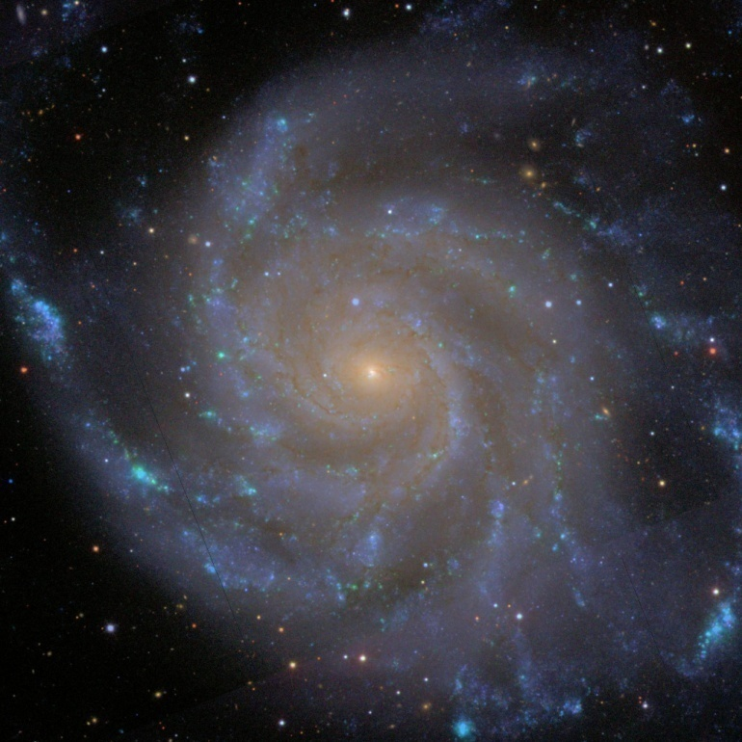
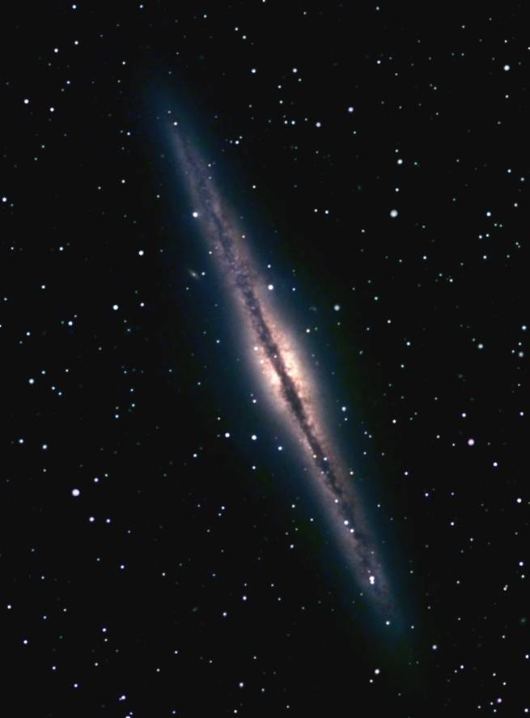
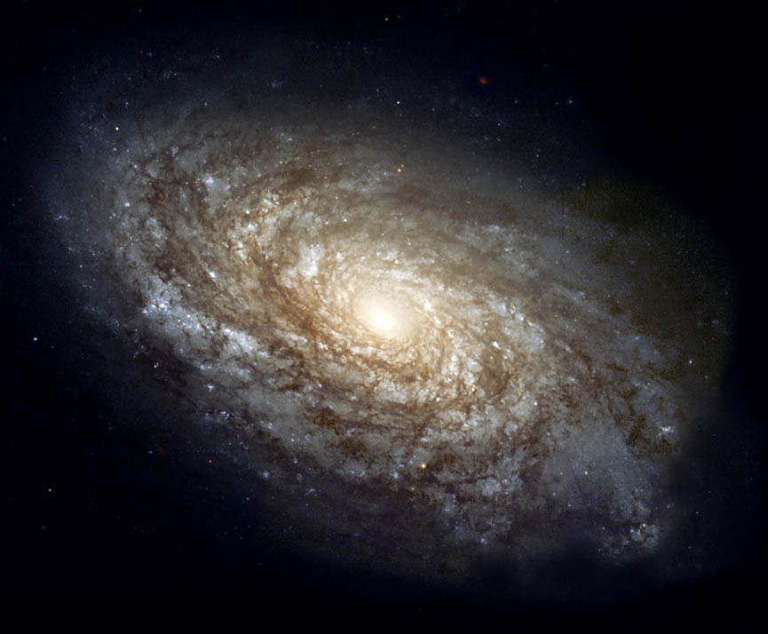
All of these galaxies are essentially rotating
disks and they rotate with about the
same speed. If we observe a spectral line
from them, which galaxy will show the
largest Doppler shift due to the rotation?
a) one seen face-on
c) one seen at a moderate tilt
b) one seen edge-on

Slide 28
Effects of atmosphere aside,
which telescope will have the best angular resolution?
A 1-meter optical telescope
A 1-meter infrared telescope
A 1-meter radio telescope

Slide 29
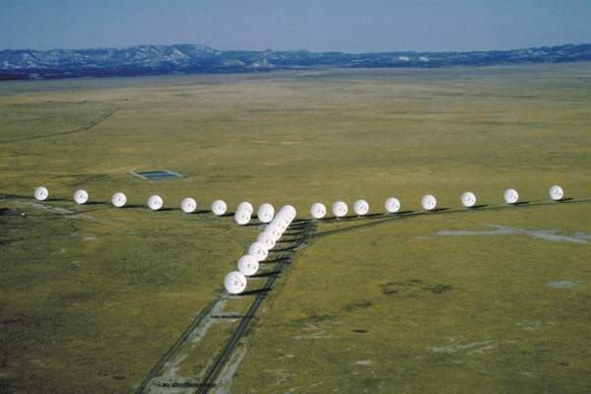
In this configuration the VLA dishes are separated by up to about 1 km.
This means that the radio maps will have:
The same sensitivity as a 1 km size single dish
The same resolution as a 1 km size single dish
Both a) and b)

Slide 30
Infrared astronomy allows you to do the following, except which?
See starlight with less absorption from dust
Observe X-rays from interstellar space
See emission from interstellar dust

Slide 31
The James Webb Space Telescope’s diameter will be 6.5 m.
The Hubble Space Telescope’s is 2.5 m. All else being equal,
JWST will have the same angular resolution as HST
JWST will be more sensitive than HST
both a) and b)

Slide 32
If a source of light, such as a star, is approaching you, you will observe that
a. its photons have increased in speed
b. it is much brighter
c. its spectral lines are lower in frequency
d. its spectral lines are shorter in wavelength
6%
54%
9%
31%

Slide 33
The energy of a photon is proportional to
a. its frequency
b. its wavelength
c. the square of its frequency
d. the square of its wavelength
44%
17%
29%
10%

Slide 34
If you see the Moon rise at about sunset, what phase is it in?
a. first quarter
b. third quarter
c. full moon
d. new moon
16%
19%
50%
15%

Slide 35
Which of the following are found in the Solar System?
asteroids
other stars
other galaxies

Slide 36
Jovian planets have which features?
rocky, many moons, close to the Sun
gaseous/liquid, many moons, close to the Sun
gaseous/liquid, spin rapidly, rings
large, no rings, far from the Sun

Slide 37
Which planet is most representative of matter in the universe
in terms of the elements it contains?
Venus
Earth
Mars
Neptune

Slide 38
At the Earth’s core, you will find:
granite-like rock
mostly iron and nickel
basalt-like rock
Brendan Fraser

Slide 39
How do we find out about the Earth’s interior structure?
We take X-rays
We use earthquakes
We drill

Slide 40
Earthquakes are
concentrated along coasts
randomly distributed over the Earth’s surface
concentrated along plate boundaries
concentrated in mountainous regions

Slide 41
We always see the same face of the Moon.
So does the Moon spin on its axis?
Yes
No

Slide 42
Which of these does the Moon have now?
continued cratering
volcanoes
earthquakes as strong as on Earth
an atmosphere

Slide 43
Volcanic activity on the Moon created
most of the craters
the highlands
the maria

Slide 44
Venus’ atmosphere
is thicker than Earth’s
consists mostly of carbon dioxide
is yellow due to sulfuric acid
all of the above

Slide 45
Why is Venus the hottest planet in the Solar System?
a) It is the closest planet to the Sun.
b) There is a lot of radioactive material in the crust.
c) There is a large concentration of carbon dioxide in the atmosphere.
d) It’s Lady Gaga’s latest hangout.

Slide 46
Which is true of Venus?
We can see the surface from Earth
The atmosphere is mostly nitrogen, as on Earth
Like the Moon, it has had no volcanic activity for
billions of years
All of the surface has about the same age – about 500
million years

Slide 47
Which of these do Venus and Mars have in common?
a mostly carbon dioxide atmosphere
evidence for flowing water on the surface in the past
a thick atmosphere due to the Runaway Greenhouse Effect
a day about equal to Earth’s in length

Slide 48
Which object is the most geologically active today?
Earth
Moon
Mars

Slide 49
Mars shows evidence of
ongoing volcanic activity
ongoing seismic activity
an icy layer beneath its surface
Stronger differentiation than on Earth

Slide 50
Why do Jupiter’s storms last years, decades or hundreds of years?
There are no land masses to break them up
The Sun’s energy disrupts storms but it is too feeble at Jupiter
c) Storms can persist for longer in an atmosphere of hydrogen/helium

Slide 51
Which is FALSE about Jupiter’s zones and belts?
They represent a convection cycle
Different colors arise from different molecules
Different colors are also related to different depths in the atmosphere
d) Wind speeds can reach a few miles per hour

Slide 52
Jupiter’s atmosphere consists mostly of
nitrogen
carbon dioxide
ammonia
hydrogen
methane

Slide 53
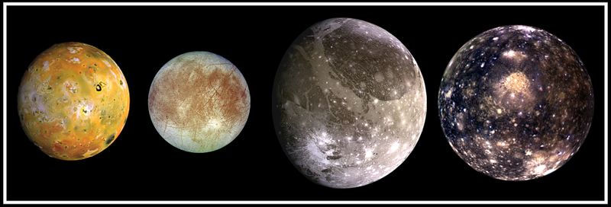
For Jupiter’s four Galilean moons, which is FALSE?
the closer to Jupiter, the lower the density of the moon
the closer to Jupiter, the higher the rock-to-ice fraction
the closer to Jupiter, the younger the surface is
Jupiter

Slide 54
Should Pluto still be a planet?
Yes
No
When’s lunch? (i.e. no opinion)

Slide 55
Why does Io have volcanoes?
It has an unusual amount of radioactive elements that act
as a heat source in its interior
Tidal stresses due to its elliptical orbit around Jupiter
cause heating by friction
It is a large enough moon that it hasn’t yet lost all the
heat it formed with

Slide 56
What are Saturn’s rings?
A large number of small icy chunks
Solid sheets of ice
dusty material ejected off its moons

Slide 57
Which is FALSE about the Kuiper Belt Objects?
There are probably tens of thousands of them
They are mostly bigger than Pluto
They have an icy/rocky composition
They generally have tilted orbits

Slide 58
Long-period comets
have periods of 50-200 years
have randomly oriented orbits
originate in the Kuiper Belt

Slide 59
Test 2 Question
The greenhouse gases cause warming of Earth’s surface by trapping what kind of radiation?
Visible
Radio
Infrared
Ultraviolet
1%
1%
53%
45%

Slide 60
Test 2 Question
Which of the following is NOT a feature of Jupiter?
Strong winds in the atmosphere
It has a moon with volcanic activity
An atmosphere composed largely of ammonia
A ring
16%
5%
52%
27%

Slide 61
How much larger is the Sun’s radius than the Earth’s radius?
ten times
a hundred times
a thousand times
ten thousand times

Slide 62
How many times more massive is the Sun than the Earth?
about ten
hundreds
hundreds of thousands
billions

Slide 63
Fusion reactions involve
nuclei of atoms being split
atoms joining to form molecules
mass being converted to energy

Slide 64
The absorption lines we observe in the solar spectrum
tell us about
the elements in the nebula from which the Sun formed
the elements being made by fusion in the Sun
both a) and b)
the elements that make up the Earth

Slide 65
Which is FALSE about sunspots?
They are roughly Earth-sized
They are cooler than their surroundings
They last for several years
They usually occur in pairs
They follow the rotation of the Sun

Slide 66
A parsec is about the same order of magnitude as
a kilometer
a light year
an Astronomical Unit
not a real unit. Made up by Star Trek

Slide 67
The closest stars are about
1 parsec away from the Sun
1 AU away
thousands of parsecs away
millions of parsecs away

Slide 68
The Hertzsprung-Russell diagram is a plot of stars’
mass vs. radius
luminosity vs. mass
temperature vs. mass
luminosity vs. temperature

Slide 69
A star’s position on the HR diagram depends on its
mass and evolutionary state
distance and mass
velocity and distance
mass and chemical composition

Slide 70
Massive stars are also very:
long-lived, hot, luminous, red, rare
short-lived, hot, luminous, blue, rare
long-lived, hot, luminous, blue, common

Slide 71
The hottest stars are about 30,000 K at their surface.
In Celsius, this is roughly
30,000 C
5/9 times (30,000 C – 32 C)
9/5 times (30,000 C – 32 C)

Slide 72
Emission nebulae
contain mostly atomic gas (not ionized or molecular)
show a continuous spectrum with absorption lines
trace ongoing star formation

Slide 73
Atomic gas in the ISM
accounts for only a small fraction of the ISM mass
is traced by the 21-cm radio spectral line
is the densest form of ISM gas

Slide 74
Molecular gas in the ISM
is associated with regions of ongoing star formation
is the hottest ISM component
accounts for only a small fraction of the ISM mass

Slide 75
Why do stars typically form in clusters?
a) Because the molecular clouds they form out of like to
cluster together
b) Because the molecular clouds they form out of fragment
as they collapse
c) As stars form they quickly gravitate towards each
other to make a cluster

Slide 76
How many times denser is a star than a typical interstellar
molecular gas cloud?
hundreds of times
billions of times
trillions of times
about 10²⁰ times

Slide 77
Why does the stellar core contract after it has completed
fusion of an element?
As the star evolves, the envelope gains mass and
weighs down more on the core
The new element is heavier, so the core contracts
under the increased gravity
If no fusion is occurring, no energy is made, so the
core collapses until it is hot enough to fuse the new element

Slide 78
Why do red giants and supergiants expand, even as the
core is not producing energy and is contracting?
contraction and expansion must balance each other
fusion in shells around the core is very energetic
the core is heating up as it contracts, so the envelope
must expand and cool to conserve energy

Slide 79
As a star cluster ages, its color
will go from redder to bluer
will go from bluer to redder
won’t change
Hint: think about what you know about
properties of Main Sequence stars.

Slide 80
The Sun will end its life
as a white dwarf
as a neutron star
by exploding as a supernova
as a black hole

Slide 81
What is the heaviest element produced by steady fusion in the core of a massive star?
a) Hydrogen
b) Carbon
c) Iron
d) Uranium

Slide 82
Which is FALSE about core-collapse supernova explosions?
They occur about once every 50 years in the Milky Way
They are triggered by a rebound in an all-neutron core
The Crab Nebula is the remnant of such an explosion
observed about 1000 years ago
d) They eject large amounts of iron into interstellar space

Slide 83
Once iron is made in the core of a massive star, how long
does it take for the core to collapse?
one thousand years
one year
one day
one second

Slide 84
Which phenomena have been associated with pulsars?
Planets around pulsars
Confirmation of Einstein’s prediction of gravitational radiation
Pulsars spinning with periods as fast as 1 millisecond
All of the above
None of the above

Slide 85
Pulsars are rapidly rotating
black holes
neutron stars
white dwarfs

Slide 86
Why is light not affected by gravity in Newton’s theory?
Because the speed of light is too large
Because gravity is balanced by electromagnetic forces
associated with photons.
c) Because light is massless

Slide 87
X-rays coming from gas just outside a black hole are observed at Earth to be shifted to:
a) lower energies
b) higher energies
c) the energy doesn’t change
d) lower speeds

Slide 88
Which of the following is true?
Only black holes can cause space curvature
A black hole is an object with an escape speed
less than the speed of light
Any object with mass can become a black hole
if it can be shrunk small enough
d) We have no good candidates for black holes

Slide 89
Fusion in the Sun is responsible for all of the following EXCEPT which?
a. converting hydrogen nuclei to helium nuclei
b. generating pressure to support the Sun
c. the mix of elements in the Sun's atmosphere
d. causing the Sun to shine
3%
16%
54%
27%

Slide 90
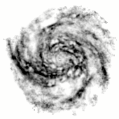
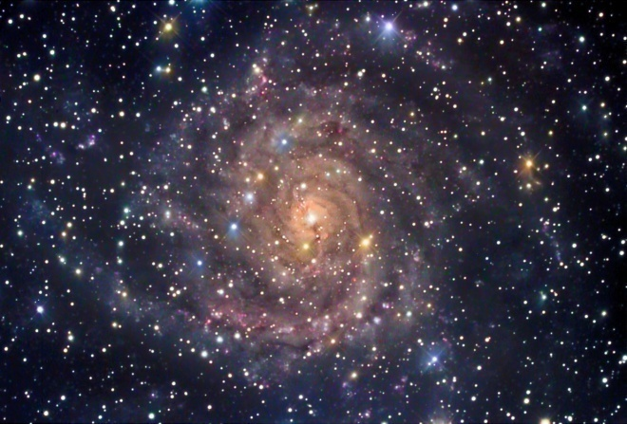
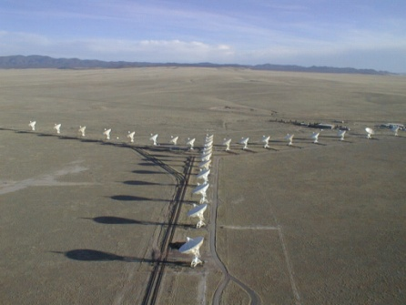
Radiation at a wavelength of 21 centimeters traces what kind of gas?
a. molecular hydrogen
b. atomic hydrogen
c. ionized hydrogen
d. none, it traces dust
18%
34%
34%
14%
21-cm
emission
map of IC 342
from VLA
Galaxy IC 342 in visible light

Slide 91
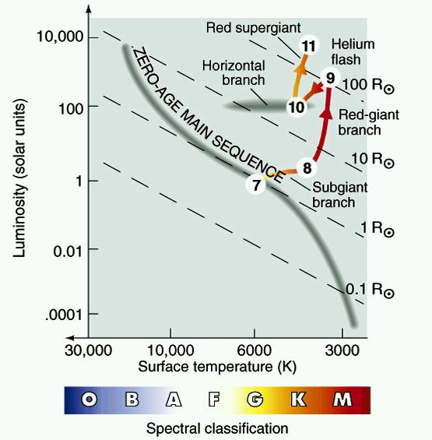
22. Which of the following is TRUE?
A planetary nebula is the disk of matter around a star that will
eventually form a planetary system.
b. As a star begins to evolve away from the main sequence, it gets fainter.
c. As a star begins to evolve away from the main sequence, it gets larger.
d. A low mass-star has a shorter lifetime on the main sequence than
a high-mass star.
23%
23%
40%
13%

Slide 92
We may not have covered this explicitly, but how many
times bigger do you think the Milky Way is relative
to the Solar System (which is about 100 AU across)?
about ten thousand
about one million
about one hundred million

Slide 93
Which of the following are not in the disk of the Milky Way?
globular clusters
interstellar gas and dust
the Sun

Slide 94
Which describes the rotation of the disk?
Stars closer to the center take longer to complete an orbit
Stars further from the center take longer to complete an orbit
c) All stars take the same amount of time to complete an orbit

Slide 95
Where are new stars being formed in the Milky Way?
bulge
disk
halo

Slide 96
What kind of galaxy do we live in?
Elliptical
Irregular
Spiral

Slide 97
The spiral arms of the Milky Way
are due to a wave
always contain the same stars and gas
c) are getting more tightly wound with time

Slide 98
Why do astronomers think that Dark Matter exists in the Milky Way?
we have detected Dark Matter particles on Earth
we see large dark lanes and patches in optical images of galaxies
c) the rotation curve implies large amounts of unseen mass

Slide 99
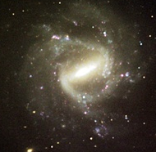
Galaxy Classification Time!
NGC 1073
a) Sa
b) Irr I
c) SBbc

Slide 100
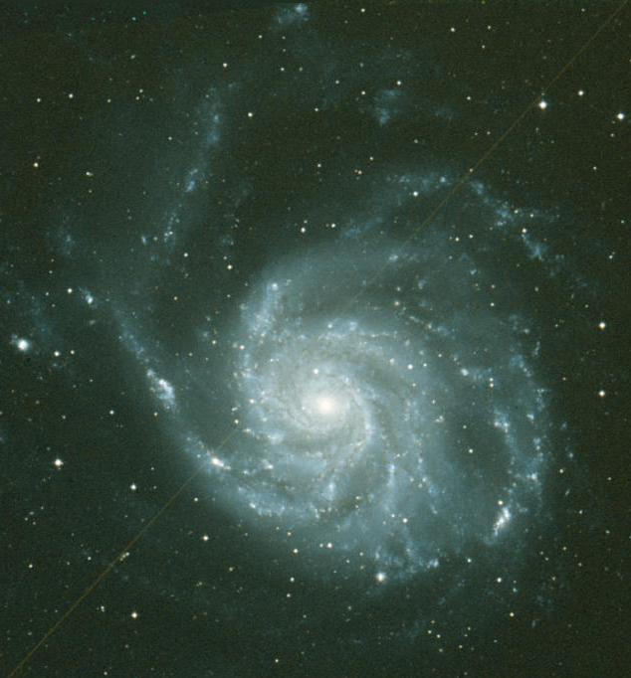
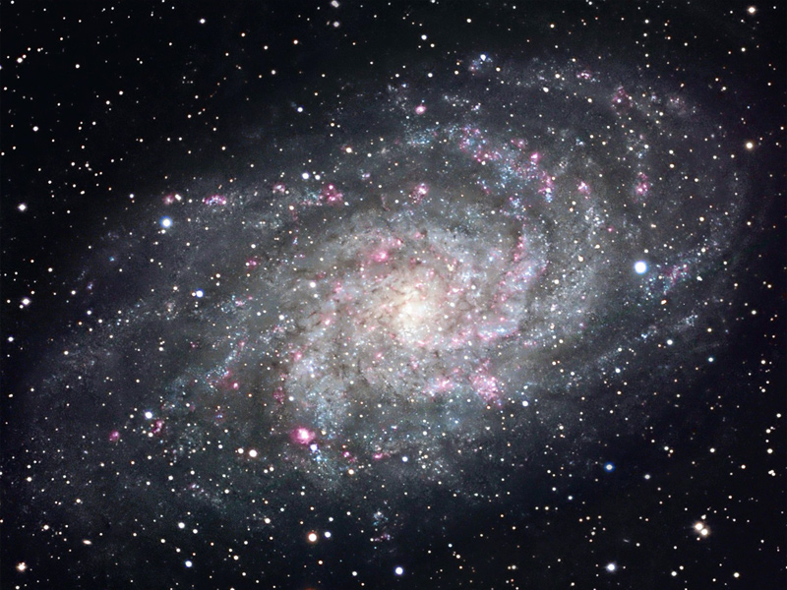
Which is the Sa galaxy?
b) M101
a) M33
c) M81
d)

Slide 101
What is a likely property of this galaxy, shown here with its real color
(hint: this yellow-orange color is about as red as galaxies get, i.e. this is a
red galaxy)?
generally old stars
rotation
much interstellar gas

Slide 102
What is the most common kind of galaxy?
Giant spirals
Dwarfs
Giant ellipticals

Slide 103
What is the most common kind of giant galaxy?
Ellipticals
Irregulars
Spirals

Slide 104
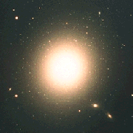
M87
a) E0
b) E5
c) E7

Slide 105
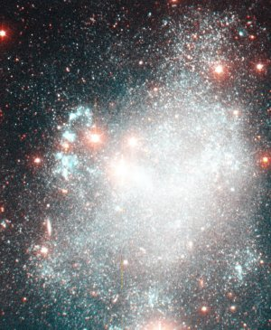
Holmberg II
a) Irr II
b) Sc
c) Irr I

Slide 106
Two Cepheid stars in different galaxies have the same apparent
brightness, but the first has a longer period. Which galaxy is
further away?
The first
The second
Cannot tell from this information

Slide 107
Slipher found that the spiral nebulae were redshifted.
So why do we credit Hubble and not Slipher with the discovery of the
expansion of the universe?
Apart from finding redshifts, Hubble also came up with the Big Bang theory to explain them
Slipher’s data weren’t of the quality of Hubble’s and his results weren’t generally accepted.
c) In Slipher’s time, it wasn’t known that the spiral nebulae were other galaxies

Slide 108
Hubble’s Law is a correlation of galaxies’ redshifts with their
Luminosities
Distances
Velocities

Slide 109
If H₀ = 65 km/sec/Mpc, what should the distance be to a galaxy
observed to be receding at 6500 km/sec?
1 Mpc
100 Mpc
100 kpc

Slide 110
Which of the following 1-dimensional structures cannot be
an analog of the universe?
a line segment
a closed loop
c) a line

Slide 111
According to the Cosmological Principle:
we are at the center of the expanding Universe
the center has not yet been discovered
there is no center to the expansion in our Universe

Slide 112
What does the spectrum of the Cosmic Microwave Background
Radiation look like?
absorption line spectrum
b) a perfect blackbody spectrum
c) emission line spectrum

Slide 113
In Hubble’s Law relating galaxy redshifts and distances, the
redshifts are due to:
galaxies moving away from each other through space
gravity, as we saw for radiation escaping from near a black hole
stretching of photon wavelengths as space expands

Slide 114
What dominates our universe, energetically?
Dark Energy
Dark Matter
The Cosmic Microwave Background Radiation

Slide 115
The distances to galaxies used to measure the acceleration
of the universe are determined using
Cepheid variables
Type I Supernovae
Hubble’s Law

Slide 116
What do measurements of the CMBR indicate is the geometry
of our 3-d universe, expressed by analogy to a 2-d surface?
Closed, like a spherical surface in 3-d space
Open, like a saddle-shaped surface in 3-d space
Flat, like a plane in 3-d space

Slide 117
Which of these elements was produced by Big Bang nucleosynthesis?
carbon
iron
helium

Slide 118
Test 2 Question
Which of the following about comets is true?
Cometary orbits always lie close to the ecliptic plane
Long period comets must originate well beyond the Kuiper Belt
The Oort cloud is the large cloud of gas surrounding a comet nucleus while it is near the Sun
Tails of comets always lie along the path of the orbit
16%
47%
21%
18%

Slide 119
Fusion in the Sun is responsible for all of the following EXCEPT which?
a. converting hydrogen nuclei to helium nuclei
b. generating pressure to support the Sun
c. the mix of elements in the Sun's atmosphere
d. causing the Sun to shine
6%
11%
49%
35%

Slide 120
Radiation at a wavelength of 21 centimeters traces what kind of gas?
a. molecular hydrogen
b. atomic hydrogen
c. ionized hydrogen
d. none, it traces dust
17%
36%
33%
13%
21-cm
emission
map of IC 342
from VLA
Galaxy IC 342 in visible light

Slide 121
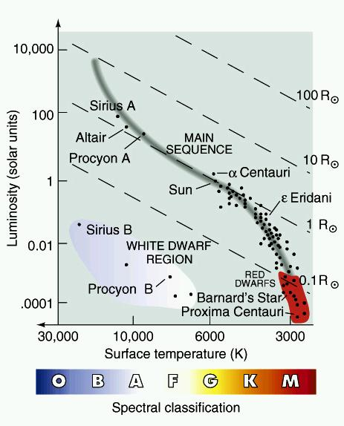
Why are the most common stars also among the most
difficult to observe?
They are enshrouded in dust
They are all very distant
They are all moving rapidly away from us
They have low luminosities
21%
34%
2%
43%
H-R Diagram of Nearby Stars

Slide 122
Which of the following is TRUE?
a. A planetary nebula is the disk of matter around a star that will eventually form a planetary system.
b. As a star begins to evolve away from the main sequence, it gets fainter.
c. As a star begins to evolve away from the main sequence, it gets larger.
d. A low mass-star has a shorter lifetime on the main sequence than a high-mass star.
18%
21%
45%
16%

