Slide 1
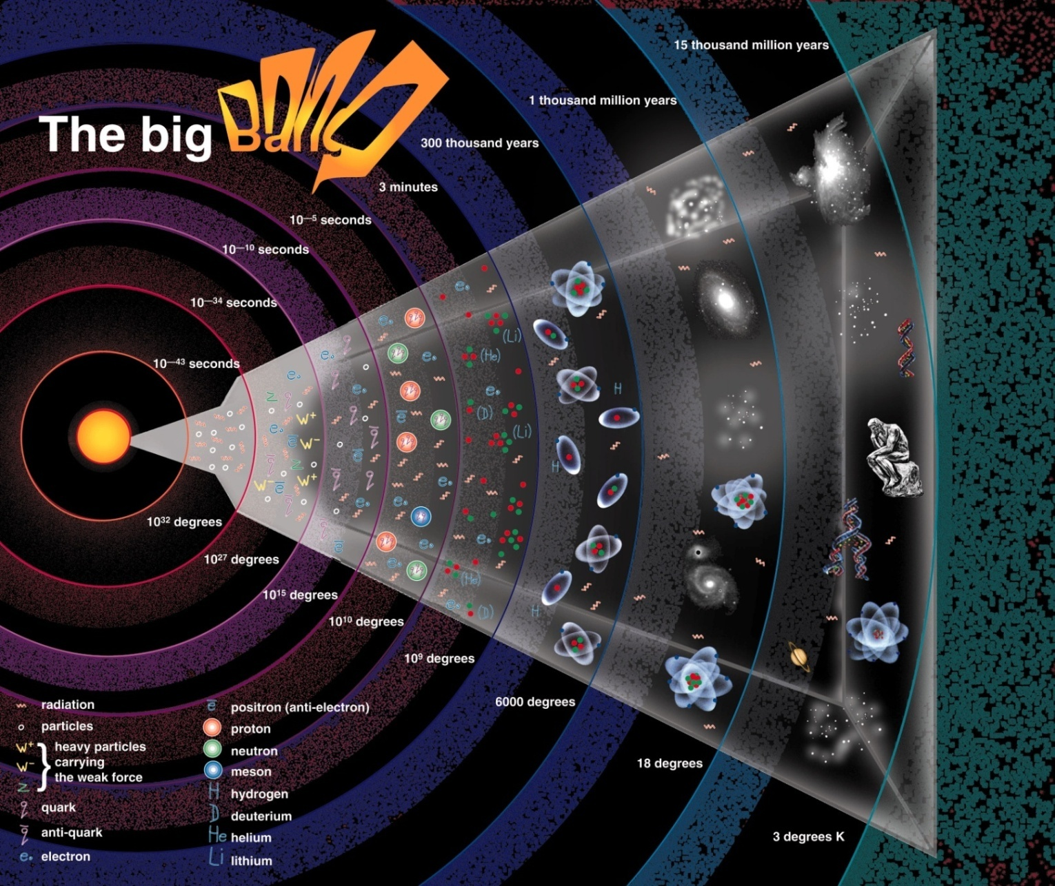
Cosmology and the Early Universe
Ch 25, 26.1, 26.4, 26.6

Slide 2
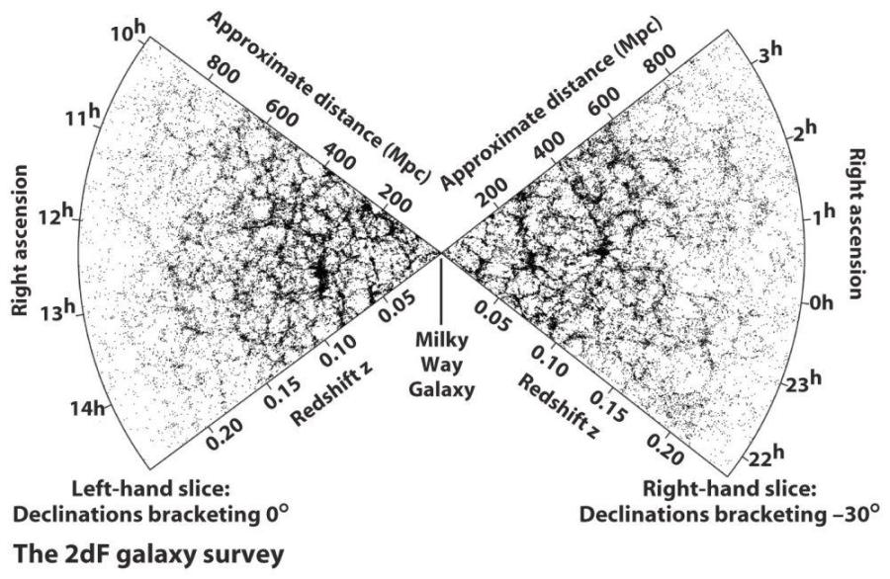
What is the largest kind of structure in the universe? The ~100-Mpc filaments, sheets and voids? On larger scales, things look more uniform.
Given no evidence of further structure, assume:

Slide 3
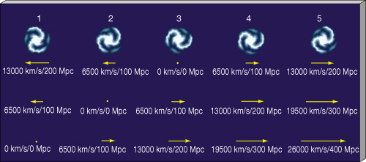
The Cosmological Principle
On the largest scales, the universe is roughly homogeneous (same at all places) and isotropic (same in all directions). Laws of physics same. Hard to prove but can be disproved.
Hubble's Law might suggest that everything is expanding away from us, putting us at center of expansion. Is this necessarily true?
(assumes H₀ = 65 km/sec/Mpc)

Slide 4
So we may not be the center. But is there one? If there is a center, there must be a boundary to define it. If we were at center, universe would be isotropic (but only from our location) but not homogeneous:
Volume of galaxies expanding away from us. If it obeyed Hubble’s Law,
would have large mass
concentration at center, with lower density towards edge, surrounded by empty space.
Us
But if we were not at center, universe would be neither isotropic nor homogeneous:
This situation wouldn’t even obey Hubble’s Law from our vantage point.
Us

Slide 5
So if the CP is correct, there can be no center, and no edge to the Universe! Does not necessarily mean it’s infinitely large, although it might be (see later).
Why should you believe the CP? Best evidence comes from Cosmic Microwave Background Radiation (later).
The Big Bang
All galaxies moving away from each other at speed proportional to separation (Hubble's Law). So, reversing the Hubble expansion, separations must approach zero at some time in past. How long ago?

Slide 6
H₀ gives rate of expansion. Assume H₀ = 75 km / sec / Mpc. So galaxy at 100 Mpc from us moves away at 7500 km/sec. How long did it take to move 100 Mpc from us at that speed?
$$t= \frac{d}{v}= \frac{100 Mpc}{7500 km/s}=13 Gyr$$
$$\frac{1}{H_{0}}$$
(Note this is just , also called the “Hubble time”). This assumes constant speed, which means H₀ assumed not constant with time, but shows that the greater H₀, the shorter the time to get to the present separation. Current result from Planck satellite: age=13.80 +/- 0.02 Gyr.
Big Bang: we assume that at time zero, all separations were infinitely small. Separations then grew in all directions. Galaxies formed as expansion continued.

Slide 7
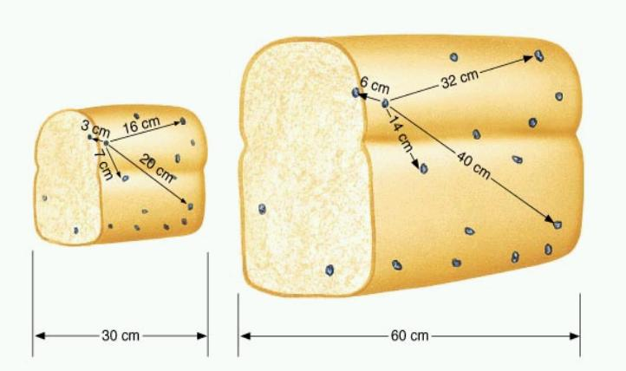
But this is not galaxies expanding through a pre-existing, static space. That would be an explosion with a center and an expanding edge, violating CP.
If CP is correct, the distance between any two points is increasing, but there is no center or edge. Space itself is expanding, and galaxies are taken along for the ride.
A raisin bread analogy provides some insight:

Slide 8
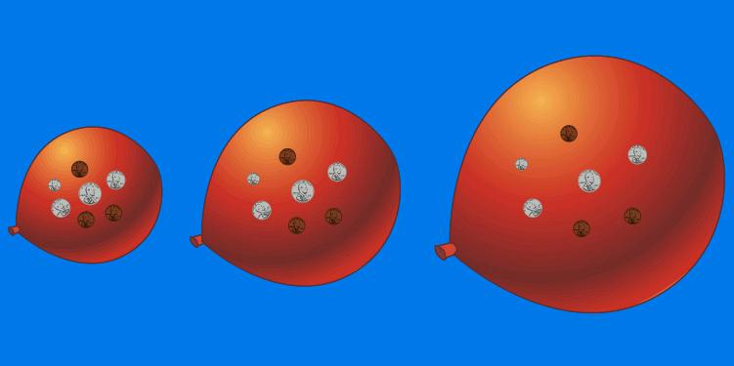
But the bread has a center and edge. Easier to imagine having no center or edge by analogy of universe as a 2-d expanding balloon surface (just one possible analogy for our universe’s geometry). All points on surface expand from each other with no center on the surface:
Now take this analogy "up one dimension". All points in space expand from each other. The Big Bang occurred everywhere at once, but "everywhere" was very close together. (This does not mean we are expanding into a real 4th dimension).
(To understand what it would be like in a 2-d universe, read Flatland by Edwin Abbott: www.ofcn.org/cyber.serv/resource/bookshelf/flat10 )

Slide 9
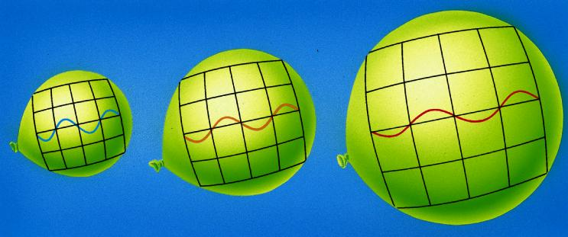
If all distances increase, so do wavelengths of photons as they travel.
When we record a photon from a distant source, its wavelength will be longer. But is not due to relative motion of source and receiver (Doppler Shift). This is the Cosmological Redshift, and is the correct way to think of redshifts of galaxies.
Ratio λ/λ₀ = 1 + z measures amount of stretching. For z=1, lengths have expanded by a factor of 2 since light was emitted.

Slide 10
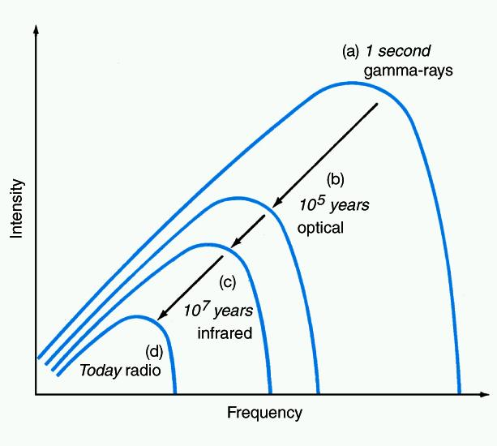
The Cosmic Microwave Background Radiation (CMBR)
A prediction of Big Bang theory in 1940's. "Leftover" radiation from early, hot, dense universe, uniformly filling space (i.e. obeying CP). Hot, dense objects have a black-body spectrum.
Photons stretched as they travel and universe expands, but spectrum always black-body. Wien's Law: temperature decreases as wavelength of brightest emission increases => was predicted to be ~ 3 K now.
Since λ_{max} α 1/T, and λ/λ₀ = 1 + z for any λ, then T/T₀ = 1/(1 + z)

Slide 11
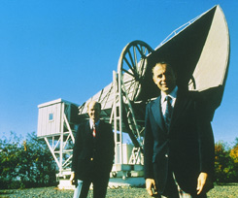
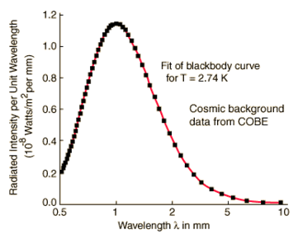
Found in 1964 by Penzias and Wilson. Perfect black-body spectrum at T = 2.718 K (best current value). Uniform brightness (and thus temperature) in every direction.
Intensity (arbitrary units)
Points are data on the spectrum of the CMBR from the COBE satellite (1989). Curve is a black-body spectrum at T=2.73 K.
1% of the “snow” on a blank TV channel is this radiation!

Slide 12
How far back are we looking? “Era of recombination”
Photons in the early universe had so much energy that all gas was kept ionized. Density very high. A photon could travel tiny distance before scattering off electron.
At z~1,100 (~380,000 years after Big Bang), the universe had cooled off to T~3,000K. Neutral atoms (H, He only elements then) formed, and remained since low-energy photons could not ionize them.
Almost all photons now had wrong λ’s to be absorbed, so traveled freely. Space became transparent. We now see these photons as the CMBR.

Slide 13
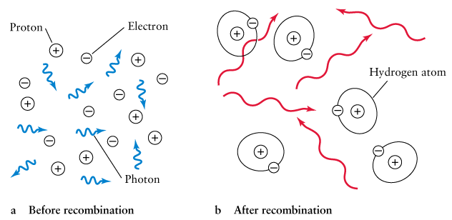
Free nuclei, protons and electrons, bathing in blackbody radiation. (He nuclei not shown). Photons travel short distance before scattering off particles.
At 3000K, recombination made scattering much less effective, absorption also very unlikely, and photons can travel undisturbed.
(He atoms would
be there too)
Analogous to Solar interior
Analogous to Solar photosphere

Slide 14
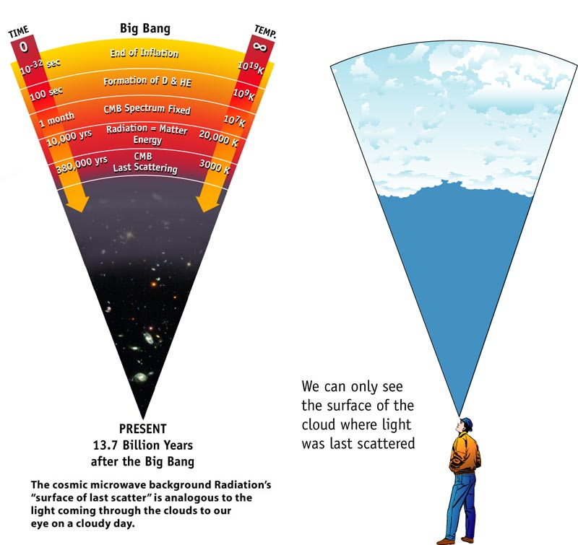
Opaque
Transparent

Slide 15
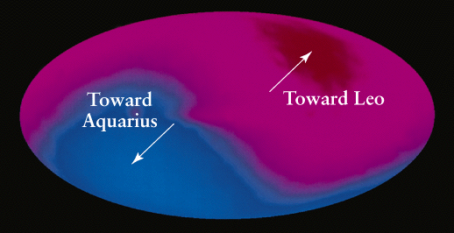
T is not quite constant for a few reasons. Largest effect: we are not at rest with respect to CMBR because we are being tugged by various masses (as we saw via deviations from Hubble’s Law). Leads to “dipole anisotropy” showing our speed and direction.
hotter
cooler
CMBR in Galactic coords from COBE satellite
Can show: ΔT/T = - Δλ_{max}/λ_{max} = v/c. ΔT = 0.00337 K => v = 371 km/s.
After removing our motion in MW, MW motion in Local Group, LG pull due to Virgo, find we are pulled by some larger mass(es). These are the “Great Attractor” at 60 Mpc and possibly “Shapley Supercluster” at 200 Mpc away.

Slide 16
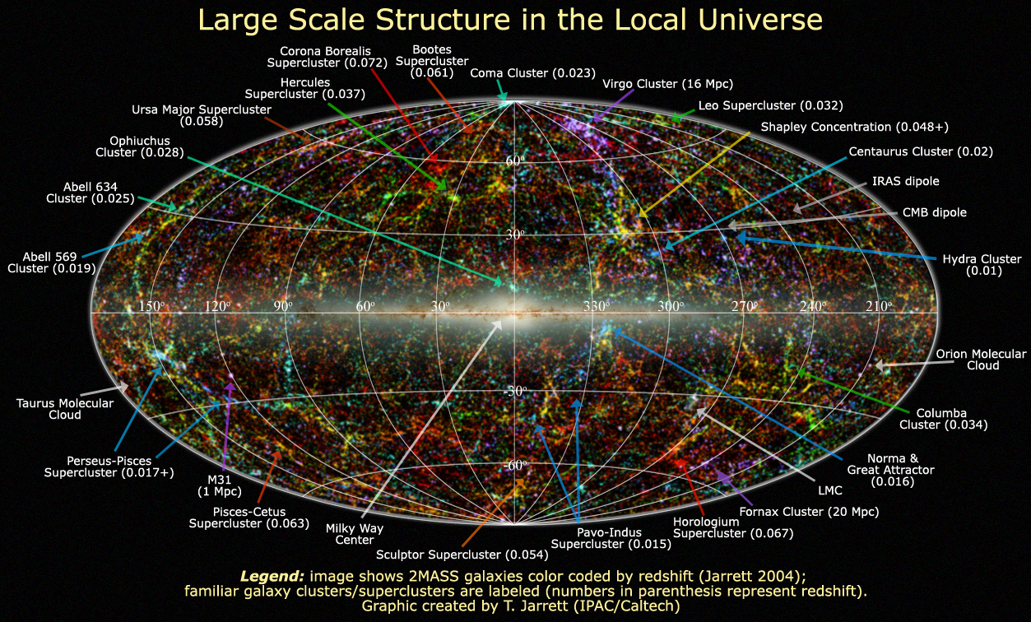
Mass of Great Attractor not well known but estimates are about 3 x 10¹⁶ M .
Shapley Supercluster is probably larger. Possibly a void on opposite side
of sky contributes as well.

Slide 17
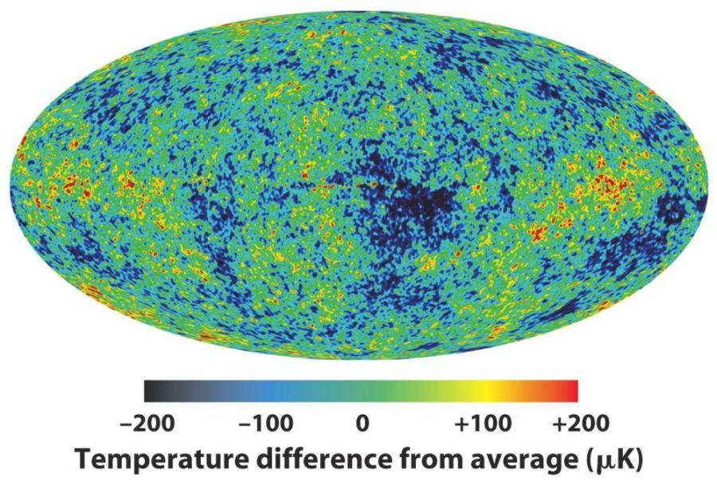
Removing dipole anisotropy, and MW emission, allows fluctuations in T to be searched for. T constant to one part in 10⁵ ! For blackbody radiation, this means intensity is very constant too (Stefan’s law). Again, supports CP.
From WMAP
satellite (30’ resolution)
Deviations are an imprint of early density fluctuations that led to current structure in universe.

Slide 18
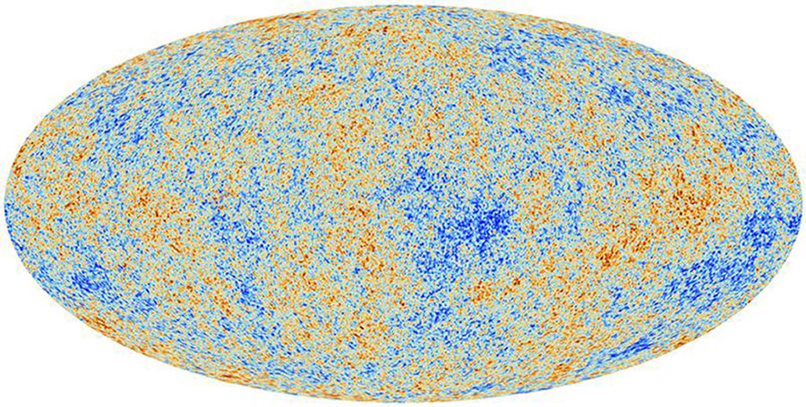
From Planck
satellite (5’ resolution)

Slide 19
That the CMBR comes to us from every direction is best evidence that Big Bang happened everywhere. That T is so constant in every direction is best evidence for homogeneity on large scales.
IF the Big Bang happened at one point in 3-d space:
Later, galaxies form and fly apart. But radiation from Big Bang streams freely (after era of recombination) at speed of light! Wouldn't see it now.

Slide 20
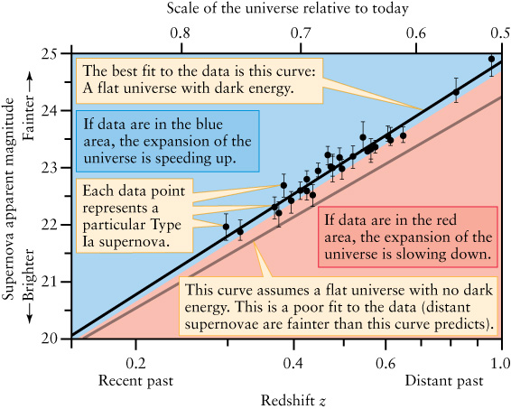
The Expansion of the Universe is Accelerating
Using SN Type Ia to measure how distance-redshift relation has changed.
(distance)
A SN at a given distance means the light has been traveling for a given time. The redshift measures the amount by which the universe has expanded. At large distances, the redshifts are not as great as they should be if the expansion rate had been constant at today’s value (red/blue line). Thus, the expansion rate must have been smaller at some time in the past, i.e. greater now. Eventually, separations may grow exponentially with time.

Slide 21
Dark Energy, or the Cosmological Constant, Λ
Can think of Λ as a repulsion that exists even in a vacuum. Introduced by Einstein in 1917 to balance gravitational attraction and create static Universe (turned out to be wrong!). But accelerating universe indicates there is such a repulsion. Also often called "dark energy". We have little idea of its physical nature. We don’t yet know if it is constant in time.
However, now we can estimate the current dark energy density. How?

Slide 22
Curvature of space
The mass/energy of the Universe causes space to be curved, like around a black hole or galaxy cluster. On largest scales, CP says curvature should be uniform.
Consider shining two powerful laser beams into space, starting off parallel. What happens?
They could remain parallel - flat space.

Slide 23
The beams might converge, if space is positively curved or closed. 2D analog is sphere. In curved space, universe bends light like a lens.
3. They could diverge, if space is negatively curved or open, like a saddle (hyperbolic). Bends light like a diverging lens.

Slide 24
The density parameter Ω₀
The geometry of the Universe depends on the total density of matter and energy (incl. dark energy). Energy converted to equivalent mass using E=mc².
There is a critical density, ρ_{c}, for which universe is flat. ρ_{c} is about 9.5 x 10⁻²⁷ kg m⁻³. Compare the actual mass/energy density, ρ₀, with ρ_{c}.
Density parameter:
This would be 1 for a flat universe, >1 for a positively curved universe and <1 for a negatively curved universe.

Slide 25
How can we measure curvature? Clue from the CMBR
Fluctuations in T represent density fluctuations when universe became transparent.
~1° fluctuations dominate. These are predicted, and their size in pc reflects balance of gravity and radiation pressure,
and turns out to be proportional to speed of light times age of Universe at era of recombination (380,000 years).
From WMAP
satellite

Slide 26
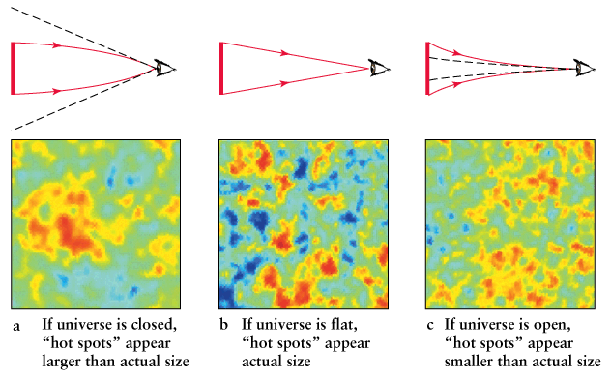
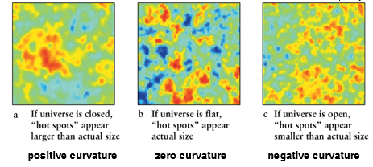
measure this angle (∼ 1°)
apparent size in blue
known
size in red
also know how far light
has traveled since t=380,000 yrs
for different curvatures.
positive curvature zero curvature negative curvature
Apparent size of spots depends on curvature of space.

Slide 27
A flat universe
Result is that fluctuations are not magnified/demagnified. Space is flat, or very nearly so. Ω₀ =1 to within 1%.
Problem: the mass density of the universe is measured to be 2.7 x 10⁻²⁷ kg/m³ (including dark matter). This matter density parameter, Ω_{m}, is
But total Ω₀ is 1: we have missing density.
$$Ω_{m}= \frac{ρ_{m}}{ρ_{c}}=0.31$$
(latest Planck satellite
results)

Slide 28
Missing density
Dark energy can explain both acceleration and flatness if it accounts for 69% of the Universe’s mass/energy density. Can write
If Ω_{Λ} = 0.69, then
and, crucially, Ω_{Λ} > Ω_{m} by right amount to explain acceleration.

Slide 29
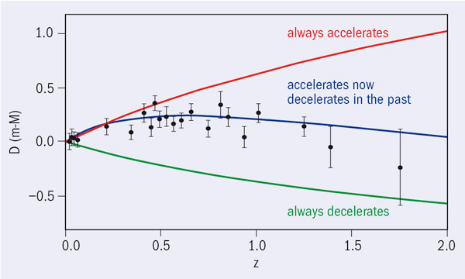
Has Expansion Always Been Accelerating?
Apparent magnitude relative to that for a “coasting” universe
(t=6 Gyr)
(t=4 Gyr)
The highest z Type Ia supernovae suggest that it used to be decelerating, as expected if matter once dominated
dark energy.

Slide 30
But Very Early On, Radiation Dominated Everything
Consider just matter and radiation first. Average density of matter ρ_{m} = M/V, where M contains both visible and dark matter. Currently, ρ_{m} = 2.7 x 10⁻²⁷ kg m⁻³.
CMBR dominates radiation in Universe. From CMBR, determine energy density of radiation. Convert to equivalent “mass” density using E=mc². Currently, ρ_{rad} = 4.6 x 10⁻³¹ kg m⁻³. So matter dominates radiation now (but dark energy dominates both).
Reverse expansion. ρ_{m} grows as V shrinks. But ρ_{rad} grows faster because each photon’s λ decreases, E increases. So at early times radiation dominated matter.

Slide 31
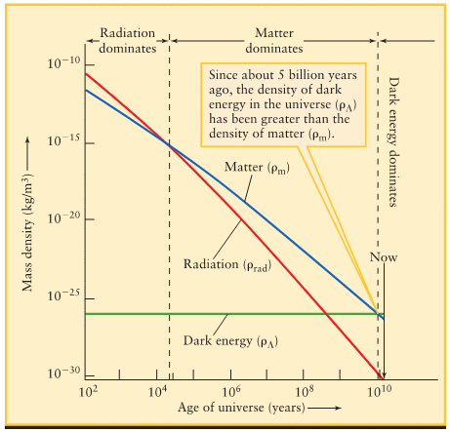
Results are consistent with Dark Energy having a constant density in time, or very slowly changing, which is hard to understand.
Era of recombination

Slide 32
Shortcomings of the Big Bang theory (beginning of material not on test!)
The simplest Big Bang theory has a few shortcomings, e.g.
“The horizon problem”
“The flatness problem”
No theory complete without addressing these problems!

Slide 33
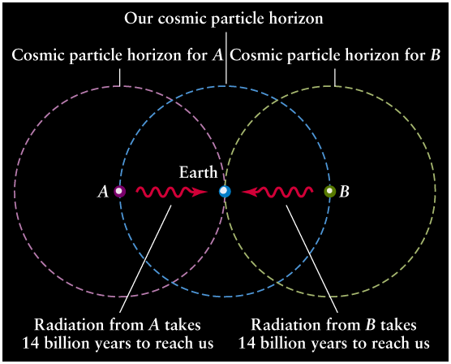
1. The horizon (or isotropy) problem
If the Universe is 13.8 Gyrs old, light has only had this much time to travel.
But light would need 27.6 Gyrs to get from one point on the “horizon” to a point in the opposite direction.
Nothing travels faster than c,
so there could have been no
heat transfer between the two
regions (they are not “causally
connected”) - yet temperature
of CMB is same - they are in
thermal equilibrium.
The observable Universe is too large!

Slide 34
2. The flatness problem
The present Universe has very low curvature (flat or nearly flat) since Ω₀ is close to 1 today.
The equations that describe expanding Universe predict that any deviation from flatness in a Universe filled with matter or radiation will rapidly grow, causing very fast collapse or expansion, with no time for structure formation.
Small deviation from flatness now => immensely small in the early Universe.

Slide 35
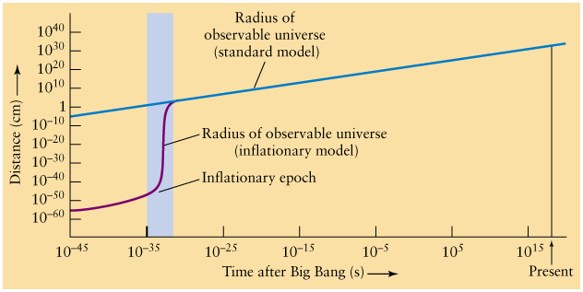
Solution: Inflation
Proposed in 1980’s: a brief period of extremely rapid expansion when Universe was 10⁻³⁵ s old. Lasted ~10⁻³² s, during which the Universe inflated by a factor of ~10⁵⁰ or more. What caused it? Not clear. Involves properties of a hypothesized “scalar field”. Also stretches out any fluctuations in universe to make it very homogenous. Region that inflated may now be ~10⁴⁵ x larger than observable universe. What preceded it? Not clear, but some sort of quantum fluctuations of this field out of which universes can be made (“eternal inflation” and the “multiverse”).

Slide 36
Solves the horizon & flatness problems
Solves the horizon problem: regions not causally connected now were once so, before inflation. Could come into equilibrium.
Solves flatness problem: enormous inflation produces locally flat geometry:
But also, inflation predicted flat geometry before it was discovered!

Slide 37
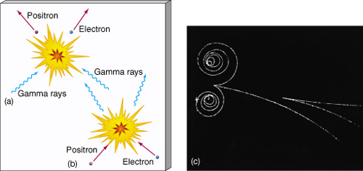
The creation of particles
Inflation also predicts the explosive creation of matter in the
universe when inflation ended. This would be what we thought of as the Big Bang. Quantum mechanics predicts
that even a vacuum has non-zero energy (this is verified in experiments). Inflation represented a huge amount of vacuum energy that was eventually released, leading to enormous creation of particle-antiparticle pairs, which would quickly annihilate into gamma rays. But then gamma rays can create more pairs.

Slide 38
But as universe expanded, any gamma ray made loses energy as wavelength gets longer.
At time > 10⁻⁶ sec, and T < 10¹³ K, gamma rays stopped producing proton-antiproton and neutron-antineutron pairs.
At time > 1 sec, and T < 6 x 10⁹ K, electron-positron pairs stopped forming.
Most matter annihilated producing huge amounts of radiation that we see as CMBR. All matter would eventually disappear, if not for a tiny imbalance (1 in 10⁹) of matter over antimatter that led to a matter universe. This is an example of “symmetry breaking”, which we know happens as a general principle, but we don’t understand this specific event. Remaining free
neutrons decayed into protons (n → p + e⁻ + ν).

Slide 39
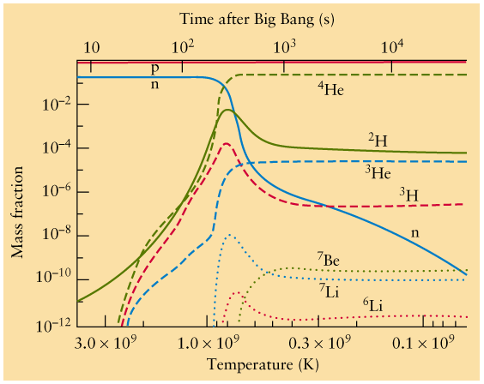
Primordial Nucleosynthesis
(back to stuff that may be on test)
Hot and dense universe => fusion reactions.
At time 100-1000 sec (T = 10⁹ - 3 x 10⁸ K), helium formed.
Stopped when universe too cool. Predicted end result: 75% H, 25% He by mass. Trace amounts of D, Li, Be, B.
Oldest Pop II stars' atmospheres (unaffected by stellar nucleosynthesis) confirm Big Bang prediction of 25% He.
D destroyed by stellar fusion. Presence in oldest atmospheres at predicted level is another victory.

Slide 40
Growth of Structure
In early universe, Heisenberg Uncertainty Principle allows fluctuations in mass and energy to exist. Before era of recombination (380,000 yrs), these could not collapse under their own gravity. But after, they could, so CMBR is an imprint of structure that would then collapse and grow into structures we see today.
Simulations follow the growth of structures, leading to galaxies, clusters, superclusters, Large Scale Structure.
Growth governed by dark matter. Getting structures to grow at the right rate on various spatial scales constrains its nature (and density). Result: must consist mostly of particles moving much slower than c (i.e. not low mass particles like neutrinos but much heavier), otherwise galaxies can’t form. Hence “Cold Dark Matter”. Must include acceleration of expansion. Hence “ΛCDM” models.

Slide 42
Growth of Structure
In early universe, Heisenberg Uncertainty Principle allows fluctuations in mass and energy to exist. Before era of recombination (t=380,000 yrs), these could not collapse under their own gravity. But after, they were able to do so, so CMBR is an imprint of the structure that would then collapse and grow into the structures we see today.
Sir James Jeans (1902) showed how, for gas at a given temperature and density, fluctuations above a critical length or mass (M_{J}) will have enough gravity to overcome the internal pressure and start to collapse.
After recombination, M_{J} ~ 2 x 10⁶ M, about Globular Cluster mass. Small, relatively dense fluctuations closer to this mass would collapse faster. Explains why subgalactic fragments were made before large galaxies, and even larger structures.

Slide 43
Simulations follow the growth of structures, leading
to galaxies, clusters, superclusters, Large Scale
Structure.
Growth governed by dark matter. Getting structures
to grow at the right rate on various spatial scales
constrains the nature (and density) of the dark matter. Result: most of it must consist of particles moving much slower than the speed of light (i.e. not low mass particles like neutrinos but much heavier), otherwise galaxies cannot easily form. Hence “Cold Dark Matter”. Must
also include acceleration of expansion. Hence these
are called “ΛCDM” models.

Slide 44
Misconceptions about the Big Bang
“The universe was once small.” The observable universe, which is finite, was once small. The nature of the entire universe at early times is not yet understood. It is consistent with being infinite now.
“The Big Bang happened at some point in space.” The microwave background showed that it happened everywhere in the universe.
3. “The universe must be expanding into something.” It is not expanding into “empty space”. That would imply the Big Bang happened at some location in space. It is a stretching of space itself.

Slide 45
4. “There must have been something before the Big Bang.” The Big Bang was a singularity in space and time (like the center of a black hole). Our laws of physics say the observable universe had infinitesimally small size, and infinite temperature and density. Fluctuations in mass/energy were enormous, causing such extreme jumbling in space and time (General Relativity) that we can’t pinpoint events in space and time.
In these conditions, we don’t have a physics theory to describe the nature of space and time. At the Big Bang, time took on the meaning that we know it to have.
"Before" is only a relevant concept given our everyday understanding of time. We must await a better understanding of the nature of space and time. Such theories are in their infancy.
Shouldn’t be surprising that these concepts are hard to grasp.
So was the heliocentric Solar System 400 years ago.

Slide 46
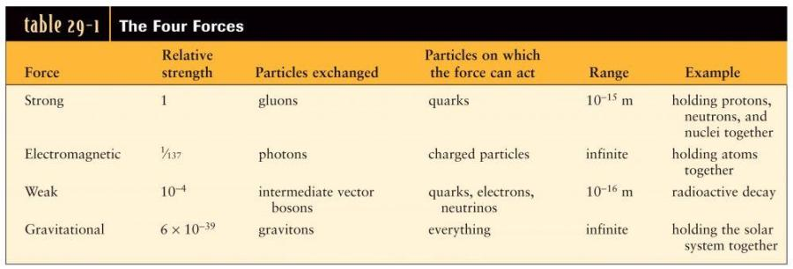
Why should this have happened?
Mediates the forces
All forces believed to be felt by exchange of differing “virtual particles”. At high energies (early Universe) these mediators predicted to become identical: the forces are unified into one. Confirmed by experiment for virtual photons and “intermediate vector bosons” (“electro-weak unification”).

Slide 47
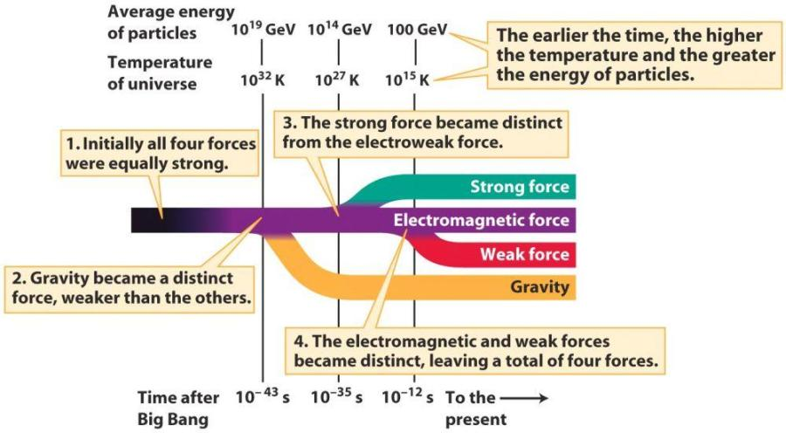
Why should inflation have happened?
Particle accelerator energies
“Theory Of Everything”
“Electro-weak Unification” : verified in 1980’s
“Grand Unified Theories”
Inflation is a predicted consequence of the strong force decoupling from the electro-weak force, but physics is very difficult and not at all well understood.

Slide 48
Particle accelerator energies
“Theory Of Everything”
“Electro-weak Unification” : verified in 1980’s
“Grand Unified Theories”
Each force acquiring a distinct nature as energy dropped involves a “symmetry breaking”. Equations similar to those for phase transitions in matter: e.g. water molecules are randomly oriented, but when T drops and ice forms, it has preferred directions (lattice). For the four forces, symmetry breaking” involves the exchange particles acquiring unique natures.

Slide 49
In early Universe, energies
rapidly dropped to point where
strong force should decouple
from the electro-weak force.
But this transition happens
slowly, leaving the forces unified
at energies when they should have
been distinct. This is an unstable state called a “false vacuum”.
Analogy: water can be rapidly “supercooled” to -20 °C and remain liquid, even though ice would be a lower energy state (water’s latent heat gets released). Likewise, Universe did not instantly move into lower energy “true vacuum” state. False vacuum had enormous energy density (like the water’s latent heat). Supercooled to about 3 K.

Slide 50
Quantum fluctuations caused the Universe to move into the true vacuum state. As it did so it was surrounded by a region of false vacuum, with much lower (negative) pressure. That caused tremendous expansion which is “inflation”. Ended when false vacuum moved to a true vacuum, and the strong force became distinct from the electro-weak force, releasing energy which reheated Universe to 10²⁷ K, and creating all the particles that became today’s matter. Actually, region which inflated predicted to be much larger than observable Universe at all times!

Slide 51
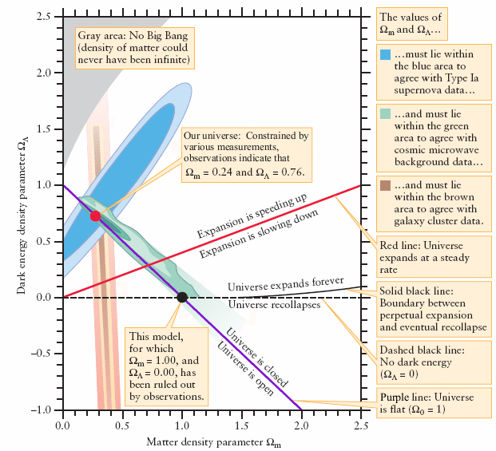

Slide 52
The creation of matter
Energy of a “vacuum”
Heisenberg uncertainty principle for energy and time:
ΔE x Δt = h/2π
Thus, in a short time interval we cannot say how much energy exists in a particular location. Quantum mechanics allows for energy to be created and disappear. The shorter the time interval, the more energy can temporarily exist. Even a “vacuum” has non-zero energy. This has been verified by experiments such as the Lamb Shift.
Because of E=mc², matter can be created too, in “virtual pairs” of
a particle and its anti-particle. Must disappear again in time Δt = h/2πΔE, where ΔE is equivalent energy created. Before inflation (10⁻³⁵ s), these were only particles in existence.

Slide 53
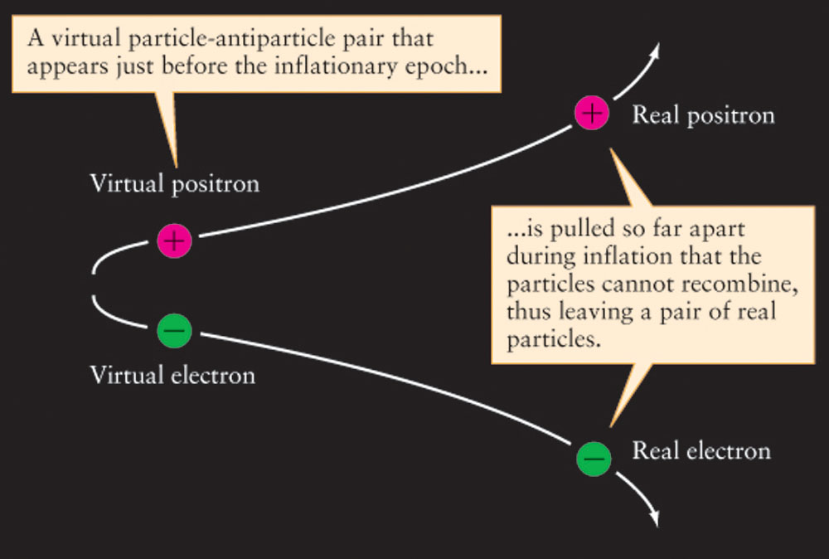
The creation of real particles
Inflation helps to explain where matter comes from.
Before inflation, virtual particle pairs were created and destroyed all the time, in tiny fractions of a second.
But inflation could
separate pairs for good,
into “causally disconnected”
regions, and create real particles from virtual ones.

Slide 54
Now real particles and anti-particles would meet and
annihilate, creating gamma rays. These would meet and
create particle pairs again.

