Slide 1
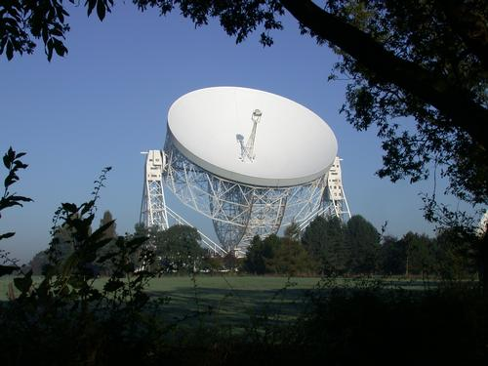
Radio Telescopes
Large metal dish acts as a mirror for radio waves. Radio receiver at prime focus.
Surface accuracy not so important, so easy to make large one.
But angular resolution is poor. Remember:
Jodrell Bank 76-m (England)
angular resolution α
wavelength
mirror diameter
D larger than optical case, but wavelength much larger (cm's to m's), e.g. for wavelength = 1 cm, diameter = 100 m, resolution = 20".

Slide 2
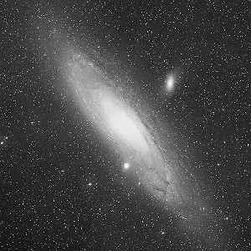
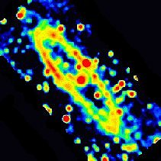
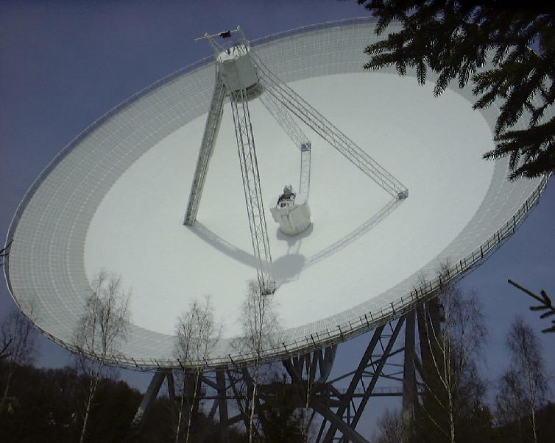
Andromeda galaxy –
optical
Andromeda radio map with 100m Effelsberg telescope

Slide 3
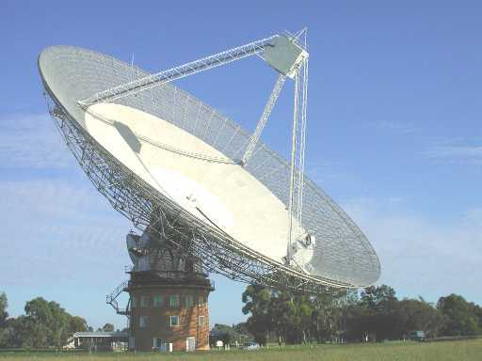
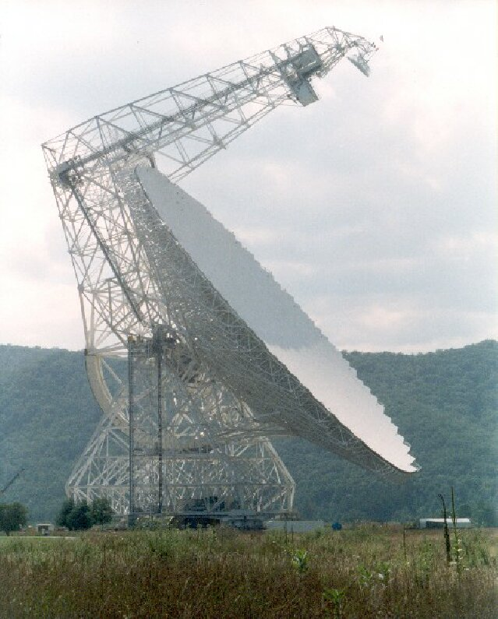
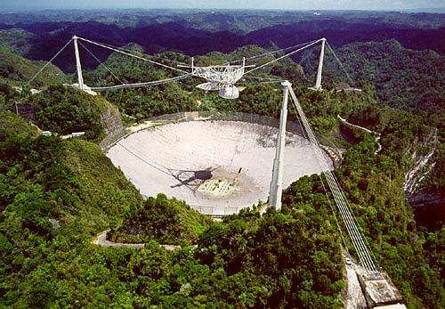
Parkes 64-m (Australia)
Effelsberg 100-m (Germany)
Green Bank 100-m telescope (WV)
Arecibo 300-m telescope (Puerto Rico)

Slide 4
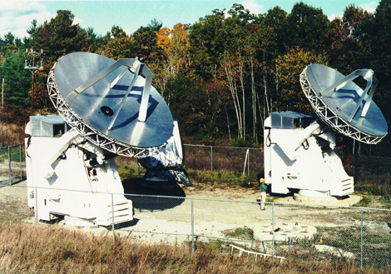
Interferometry
A technique to get improved angular resolution using an array of telescopes. Most common in radio, but also limited optical interferometry.
D
Consider two dishes with separation D vs. one dish of diameter D.
By interfering the radio waves from the two dishes, the achieved angular resolution is the same as the large dish.

Slide 5
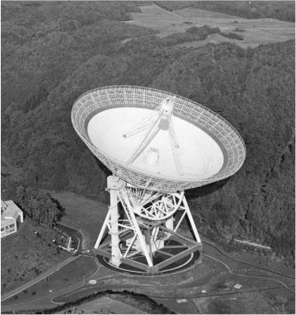
BUT! That resolution is achieved only in direction perpendicular to “baseline”
connecting dishes.
Source shape observed
with single-dish.
Blurred into large
size (λ/D) due to poor
resolution.
True source shape
(size < λ/D)
Source shape observed with East-West baseline. High resolution only in that direction
Source shape observed with North-South baseline. High resolution only in that direction

Slide 6
Also, baseline only sensitive to structure on angular scales of ∼λ/D. For example, if λ/D = 5”, and if source is 1’ across and is perfectly smooth on 5” scales, you get almost zero signal.
λ/D = 5”, almost no signal
1’
5”
λ/D = 5”, good signal
So to be sensitive to structure on all angular scales, need baselines of many lengths.

Slide 7
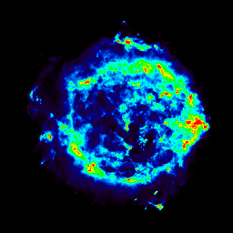
So if your source has structure on many scales and directions, do you need huge number of baseline lengths and angles?

Slide 8
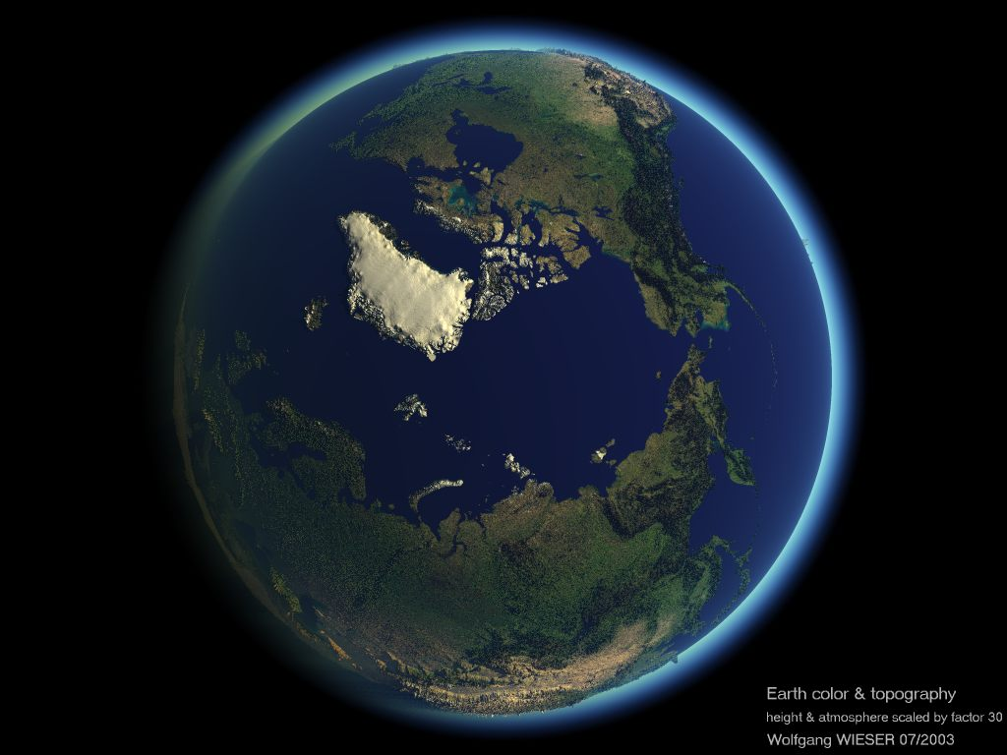
No, can cheat using Earth’s rotation. Consider the perspective of a source above N Pole:
Baseline changes
orientation as
Earth rotates!
Similar for other
Declinations

Slide 9
Also, except right at pole, “projected” baseline length changes as
source crosses sky. Projected length determines resolution.
So each baseline provides a range of projected lengths as
Earth rotates and source moves across sky.
projected baseline
length
projected baseline
length

Slide 10
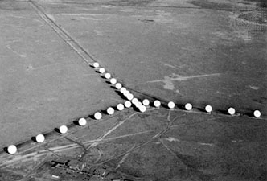
With VLA, get many baseline lengths and orientations over several hours
Result is that you
simulate a filled
dish equal to size
of array. “Aperture
Synthesis”

Slide 11
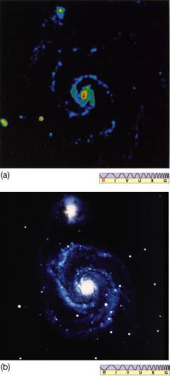
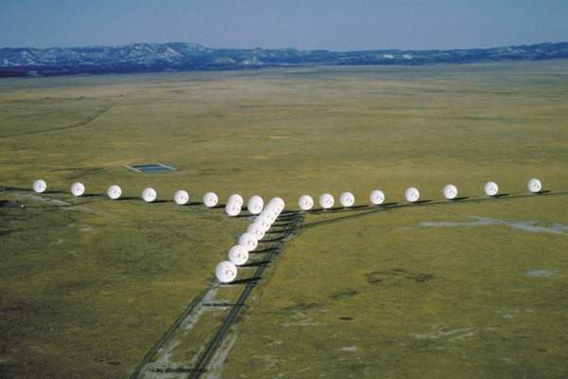
Example: wavelength = 8 cm, separation = 3 km, resolution = 5"
Here, maximum separation of dishes: 1 km. Can separate them up to 36 km.
VLA and optical
images of M51

Slide 12
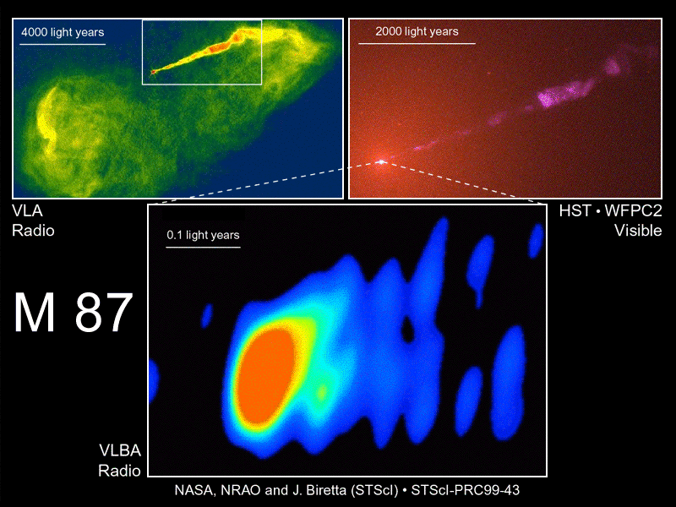
Very Long Baseline Array. Maximum separation 1000's of km
resolution: few arcsec
resolution: 0.05 arcsec
Radio jets from an Active Galactic Nucleus – at center of elliptical galaxy
resolution: 0.001 arcsec!

Slide 13
But note: VLA has resolution but not sensitivity of a single dish of the same size as the array…collecting area much smaller.

Slide 14
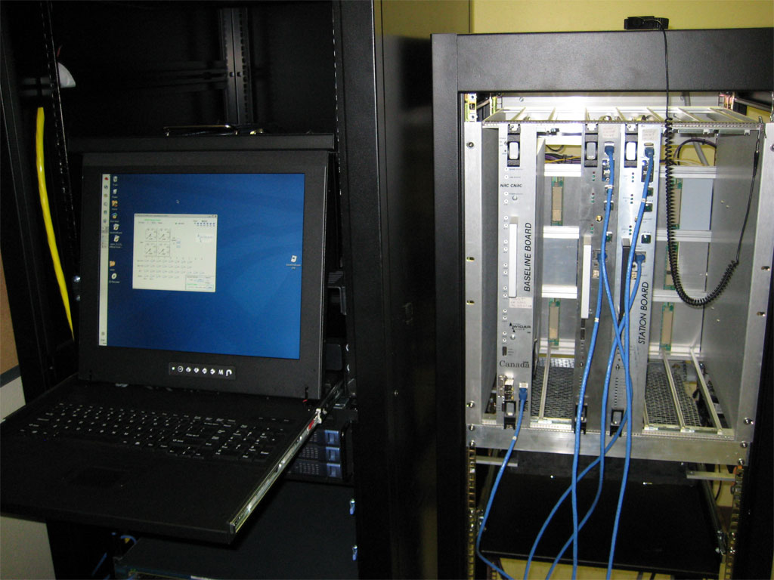
Another area we’ll see is the “correlator room”. The digital correlator consists of many
racks of electronics where the signals from each pair of telescopes is combined.

Slide 15
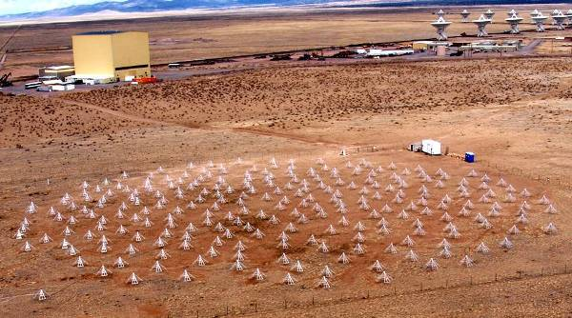
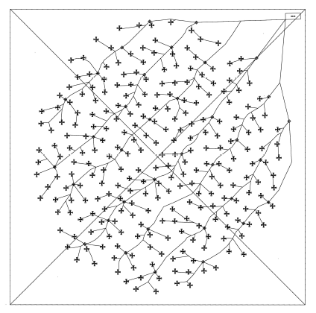
The Long Wavelength Array (LWA) – a UNM-led project
Operates at 10-88 MHz (most VLA work is at 400 MHz – 45 GHz), or 3-30 m wavelengths. For such photons, this “station” of dipole receivers appears as a filled aperture.

Slide 16
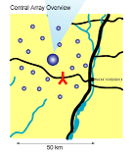
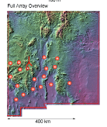
Full array will provide angular resolution of a few arcsec, matching VLA at shorter
wavelengths.
Some science areas (already underway):
Early universe
Radio galaxies
Supernova remnants
Jupiter-like exoplanets

Slide 17
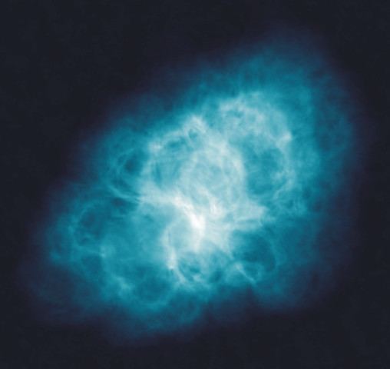
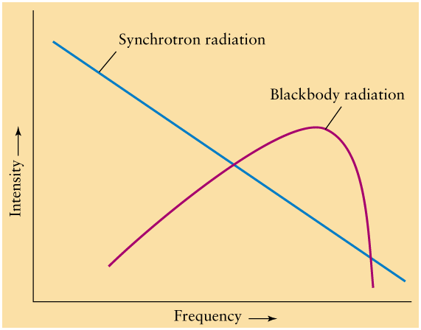
Some objects and types of emission the VLA observes
Synchrotron emission – charged particles in ISM at speeds close to c in presence of magnetic field radiate. Emission often in radio spectrum (and is continuous). Emission falls of steeply with frequency.
Crab Nebula – Supernova Remnant

Slide 18
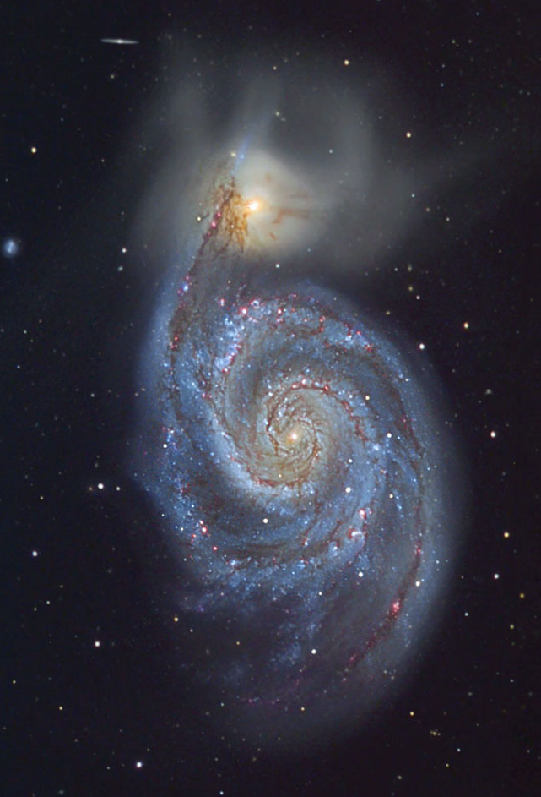
Synchrotron emission from Messier 51

Slide 19
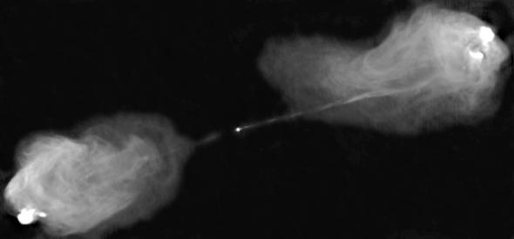
Cygnus A radio galaxy – again synchrotron emission

Slide 20
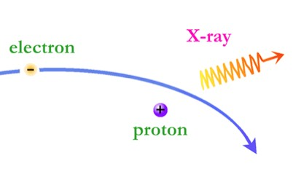
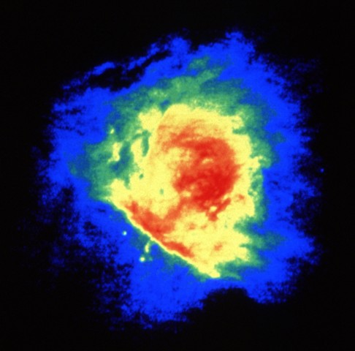
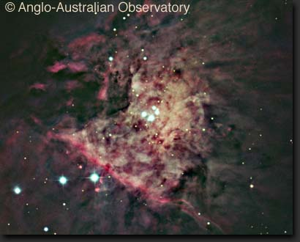
Bremsstrahlung – braking radiation. Emission is continuous but fairly constant with
frequency in radio regime.
radiation
Orion in optical (left) and radio (20 cm; above)

Slide 21
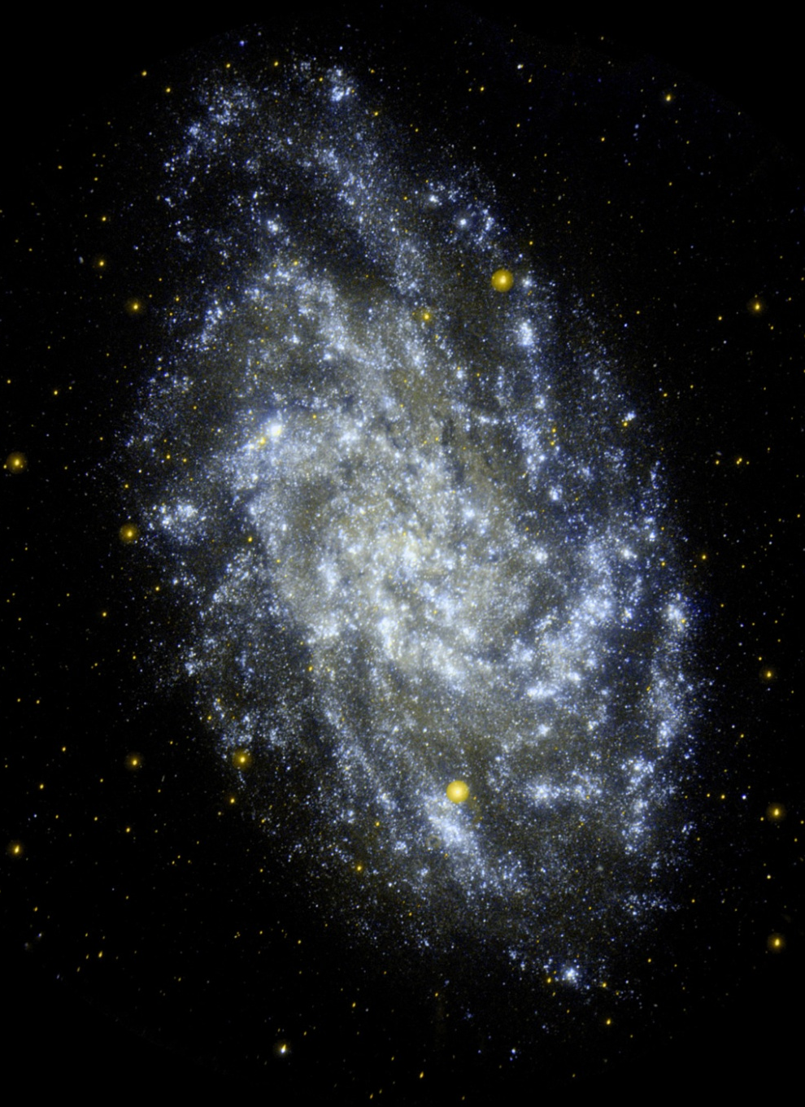
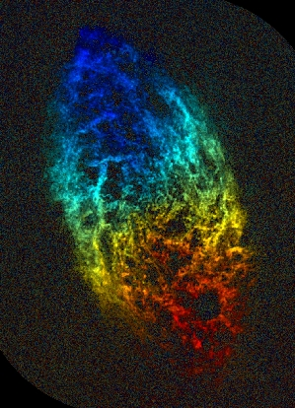
Spectral line radiation – 21 cm
Messier 33 – 21-cm emission
color-coded by Doppler shift
Messier 33 – optical

Slide 23
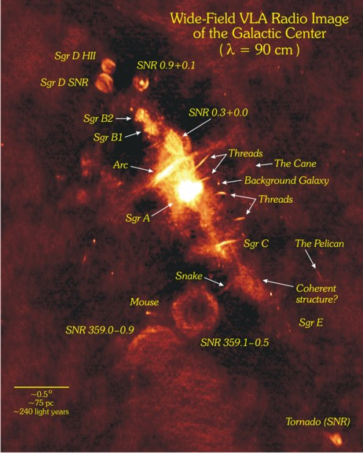
Galactic center – supernova remnants, filaments, Sgr A* - marks the massive black hole.
90 cm is the longest wavelength the VLA observes

Slide 24
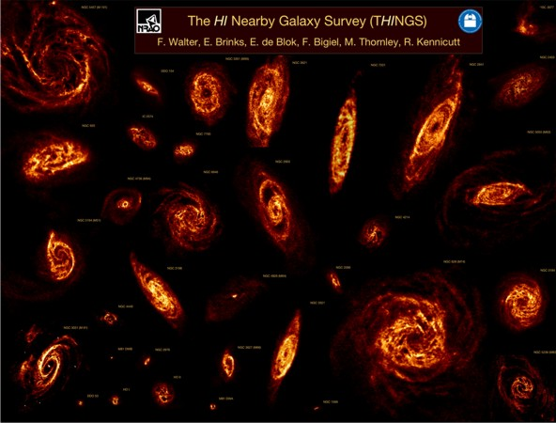
Also Sun, planets, stars, pulsars, many other types of object

