Slide 1
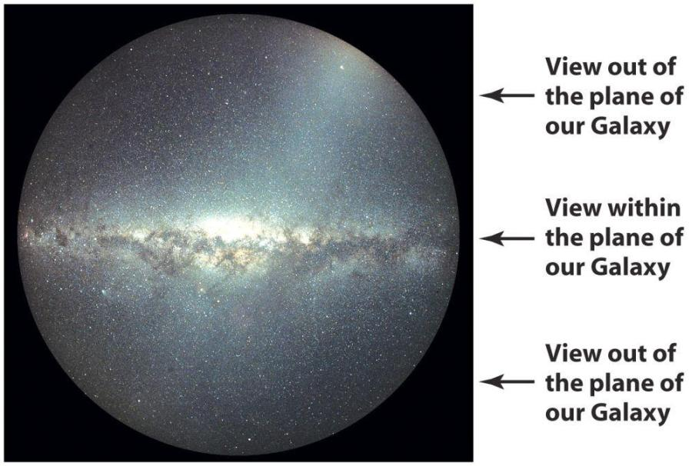
The Milky Way - Chapter 22

Slide 2
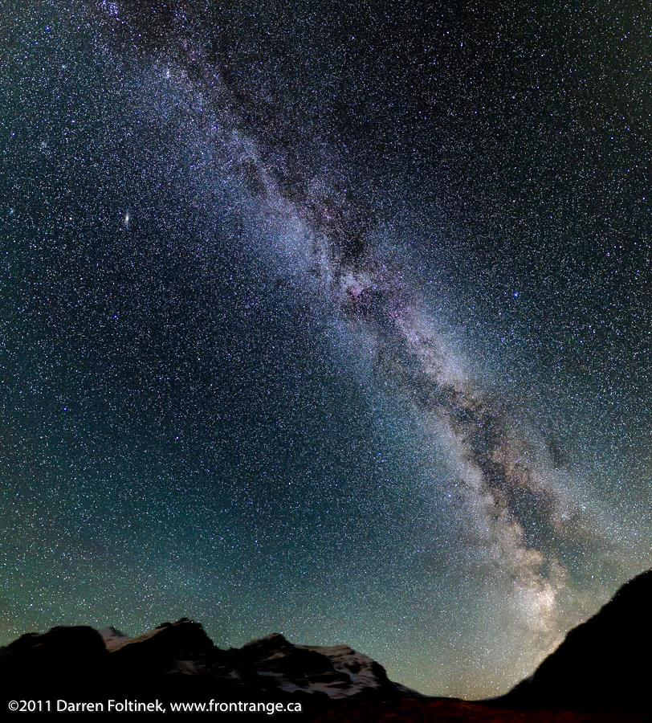
Best seen around August, running NE to SW

Slide 3
The Milky Way Galaxy
A galaxy: huge collection of stars (few 100 up to ∼ 10¹⁴!), interstellar matter (gas & dust), and dark matter, held together by gravity. But there is no accepted formal definition of a galaxy!
Our galaxy: the Galaxy, or the Milky Way.

Slide 4
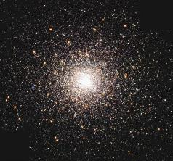
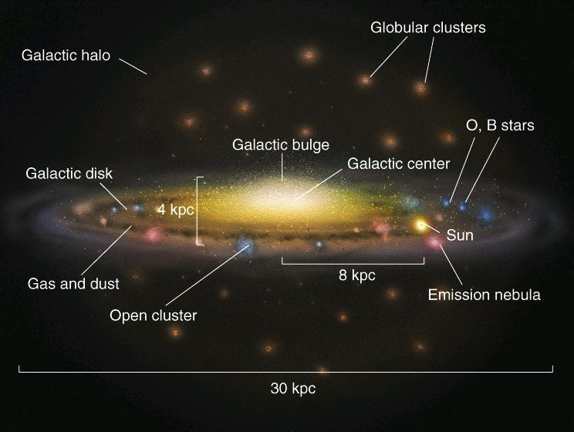
Take a Giant Step Outside the Milky Way
Artist's Conception (optical light)
Example (not to scale)

Slide 5
Disk: young and old stars, gas and dust, ongoing star
formation. Stars have relatively high “metal” content because
most formed out of ISM “enriched” by fusion in previous generations of stars (“Population I” stars). This is where most stars are (~1-4 x 10¹¹).
Halo: oldest stars (13 Gyr or so).
Globular clusters account for 1%
of halo stars. Low metal content
(“Population II” stars). Only
several billion stars. Little gas.
Bulge: several billion stars – mostly old. Not as prominent as shown. More like 1 kpc across and 600 pc vertical extent.
(not shown: dark matter, also in a quasi-spherical halo form,
larger than stellar halo).

Slide 6
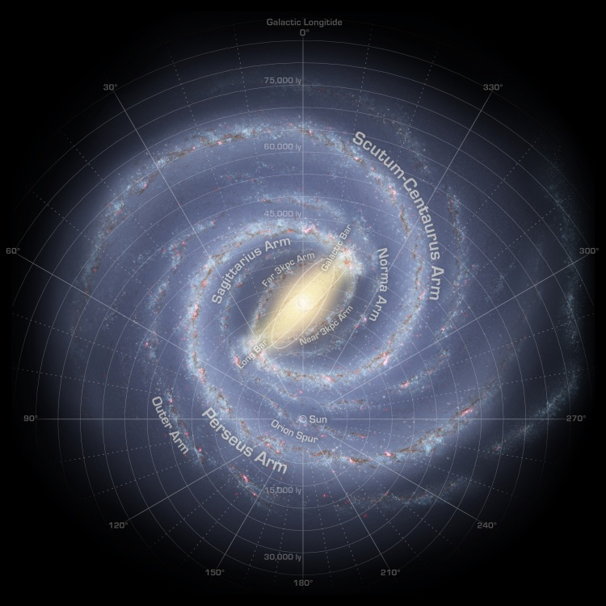
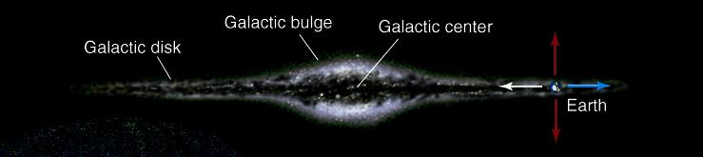
From above (face-on)
see disk, which features spiral structure and a bar, and bulge (halo too faint)
Sun
From the side (edge-on)

Slide 7
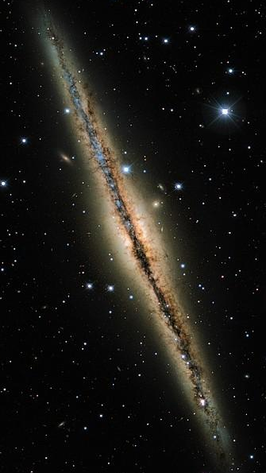
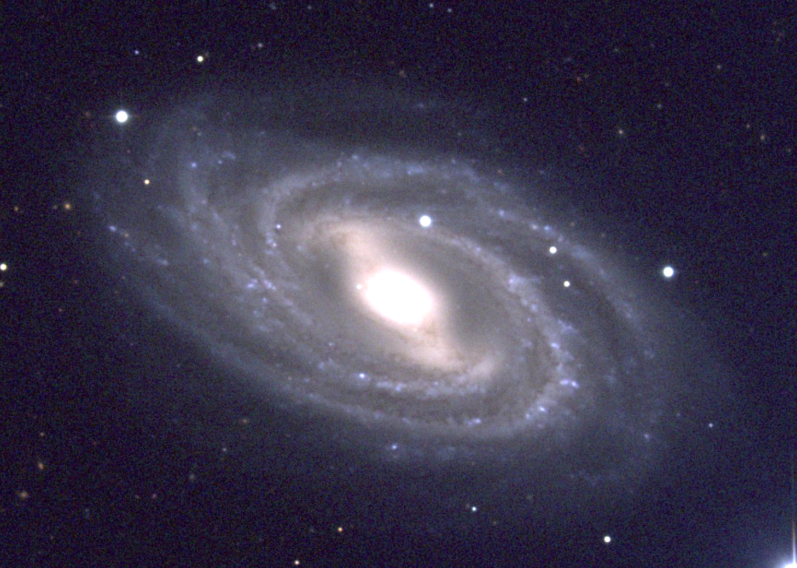
Galaxies roughly resembling the Milky Way
Messier 109
NGC 891

Slide 8
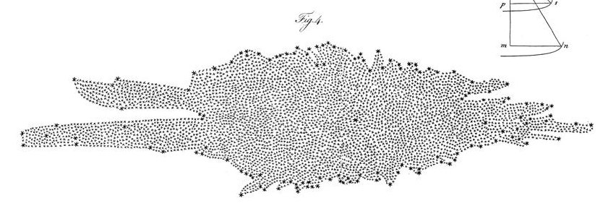
Historical measurements of the size and shape of Milky Way
First attempts by Caroline & William Herschel (1785) and Kapteyn (1922) by counting stars through telescopes.
Both found MW is a flattened structure. But both put the Sun near the center. Studies limited by small telescopes, lack of understanding of extinction by dust, and (in Herschels’ case) no stellar distances had been determined. Kapteyn inferred MW only 17 kpc across.
This was before spiral structure known, or that some “nebulae” were galaxies beyond MW.
Herschel’s drawing of
the Milky Way (side view)
Sun

Slide 9
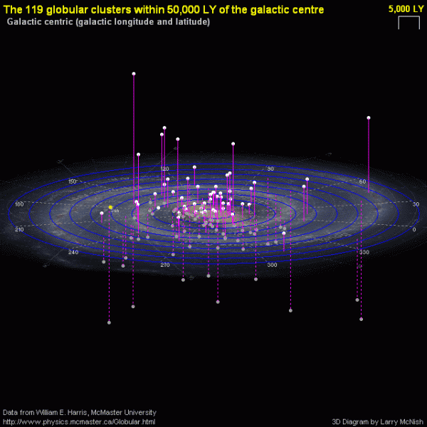
Shapley – Globular Clusters
Shapley (1915-21) used globular clusters:
  Uniformly distributed above & below the MW plane.
  He found they had large distances (next slide).
  Assumed they formed a system centered on center of MW.
  Noted a concentration toward Sagittarius. Inferred center was in that direction.
Sun

Slide 10
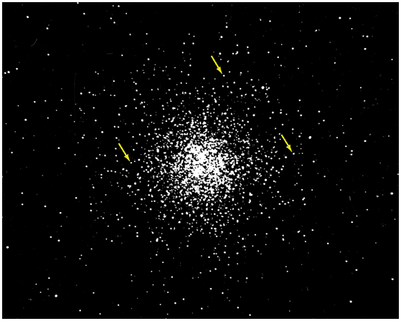
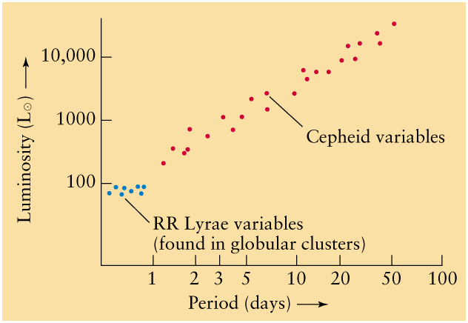
Shapley used RR Lyrae variable stars in globular clusters to determine their distances and thus size of the MW and our distance from center.
RR Lyraes:
- Easy to spot, and all have same luminosity
  - Periods of several hours
  - Evolved low mass (HB) stars, thus older than Cepheids
Still no dust correction!
Found Sun 16 kpc from center. Modern value 8 kpc.

Slide 11
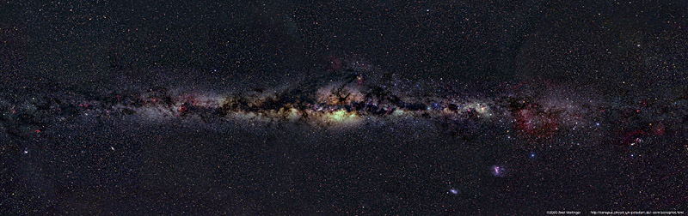

Nowadays use near-IR imaging to better probe stellar structure of MW. Near-IR penetrates dust better, reveals true stellar distribution better, including disk, bar and central bulge.
Optical
2 micron (2MASS survey)

Slide 12
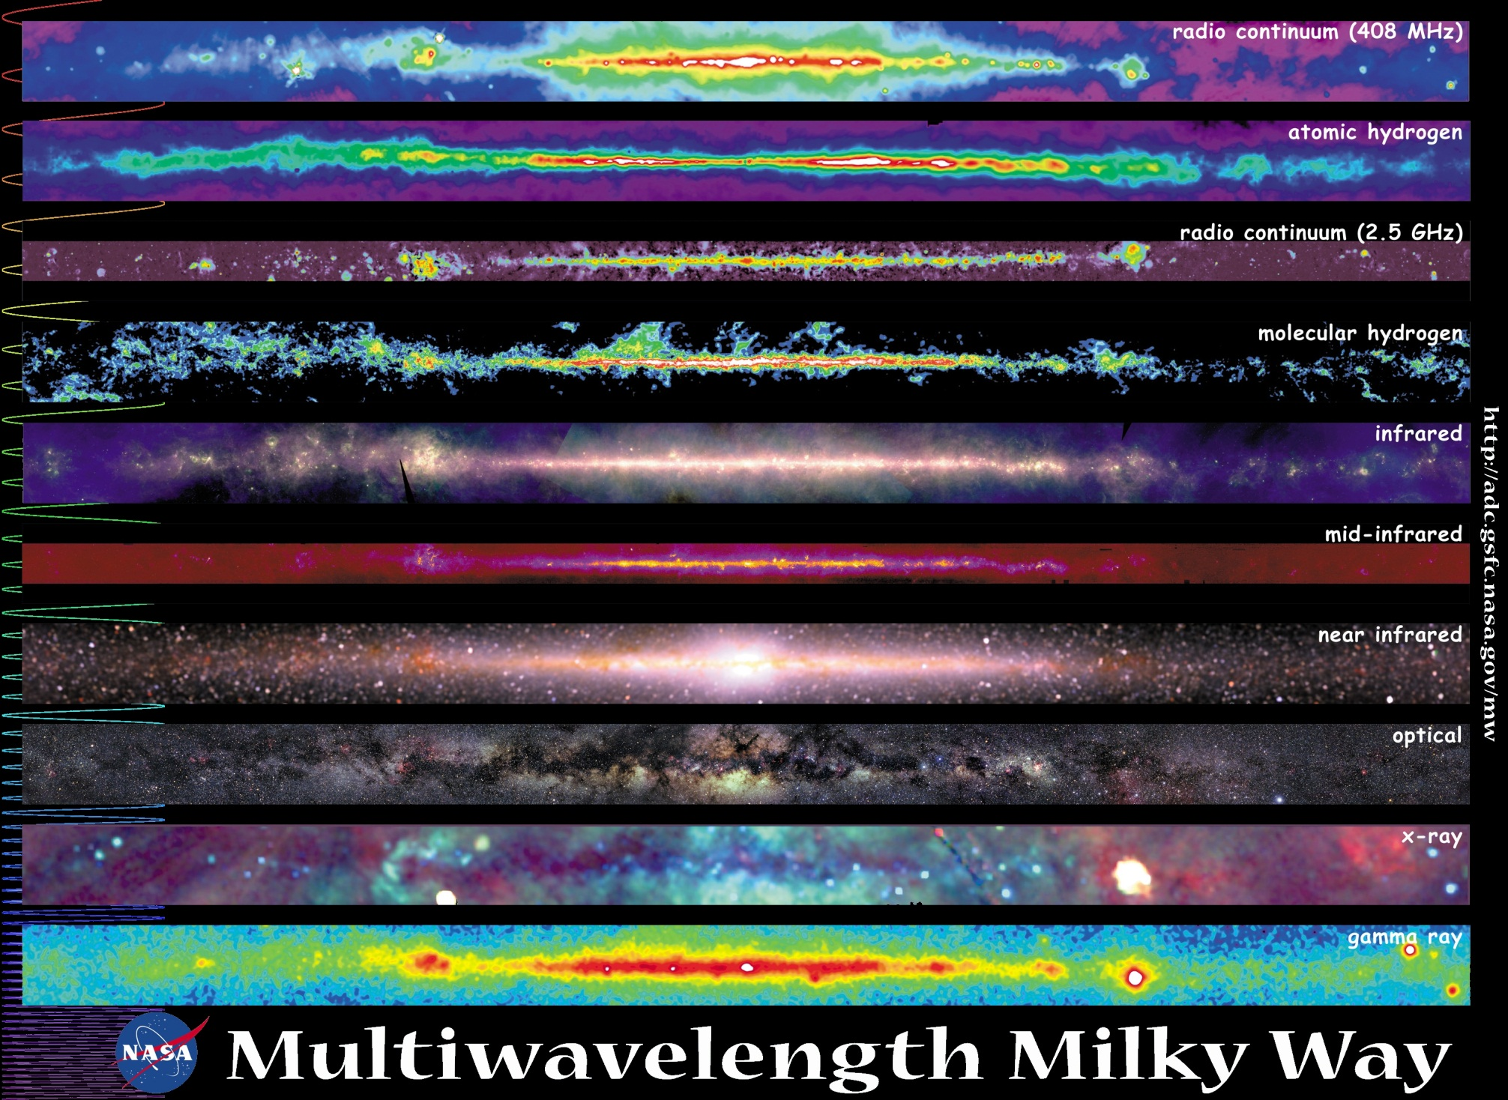
Milky Way appears very different depending on wavelength or physical component observed
90°
Galactic latitude (b)
180° 90° 0° 270° 180°
Galactic longitude (l)
-90°

Slide 13
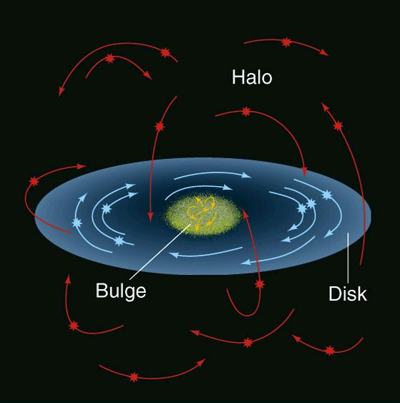
Orbits
Halo: stars and globular clusters swarm around center of Milky Way. Very elliptical orbits with random orientations.
Bulge: similar to halo.
Disk: stars, gas, dust rotate.

Slide 14
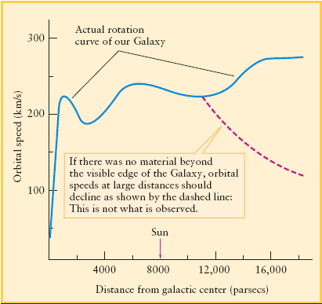
Rotation of the Disk
Sun’s rotation speed 225 km/sec. An orbit takes 240 million years. Objects with known distances at other radii, and measured Doppler Shifts, used to define “rotation curve”.
Orbital period increases with radius => rotation not rigid. Rather, "differential rotation".
Over most of disk, rotation velocity is roughly constant.
The rotation curve of the Milky Way
If V=const, how does period depend on R?

Slide 15
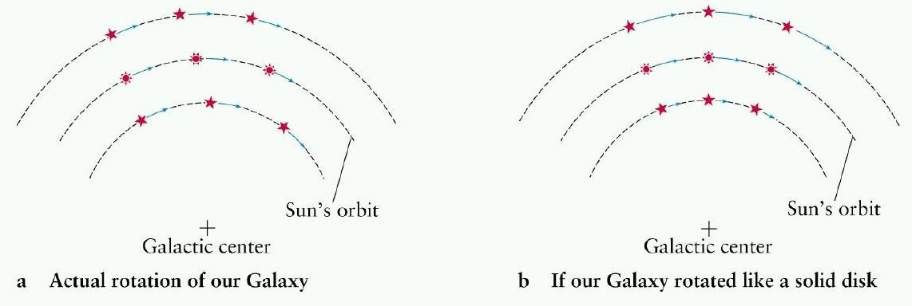

Slide 16
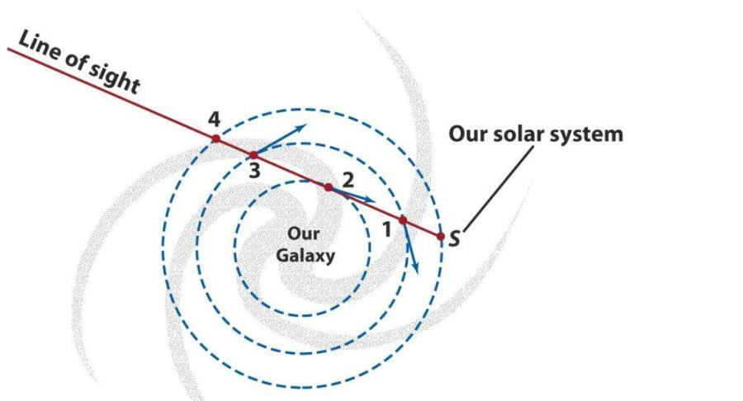
Once rotation curve known, can use it to measure distances to other objects in disk (“kinematic distances”) => determine distribution of various components, e.g.:
Stars, from Doppler shifts of stellar absorption lines.
Ionized gas, via emission lines from HII regions.
Atomic gas, via the 21-cm line.
Molecular gas, via lines of CO and other molecules
e.g. assume V=const at all R, and circular orbits, how will Doppler shifts of stars at 1, 2, 3 and 4 compare?

Slide 17
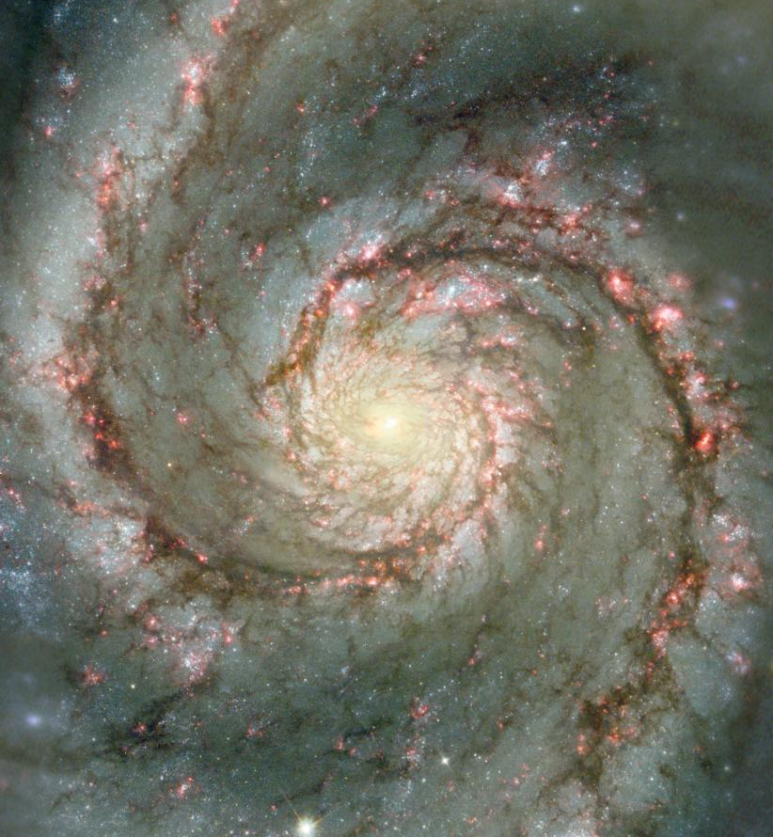
Spiral Structure of Disk
Most big galaxies are spirals. Spiral arms best traced by:
Young stars and clusters
Emission Nebulae
Atomic gas
Molecular Clouds
(old stars to a lesser extent)
Disk not empty between arms, just less material there.
Inner disk of M51 with HST – note dust lanes, HII regions, young blue clusters concentrated to arms.
Recall: disk has “differential rotation”, not rigid-body.

Slide 18
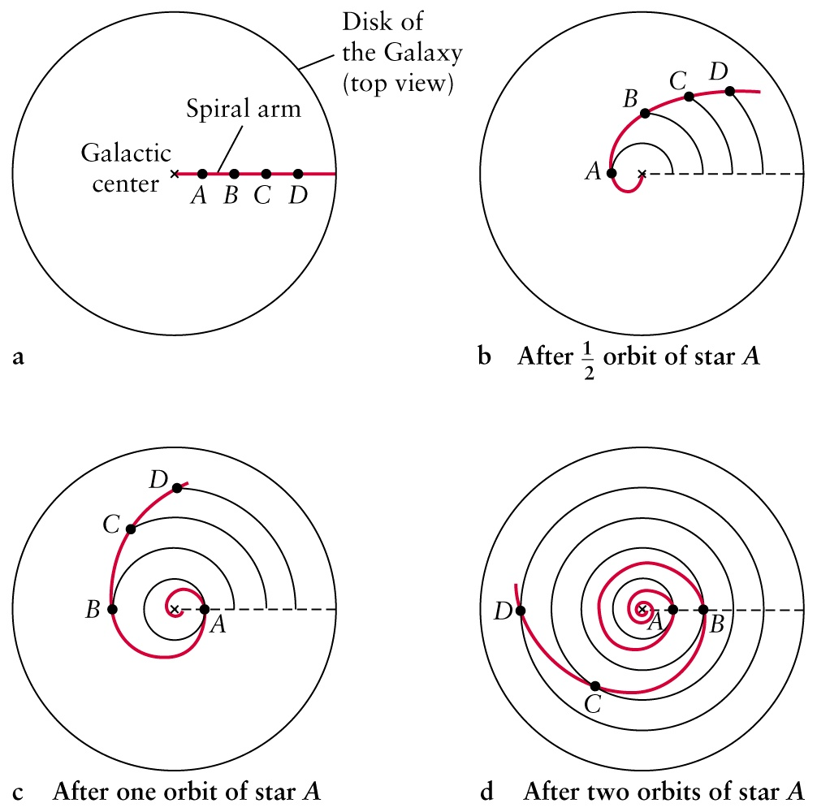
Problem: How do spiral arms survive?
Given differential rotation, if arms always contain same material, should be stretched and smeared out after a few revolutions (Sun has made 20 already):
The Winding Dilemma

Slide 19
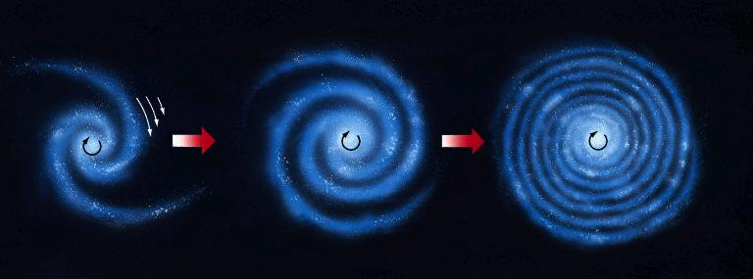
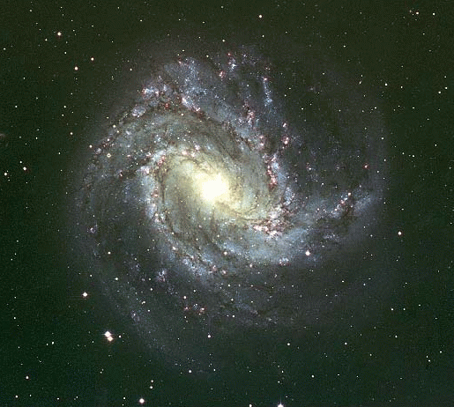
So if spiral arms always contain same material, the spiral should end up like this after just a few orbits:
Real structure of Milky Way (and other spiral galaxies) is more loosely wrapped.

Slide 20
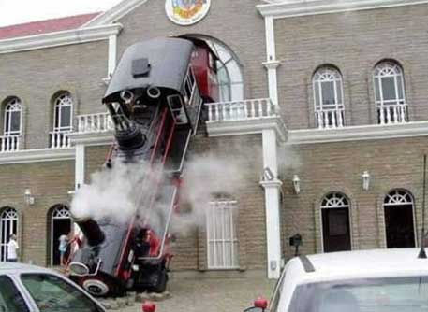
Proposed solution:
Arms are not material moving together, but mark peak of a compressional wave circling the disk:
A Spiral Density Wave (Lin & Shu 1964)
Traffic-jam analogy

Slide 21
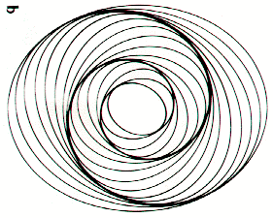
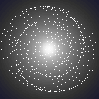
Replace cars by stars (ignore gas clouds for now). Traffic jams are due to the stars' collective gravity: higher gravity of jams makes star orbits crowd together, which in turn maintains the enhanced gravity –> self-perpetuating. Calculations and simulations suggest this may be maintained for a long time. How must orbits be arranged to make spiral shaped compression?
Traffic jam on a loop caused by merging
circular traffic jam simulation
Not shown: whole pattern rotates slowly.
Rigidly? Can it survive for billions of years?
Waves may be transient and recurrent.
Another animation

Slide 22
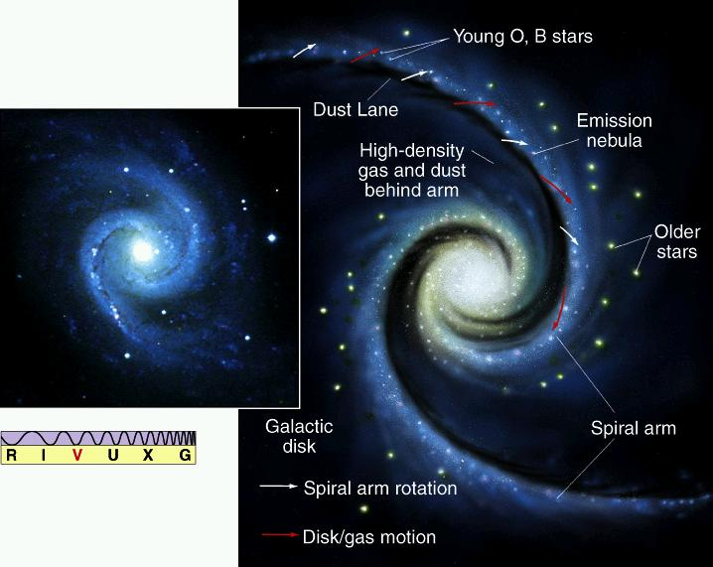
HII regions and young, blue clusters form
dust lane – gas and dust pile up
Gas clouds pushed together in arms too => high density of clouds => high concentration of dust => dust lanes.
Also, squeezing of molecular gas clouds initiates collapse within the denser ones => star formation. Bright young massive stars live and die in spiral arms. Emission nebulae mostly in spiral arms (animation).
So arms always contain same types of objects, but individual objects come and go.

Slide 23
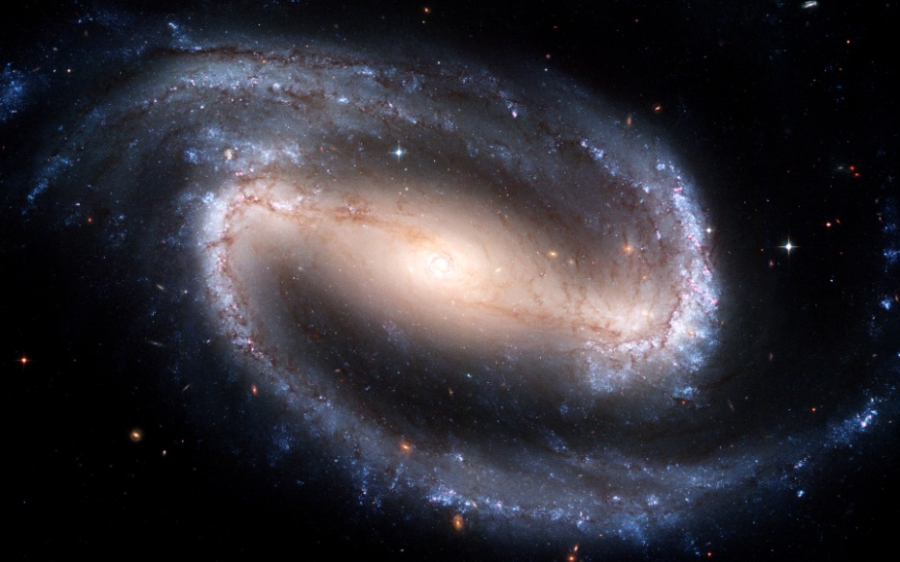
A bar is a pattern too, like a spiral.
Bar simulation

Slide 24
Estimating the mass of the Galaxy, and Dark Matter
Most radiating matter runs out
at about R=12 kpc.
Rotation speed there is
V = 225 km/s.
Use Newton’s laws to deduce mass
within this radius.
v
R
GC

Slide 25
For object moving at speed V in a circular orbit of radius R the acceleration is:
If a small mass m orbits a mass M (e.g. Earth and Sun), with centers separated by R, then from Newton’s second law, F=ma, along with law of gravitation,
But in a galaxy, M is extended in radius, and m is within it. For a spherical mass distribution, Newton showed you can ignore mass outside R, and treat mass inside R as all being at the center. So if M_{int}(R) is the mass of the Galaxy within R, then,
int

Slide 26
Putting in numbers, we get the mass within R=12 kpc.
M (12 kpc) ∼ 10¹¹ M
Little radiating material beyond R∼12 kpc. But is there significant mass beyond 12 kpc? First, rearrange:
int
int
int
If almost all mass within 12 kpc, then for the few stars and gas clouds beyond 12 kpc, M ∼ const., and thus:
int

Slide 27
This is Keplerian motion (as for the planets). But recall rotation curve for Milky Way:
Stays flat instead of Keplerian out to at least 16 kpc (may even rise a bit). So M_{int}(R) must grow with R. But this matter is not radiating! (Other spirals: same result).

Slide 28
Dark Matter
Needed to explain flat rotation curve. Inferred by its gravity, even though it does not radiate. Inferred to be a quasi-spherical halo via various observations.
Total mass of Milky Way from V at largest R we have measured is at least ∼10¹² M.
Only about 5% is radiating normal stuff, e.g., stars, gas, dust.

Slide 29
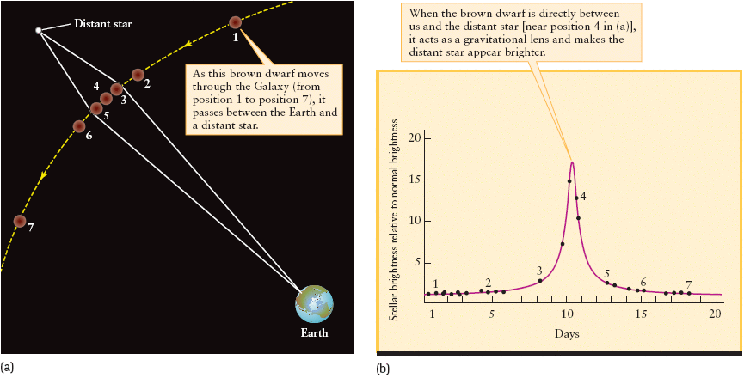
What is dark matter?
Some consists of dim objects (brown dwarfs, white dwarfs, neutron stars, black holes, i.e. “MACHOs”), but not all. Limits on this from “gravitational microlensing” in the halo. Result: few to 20% of dark matter at most.

Slide 30
Most is likely to be an as yet unidentified particle(s). A small amount is in neutrinos.
True nature is not yet known – but this material is most of the mass of the Universe.

Slide 32
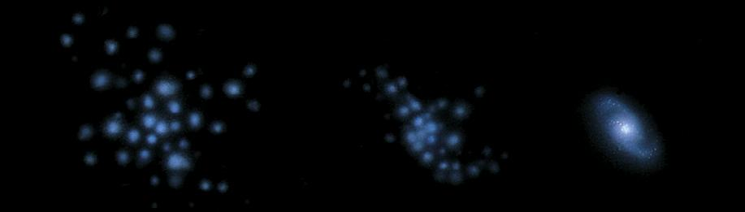
How did the Milky Way form?
Halo – spherical and oldest – formed first (13 Gyr ago). Oldest disk stars younger – formed later.
Deep observations reveal other galaxies in their youth. They suggest first things to form are “sub-galactic fragments”. Many come together to form large galaxy. Initially, assemblage of fragments rotates slowly. Star formation in them creates halo.
Nearly spherical distribution with highly elliptical orbits. Low metals, due to “clean” gas.

Slide 33
With time, remaining gas loses energy by radiation, collapses, and spins up into a rotating disk.
Stars that form in the disk are younger and have coplanar orbits with primarily circular motions.
High metals, due to enriched gas from previous star formation.

Slide 34
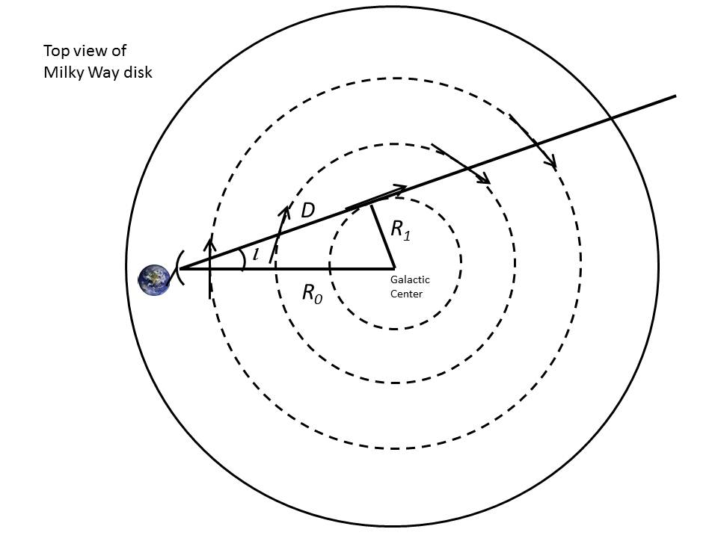

Slide 35
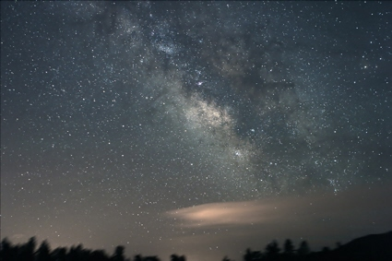
Interactive version

Slide 36
Herschel: first measurement of size and shape of Milky Way
Caroline & William Herschel (1785) counted stars along 683 lines-of-sight and estimated apparent brightnesses. No stellar distances then known.
Assumptions: all stars same luminosity (gives distance) and that they could see to the edge. Concluded MW flattened, Sun near center. This is before spiral structure known, or that galaxies existed beyond MW.

Slide 37
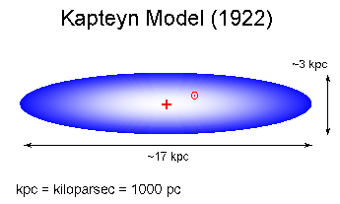
Kapteyn: photographic counts
Early 1900s: estimated distances statistically based on known luminosities of nearby stars. Still before it was known that some nebulae were galaxies beyond MW.
=> MW is a ~17 kpc flattened disk, ~3 kpc thick with Sun slightly off-center.
What did Herschel and Kapteyn neglect?
Interstellar extinction by dust

