Slide 1
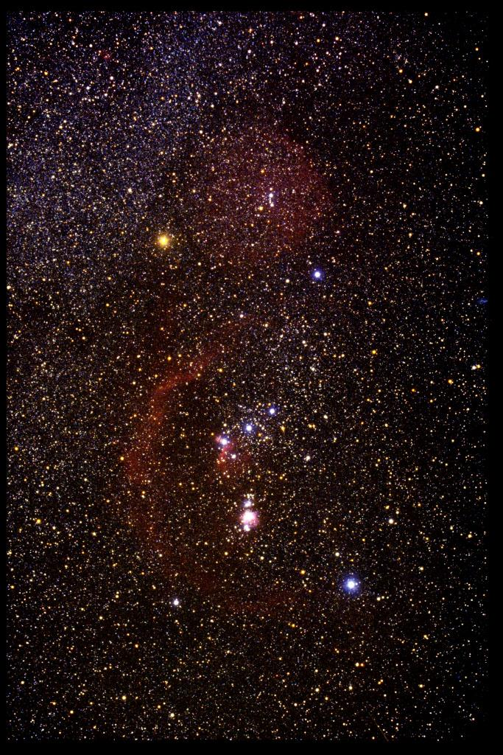
How to Understand Stars Chapter 17
How do stars differ? Is the Sun typical?
Image of Orion illustrates:
The huge number of stars
Colors
Interstellar gas
How can we describe/classify stars?
Location
Temperature
Luminosity
Mass
Evolutionary state
Physical size
Composition
True motion in space
Environment
To estimate most parameters, we need to know the distance!

Slide 2
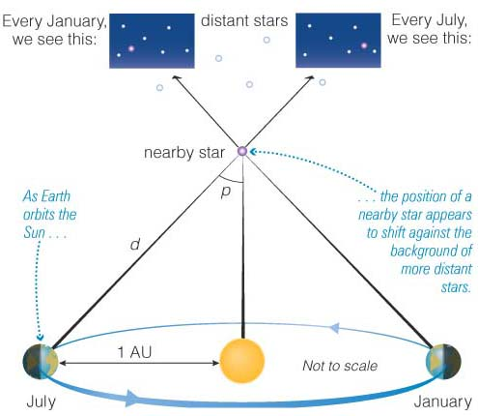
Location in space
Two dimensions are easy – measure angular position from image.
Distance not so easy, the only direct means is by parallax. Other methods later.
Reminder: parallax is the apparent angular shift of an object due to a change in an observer’s point of view. In general, a star will appear to follow an elliptical path over a year.
Notes:
What motion does a star make on the sky over the course of a year? Is this a real motion,or an apparent?

Slide 3
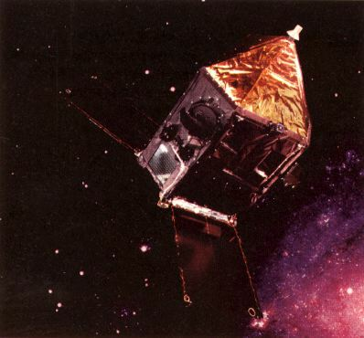
How parallax relates to distance
Remember, a star with a parallax of 1” is 1 parsec (“parallax of one arcsecond”) away
where p is the parallax angle and d is the distance.
Distance units: 1 pc = 3.26 ly = 3.09x10¹⁶ m = 206,265AU
First done in 1838.
d (pc) =
1
p(”)
Limitations
Until the 1990’s we only knew accurate (0.01") parallaxes for a few 100 stars (=> d~100pc)
In the 1990's the Hipparcos satellite measured over 100,000 parallaxes with an accuracy of 0.001"
This is still a small portion of the Galaxy

Slide 4
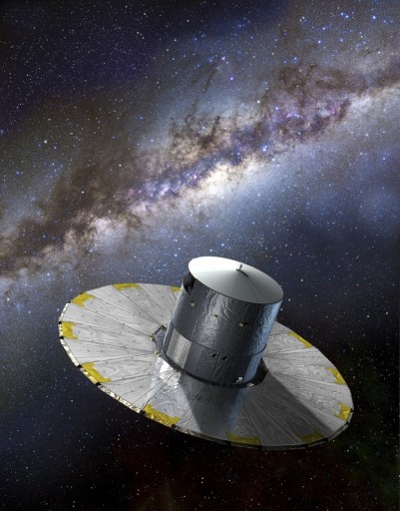
Gaia
Launched in 2013 (European). Follow up to Hipparcos, all-sky survey instrument. Aims to measure parallaxes for a billion stars with 20 μas accuracy. Will also measure colors, radial velocities, and (see next slide) proper motions. http://sci.esa.int/gaia/

Slide 5
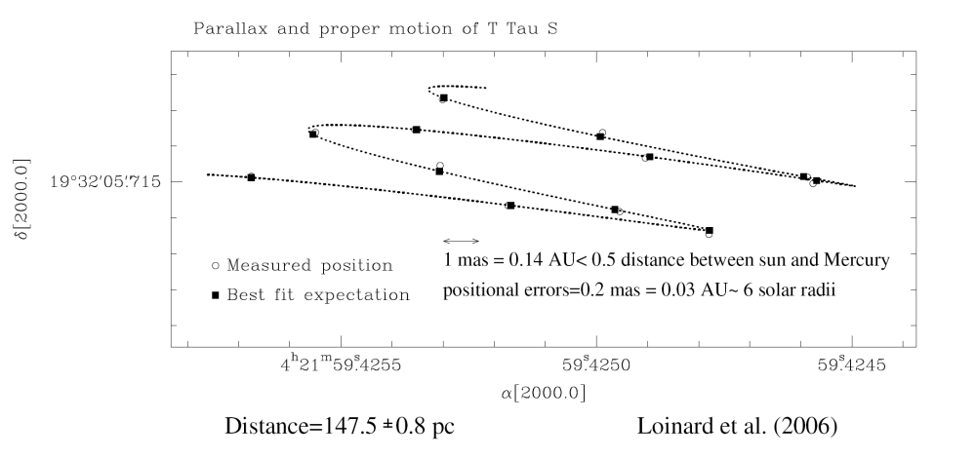
Proper motion
Caused by movement of a star relative to the Sun (in contrast to parallax which is an apparent motion of star due to Earth’s motion). Hard to measure for distant stars.
Proper motion is the angle in arcsec a star moves per year
The superposition of this linear motion and the elliptical motion from the parallax effect leads in general to a helical path on the sky (if both motions can be detected).
Barnard’s Star moving 227” over 22 years - a huge proper motion of 10.3”/yr.
Notes:
More distant stars tend to have small proper motions, but a small proper motion doesn't necessarily mean a large distance!

Slide 6
Tangential velocity
v_{t} = 4.74 μd, where μ is proper motion [”/yr], d is distance [pc], and v_{t} is in units of km/s.
Radial velocity
Given by Doppler shift:
v_{r} = [(λ_{observed} - λ_{emitted}) / λ_{emitted} ] c
Depends on distance
Independent of distance

Slide 7
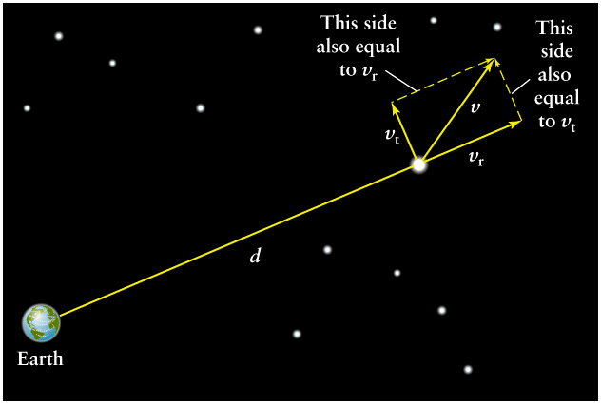
Space Velocity (relative to the Sun, which is also moving through space)
Speed and direction of star. From Pythagorean theorem
θ
Typical space velocities are 20-100 km/s for nearby stars.
Thus, three quantities need to be measured to get space velocity.
Can also measure direction of motion relative to
the line of sight, from
θ = arctan (v_{t}/v_{r})

Slide 8
Why care about stellar motions?
A tool to learn about stellar properties and structure and dynamics of our Galaxy, even to reveal unseen objects:
Motion of the Sun
Rotation of the Galactic disk
Binary stars – masses of stars
Masses of clusters of stars
“Stellar streams”
Unusual stars
e.g. Stars orbiting an unseen mass at the center of the Milky Way:
http://www.astro.ucla.edu/~ghezgroup/gc/animations.html

Slide 9
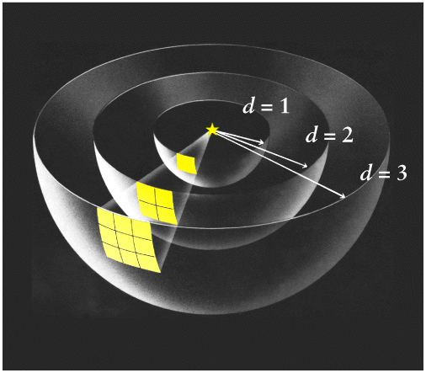
Reminder of Luminosity, Incident Flux
(Box 17.2)
Luminosity (L, intrinsic property): the total energy output, a physical property of the star. Doesn't depend on distance. Units J/s or W.
Apparent brightness or incident flux (b, or F_{i}): measures how bright a star appears to be. Does depend on distance! Units W/m².
The incident flux diminishes as the inverse square of the distance.
F_{i} = L / 4πd²

Slide 10
Apparent magnitudes
Logarithmic (base 10) measurement of apparent brightness (incident flux) of stars. Modern scale a refinement of Hipparchus’ original scale of magnitudes 1-6. Used mostly in optical astronomy (also near-IR, UV).
A difference of 5 magnitudes implies a factor of 100 in apparent brightness. Smaller magnitude means brighter star!
Magnitude difference related to brightness ratio:
So if , then
This is a logarithmic and relative scale – zero point arbitrarily chosen.

Slide 11
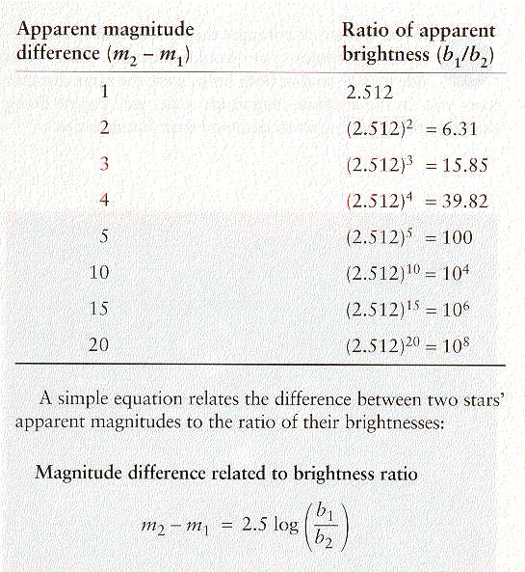
Or solve for brightness ratio in terms of magnitudes:
$$\frac{b_{1}}{b_{2}}={10}^{\frac{m_{2} − m_{1}}{2.5}}$$

Slide 12
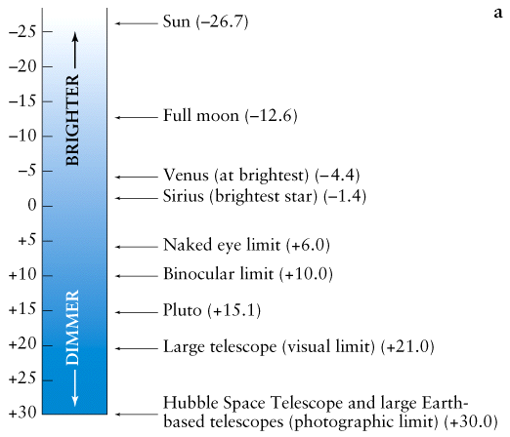
The apparent magnitude scale - some examples:

Slide 13
Absolute magnitude
Caution:
Apparent magnitude is NOT luminosity! A star may have bright (small) apparent magnitude because it is close to us, or because its luminosity is high.
We want a brightness scale that takes distance into account and measures luminosity, an intrinsic property of star.
Absolute magnitude:
Definition: the apparent magnitude a star would have if it were precisely 10 pc away from us. Call this M. Then, for two stars with luminosities L₁ and L₂, the difference in their apparent magnitudes at 10 pc would depend only on the ratio of their luminosities:

Slide 14
Zero point again arbitrarily chosen. Examples:
M Star
-5.6 Betelgeuse
1.3 Sirius A
+4.7 Sun
+8.6 Sirius B
Given this definition, the inverse square law is expressed in
magnitudes by:
m is apparent magnitude (measured)
d is distance in pc
M is absolute magnitude

Slide 15
Distance modulus
Instead of giving an object's distance, we sometimes speak of its “distance modulus” m - M
m – M Distance
0 10 pc
10 1000 pc
15 10,000 pc
Note these magnitudes do not refer to any wavelength or color. But it is
in practice difficult to measure a star’s light over entire spectrum. Typically
observed through a filter that lets in, e.g., blue, red, infrared, UV, etc. light.

Slide 16
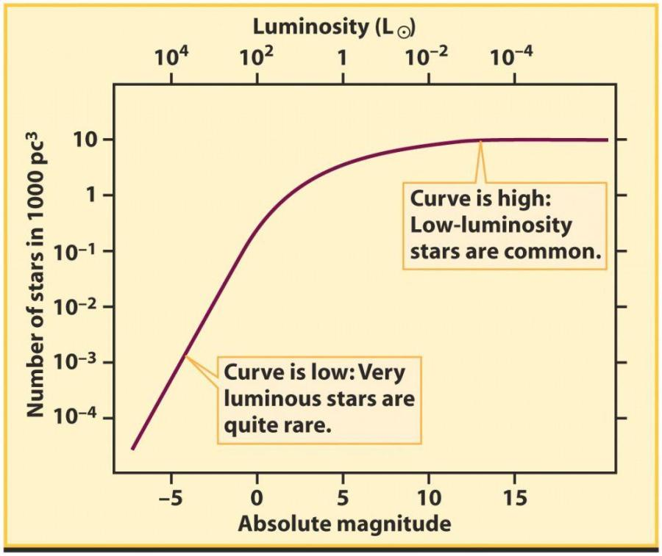
Luminosity function
A function you can examine once you have distances to many stars
Describes the relative numbers of stars with different luminosities
Note the enormous range in luminosity
There are more faint stars than bright. Why?
Determined in Solar neighborhood

Slide 17
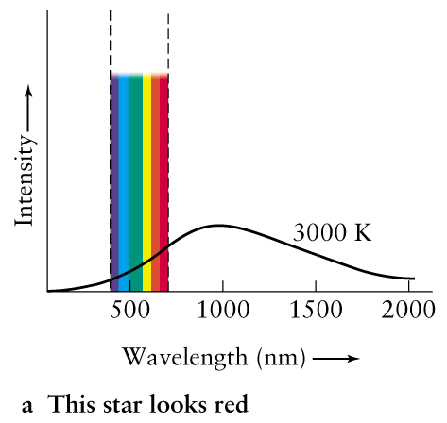
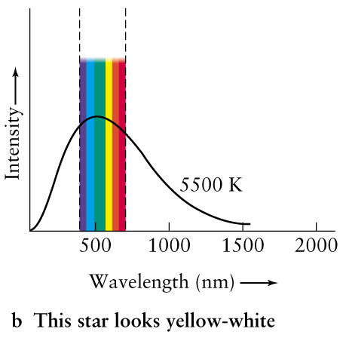
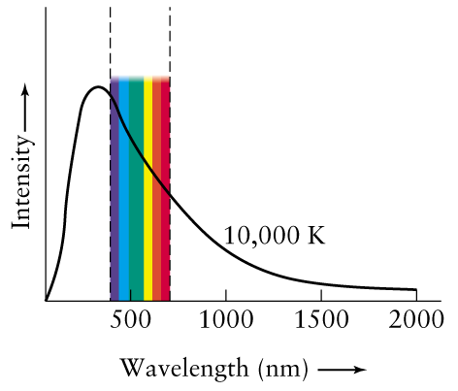
Colors and temperatures of stars
Reminder: from Wien's law λ_{max} = 0.0029 /T (units: m, K) we expect hotter objects to be bluer.

Slide 18
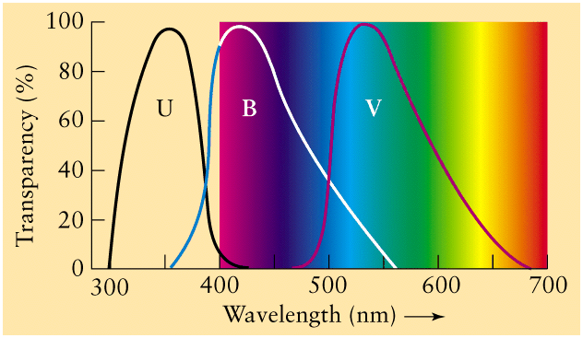
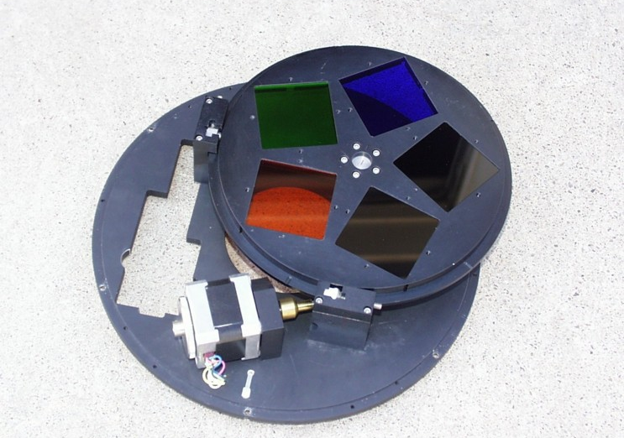
To measure colors
A set of filters can be used to determine the colors of stars
Determine relative brightness in, e.g., B and V filters: b_{V}/b_{B}. (Usually put on magnitude scale, i.e. m_{B} – m_{V}, but don’t worry for this class).
Note we don't need distances
The Johnson UBV system
Notes:
Harold Johnson was the name of the guy defining this.

Slide 19
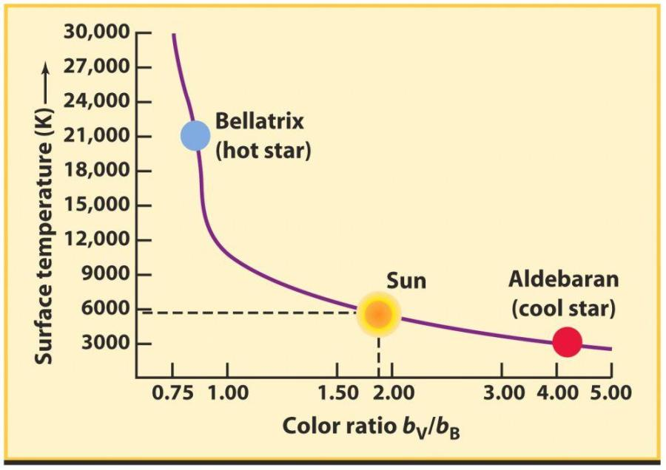
Temperature, color and color ratio
(equivalent ideal blackbody)
The b_{V}/b_{B} color ratio is small for hot stars, and large for cool stars.

Slide 20
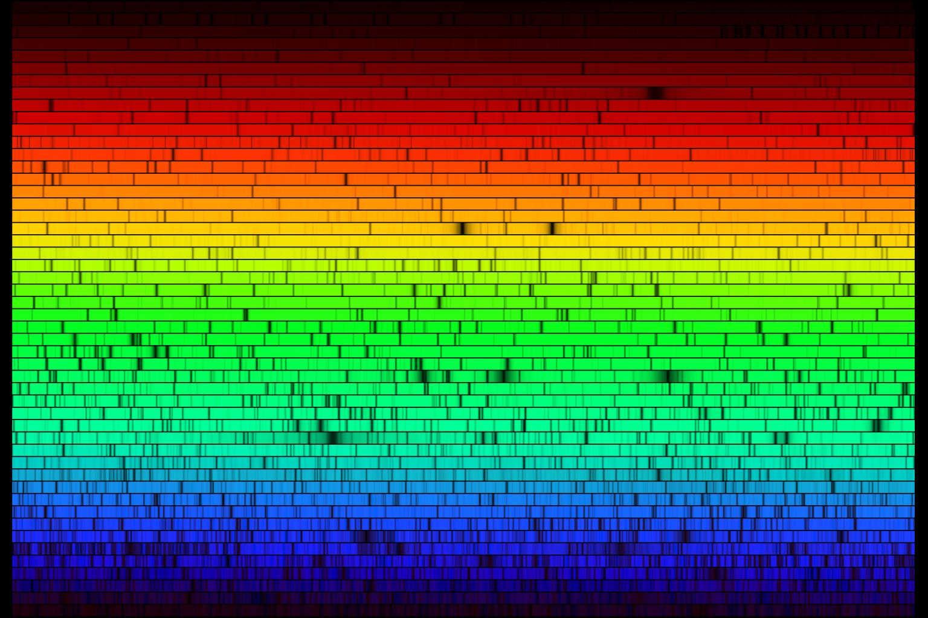
Stars - spectral types
1901: Led by Annie Jump Cannon, Harvard astronomers looked at the spectra of >200,000 stars. Classified them as A, B, C etc. Cannon rearranged them into OBAFGKM based on how lines of H, He, “metals” (Ca, Mg, etc), and complex bands would come and go. Knew colors changed too.
In 1910’s it became clear that spectral lines related to photosphere temperature because of known connection with colors (blackbody radiation was understood), and some lab spectroscopy. In 1920’s, using quantum mechanics, Cecilia Payne explained how temperature governed spectral lines, and this explained OBAFGKM. Subdivisions: 0 (hotter) - 9 (cooler). Sun is G2.

Slide 21
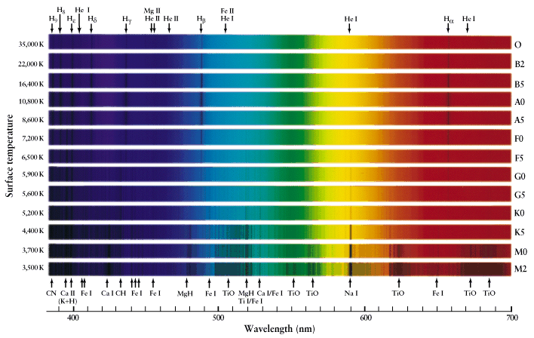
7

Slide 22
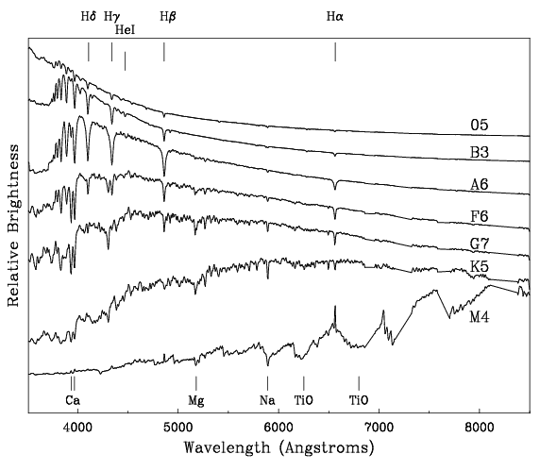
Incident flux or apparent brightness

Slide 23
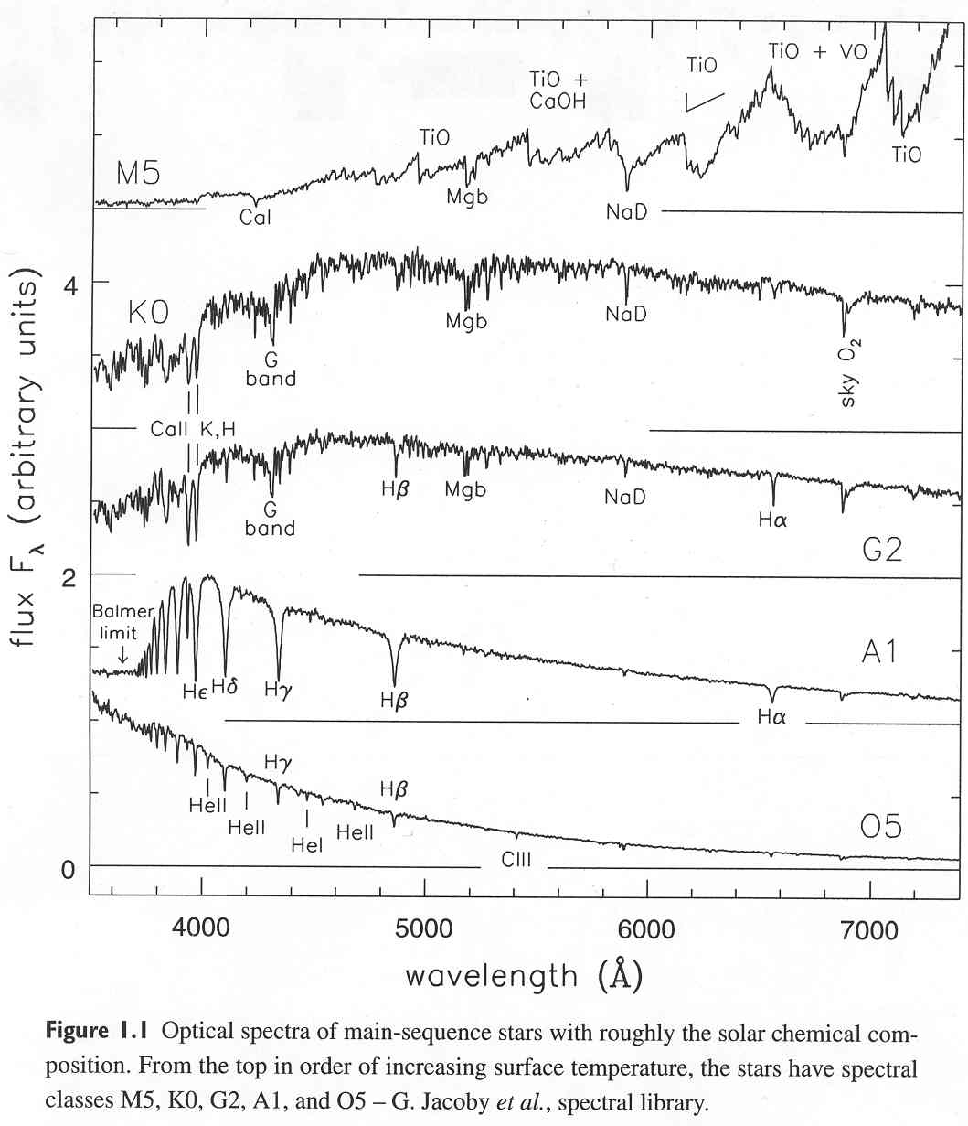
Just to prove that
the hot stars really
do show lines of
Helium:

Slide 24
Mnemonics
Oh Be A Fine Girl/Guy Kiss Me
Oh Bother, Another F's Gonna Kill Me
Oh Bother, Astronomers Frequently Give Killer Midterms
One Bug Ate Five Green Killer Moths
Oven-Baked Ants, Fry Gently, Keep Moist
Only Boring Astronomers Find Gratification Knowing Mnemonics

Slide 25
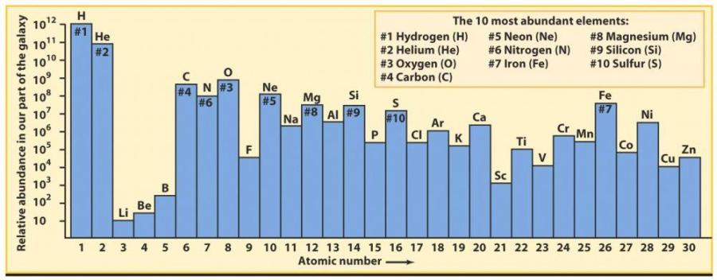
Differences in strengths of the lines are NOT primarily due to a difference in abundance of elements.
Almost all stars’ atmospheres are about 74% H, 25% He and <1% heavier elements by mass. Small variations exist – these give clue to time of stellar birth.
Abundances (in “local” interstellar gas, but star atmospheres about same)

Slide 26
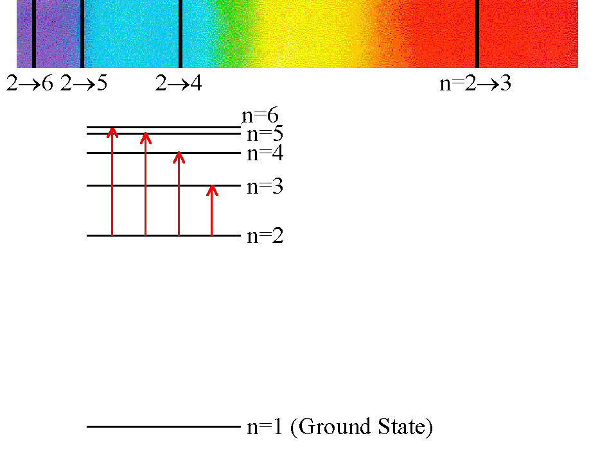
Why do spectra change with temperature?
Higher T => more energetic collisions and photons, excitation of higher levels (collisions actually more important in populating the various levels, even though radiation from deeper down propagating through photosphere leads to absorption lines).
Example hydrogen: if T= 5000 K, most electrons are in the n=1 orbital state => cannot absorb visible light (Balmer photons).
Typical atom kinetic energy is ~3/2 kT ∼ 0.6 eV. Excitations to n=2 require 10.2 eV and are rare.
12.1 eV above ground
10.2 eV above ground

Slide 27
If T~10⁴ K, 3/2 kT ∼ 1.3 eV. Still low, with almost all H in ground state, but enough collisions have energy to excite to n=2 state and give noticeable Balmer absorption lines.
If T>>10⁴ K, dramatic rise in UV photons that can ionize H due to Wien and Stefan-Boltzmann Laws. H starts to become significantly ionized by UV photons. Balmer lines weaken again.

Slide 28
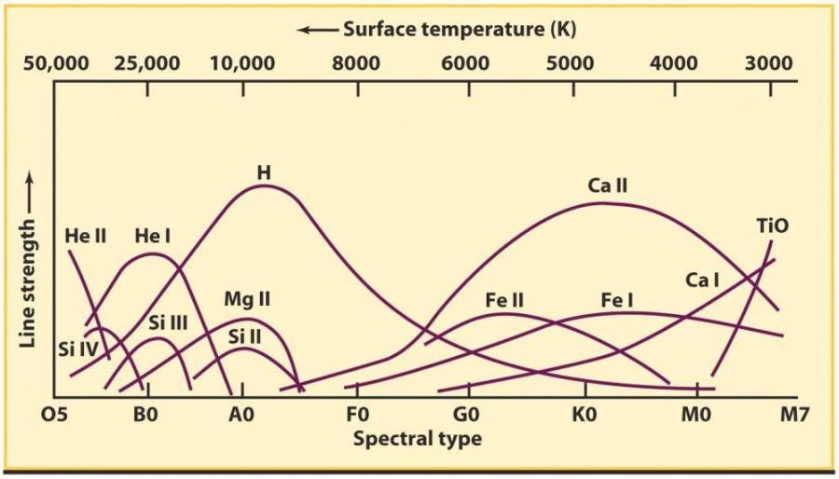
Balmer lines of H are most prominent at about 10,000 K, peaking around A0.
He requires even higher energies to excite or ionize – only seen in hottest stars.
Why are other elements’ lines comparably strong, despite lower abundances? They have lower lying energy levels (1 – few eV) so easy to excite at lower temperatures. Also typically less energy to ionize than H.
Balmer lines of hydrogen are most prominent about 10,000 K, peaking around A0. Other lines peak at different temperatures.

Slide 29
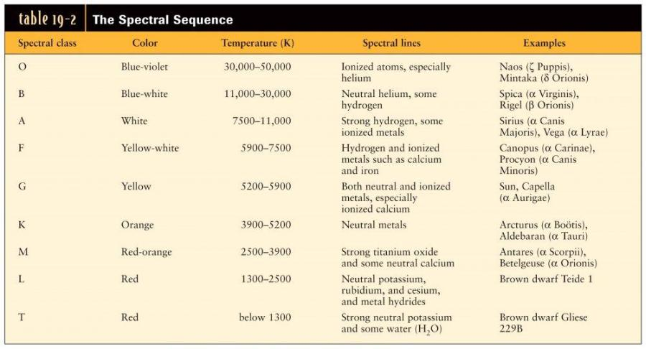
There is much more detailed information about a star’s temperature (and other
properties) from its spectrum than from its color!
(So why measure colors with filters?)

Slide 31
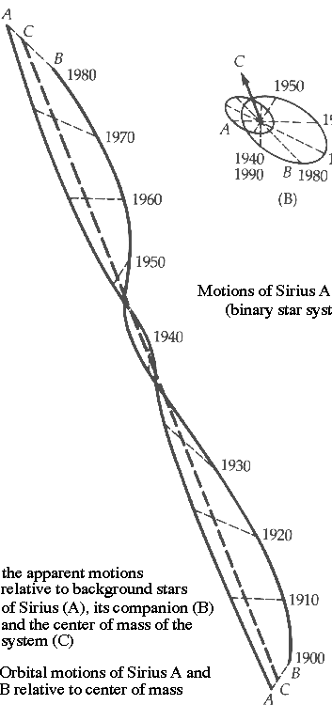
Binary stars and masses
Visual binaries - can see both stars. Binaries (any type) always orbit around the mutual center of mass. May also have measurable proper motion.
Plot stars’ positions relative to background stars
Assume orbit in plane of sky.
Only one straight line can be drawn
(C) that divides a line connecting the
stars into the same ratio at all times.
This marks the unaccelerated center
of mass at common focus of orbits.
More complicated if orbit not in plane
of sky but center of mass can still
be found.

Slide 32
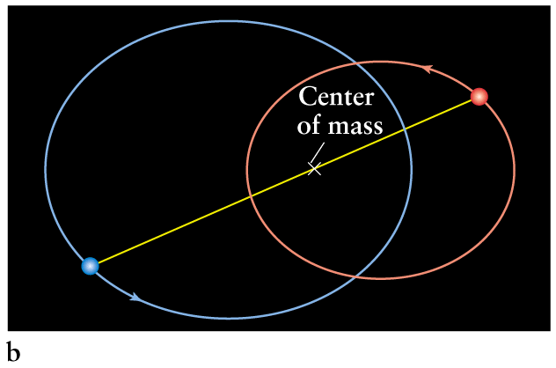
Assume distance known. In frame of center of mass:
a₁
a₂
a₁M₁=a₂M₂
where a = semimajor axis, M = mass
Recall semimajor axis = half of the long axis of ellipse

Slide 33
Visual binaries allow direct calculation of stellar masses. Use Newton’s generalization of Kepler's third law:
M₁, M₂ are masses of the two stars (in M).
a = a₁ + a₂ , which is also the mean separation over the orbit, in AU (note text says a is semimajor axis of one star's orbit around the other – not true). Can also do this if orbit not in plane of sky.
P = orbital period (in years)
So we have two equations in two unknowns => can solve for individual masses, as long as distance, inclination and tilt axis are known.

Slide 34
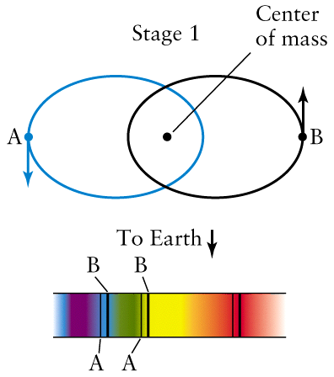
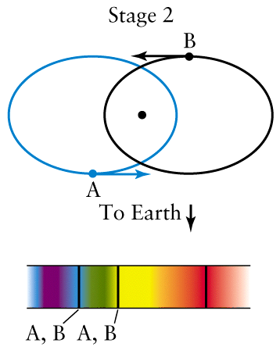
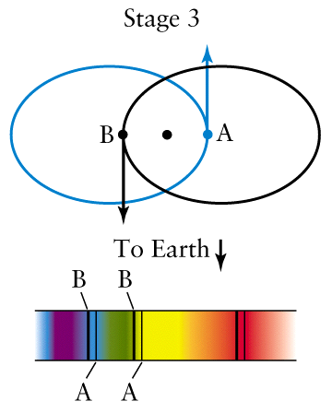
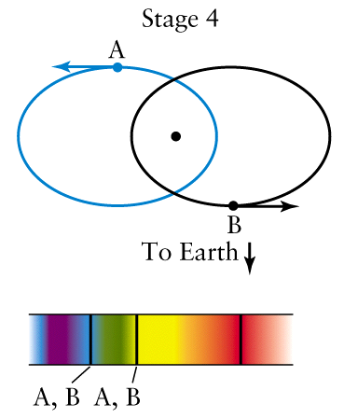
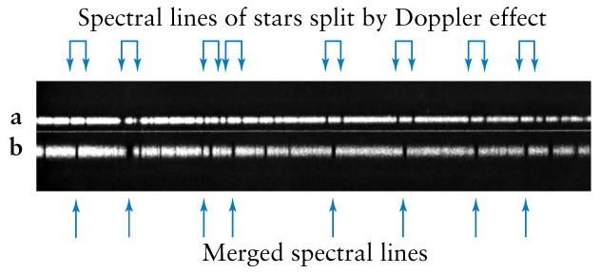
2. Spectroscopic binaries - even if you can't image both stars, might infer binary from spectrum. Below is a “double-lined” spectroscopic binary.
Stage 1
Stage 2
Spectroscopic binary applet (http://www.phys.unm.edu/~rjr/spectroscopicBinaries_scaleable.html)

Slide 35
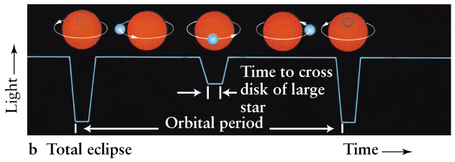
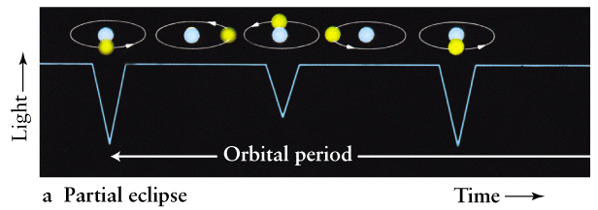
Eclipsing binaries - stars periodically eclipse each other. If not resolved into 2 stars, can tell it's binary from "light curve" - plot of brightness vs. time.
Astrometric binaries - one star can be seen, the other can't. The unseen companion makes the visible star "wobble" on the sky.

Slide 36
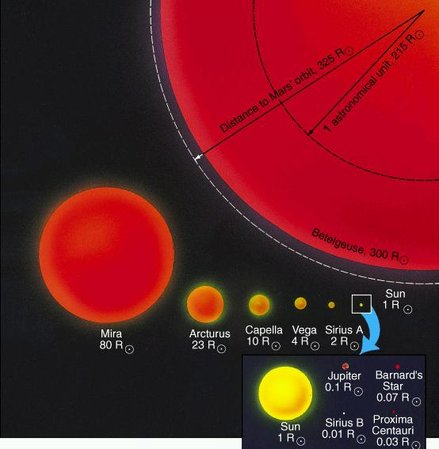
Results for stellar masses
Masses known for about ~200 stars in binaries, within a range of 0.08 - 60 M. Most massive star known may be up to 200 M?
Stellar radii
Direct radius measurements hard because of large distances (the Sun at 1 pc distance would have an angular diameter of 9.3 milliarcseconds).
So how do you do it?
Recall for a blackbody:
L = 4πR²σT⁴
If L,T known, find R.

Slide 37
What we know so far about stars:
Distances
True 3-D motion
Luminosity/Absolute magnitude
Temperature/Spectral type/Color
Mass (for some)
Radii
=> synthesize this information (except motions) into the Hertzsprung-Russell (H-R) diagram.

Slide 38
The Hertzsprung-Russell (H-R) Diagram (1911)
Simple in concept, but a VERY powerful tool to examine stellar structure and evolution
Hertzsprung and Russell independently asked themselves: "What are the two basic things about stars we can measure"?
Luminosity (when distance known)
Temperature (or color or spectral type)
H-R diagram is a plot of L (or Abs. Mag.) vs. T (or color, spectral type) for stars.

Slide 39
H-R diagram
of some nearby
and bright stars
(y-axis may also
be absolute
magnitude in some
filter, e.g. V. x-axis
may be b_{b}/b_{v} color.
“Color magnitude
diagram”)
or B-V color

Slide 40
Since we know
L = 4πR²σT⁴
we can plot lines of constant R
if both axes are log.
A star’s position in H-R diagram
depends primarily on mass and
evolutionary state.
Main Sequence stars are in the
longest phase of their lifetime
where they fuse H into He.
They move little in this diagram.
Other stars are at late evolution
stages.
How do we know? Our stellar
models predict L and T for different
masses and stages of evolution.

Slide 41
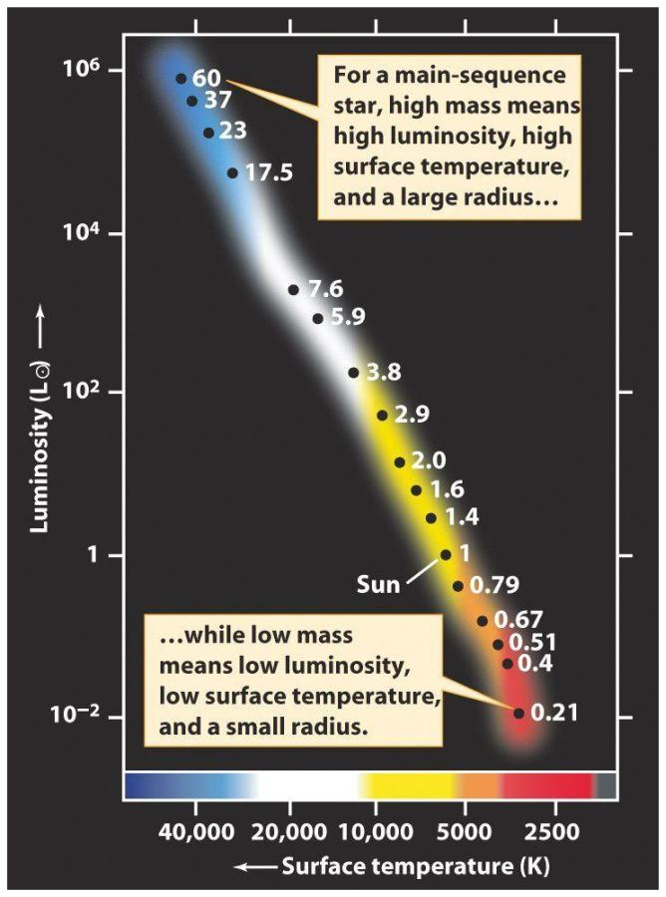
Main Sequence is a sequence of mass.
So M, L, T, R all related for
Main Sequence stars.

Slide 42
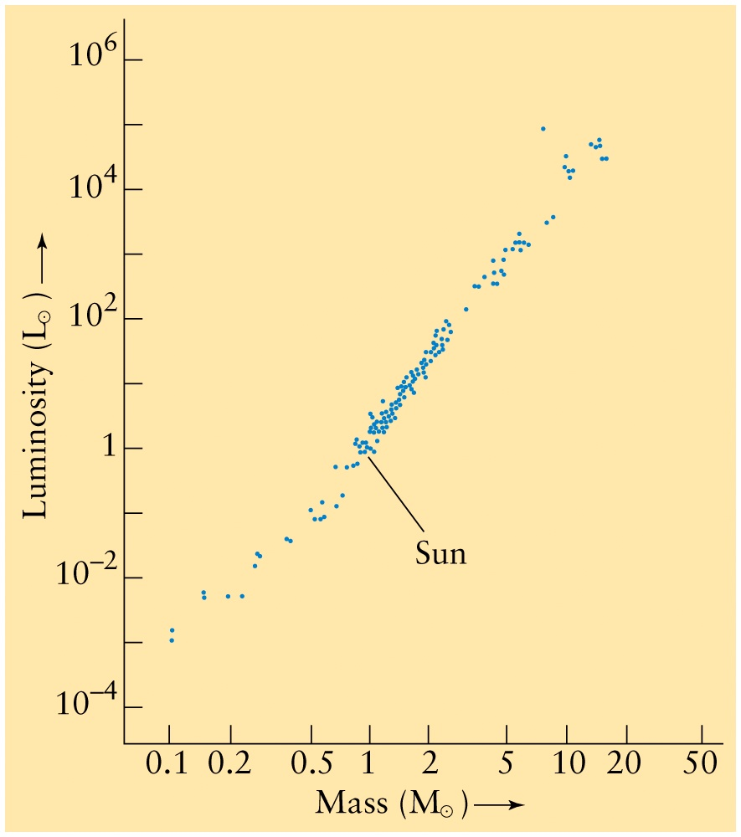
With various quantities determined, can start relating to each other. For Main
Sequence stars only:
R α M^{0.8}
or R/Rʘ = (M/Mʘ)^{0.8}
L α M^{3.5}
or L/Lʘ = (M/Mʘ)^{3.5}

Slide 43
How Long do Stars Live
(as Main Sequence Stars)? See Box 19.2
Main Sequence stars fuse H to He in core. Lifetime depends on mass of H available and rate of fusion. Mass of H in core depends on mass of star, roughly linearly. Fusion rate is proportional to luminosity (fusion reactions make the radiation energy).
mass of H in core
fusion rate
mass of star
luminosity
lifetime α
α
So,
since luminosity α (mass) ^{3.5},
mass
(mass)^{3.5}
1
(mass)^{2.5}
lifetime α
or
Or can write:
So if the Sun's lifetime is 10 billion years, a 10 M star's lifetime is only:
τ/τʘ = (Mʘ/M)^{2.5}
1^{2.5}
10^{2.5}
1.0x10¹⁰ yrs x
= 3 x 10⁷ years. Such massive stars live only "briefly".

Slide 44
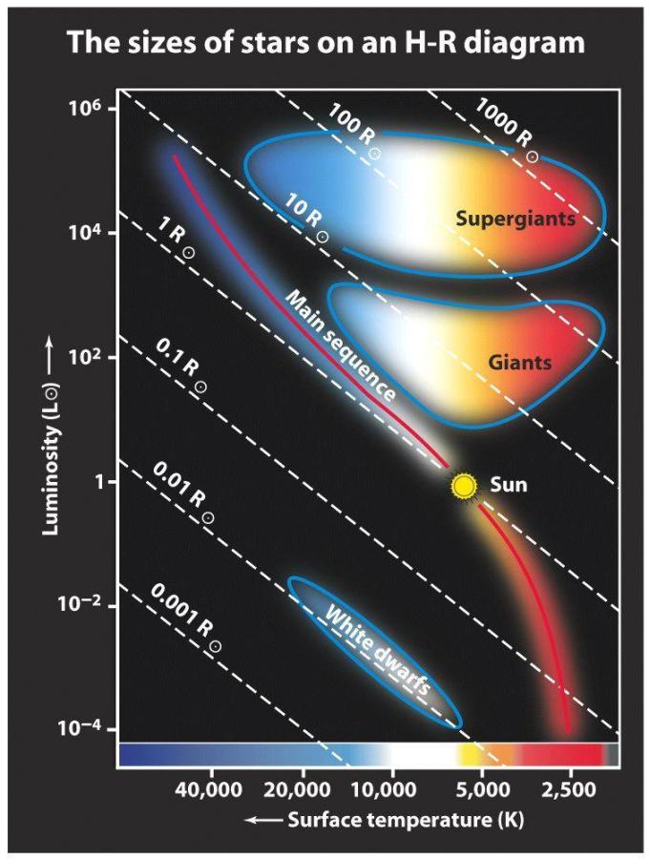
What if we find a star with T=5000 K and measured incident flux, but don't know its distance?
Can we place it in the H-R diagram and find its luminosity, and thus distance?
How do we know where to place it on the L axis?

Slide 45
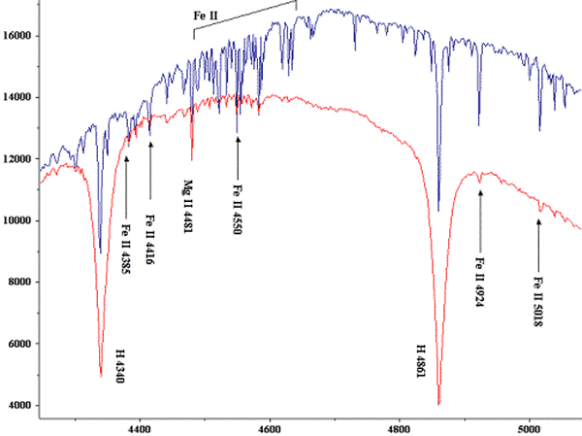
Line width and stellar size
Atmospheric pressure affects width of absorption lines:
Lower pressure => decreased line width
Higher pressure => increased line width
The atmospheric pressure is lower in the photosphere of an extremely large red giant than in a main sequence star of similar temperature
=> giant's spectral lines are narrower
Deneb (supergiant)
Vega (MS)
B8 supergiant (top), main sequence (bottom).

Slide 46
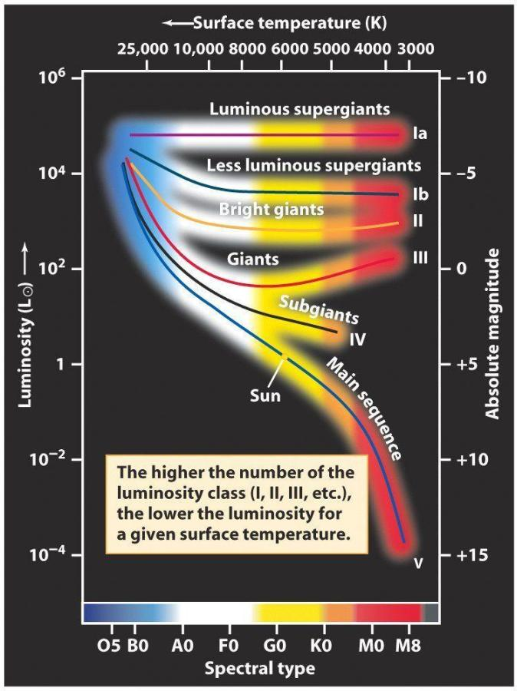
Luminosity classes
We classify stars in luminosity classes; I - V (from narrow lines to wide lines, which also is from very luminous to less luminous)
Thus a star is classified by its spectral type and its luminosity class.
Full description of the Sun is G2 V.

Slide 47
Spectroscopic parallax
Without knowing a star's distance, we can place it on the H-R diagram (spectral type and width of lines).
This yields a luminosity, to be compared to the star's apparent brightness.
=> distance can be estimated (to about ±10%).
This is how we infer distances to most isolated stars! (We’ll return to clusters)

Slide 49
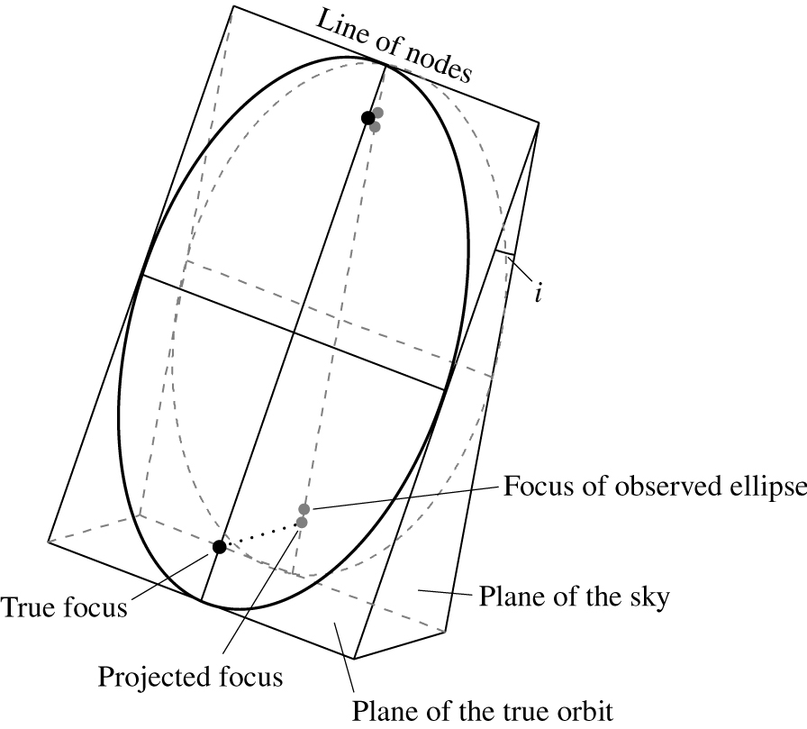

Slide 50
Derivation
This comes from the definition of magnitude:
Consider two stars with same L, but assume star 1 is at a distance d with an apparent magnitude m₁=m , and star 2 is 10 pc away with apparent magnitude m₂=M:
F₂
F₁
= 10 ^{(m1 - m2)/2.5}
F_{10pc}
F_{d}
= 10 ^{(m - M)/2.5}
Next we use the relation F = L/4πd²:

Slide 51
Thus,
$$\frac{d^{2}}{100 {pc}^{2}}= {10}^{(m −M)/2.5}$$
$→ d^{2}= {10}^{2}{×10}^{\left(m−M\right)/2.5}{pc}^{2}={10}^{(m−M+5)/2.5}{pc}^{2}$
Taking the log of both sides then yields
or
where d must be in units of parsecs.
$$2\log\left(d\right)=(m−M+5)/2.5$$
$$m−M=5\log\left(d\right)−5$$

Slide 52
Since L = 4πd²b, we can compare any star’s luminosity to the Sun’s by a ratio:
Knowing relative distance and brightness, we know the star’s luminosity relative to the Sun’s. Finally, you can show from the above eqn and definition of distance modulus that
Will see  symbol for Sun, e.g. L, R, etc.
Or in general,

Slide 53
So the three key equations for magnitudes are:
Relating apparent magnitudes of two stars to incident fluxes:
Apparent, absolute magnitudes of a star and its distance:
Relating absolute magnitudes of two stars to luminosities

