Slide 1
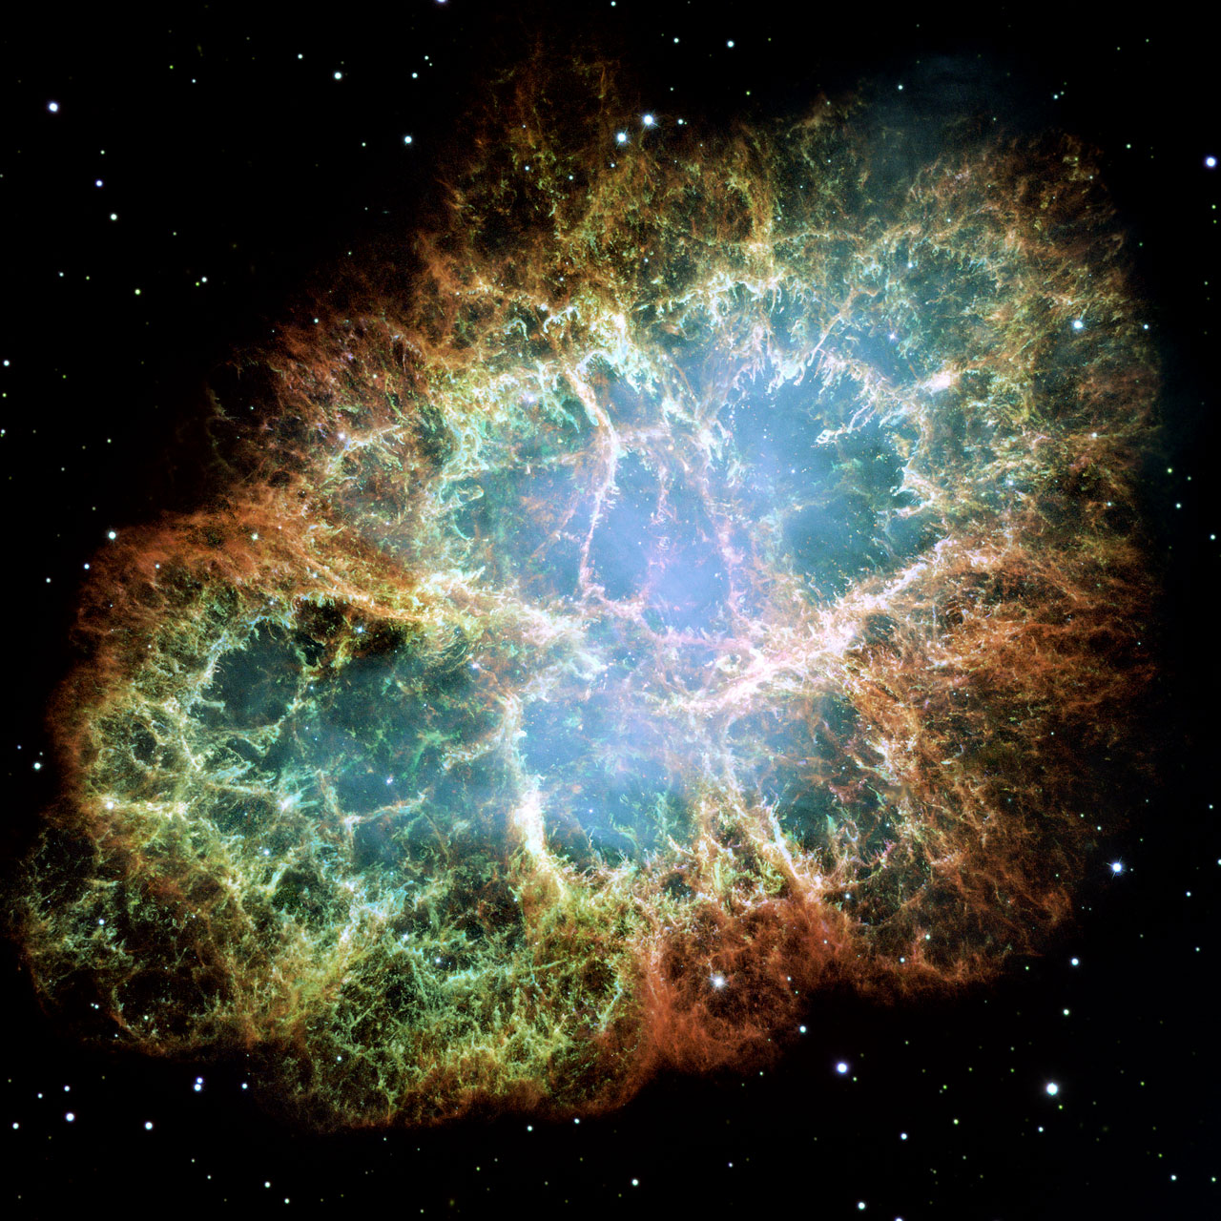
Explosive Deaths of Stars Sections 20-5 to 20-10

Slide 2
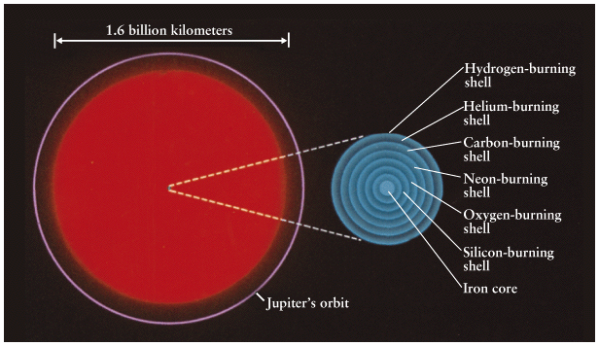
Evolution of high mass stars
For stars with initial masses > 7 M, the fusion process goes beyond C and O.
Possible because central temperatures high enough for C, O fusion. Core hot enough so still an ideal gas, not degenerate. Fusion starts without a flash.

Slide 3
Onion shell buildup
Pick up from stage where inert C-O core contracts and heats up, H & He shell burning.
C-O core contracts until T~ 6x10⁸ K: igniting C. Fusion of
¹²C with¹²C or ⁴He produces ¹⁶O, ²⁰Ne, ²⁴Mg.
Inert O-Ne-Mg core contracts and heats up, H & He & C shell burning. (For M∼7(?) – 8(?) M, fusion ends with O, Ne, Mg and core does become degenerate. Explains rare “O-Ne-Mg White Dwarfs”).
If M>∼ 8 M, core contracts until core T ~ 10⁹ K, fusion starts again, mainly ²⁰Ne -> ²⁴Mg.
When exhausted, core shrinks, shell of Ne fusion established. When core T~1.5x10⁹ K, fusion starts, mainly ¹⁶O -> ²⁸Si, ³²S.
6. Then core contracts, shell of O fusion established. When core T~2.7x10⁹ K, ²⁸Si, ³²S fuse to mainly ⁵⁶Fe, ⁵⁴Fe, ⁵⁶Ni.

Slide 4
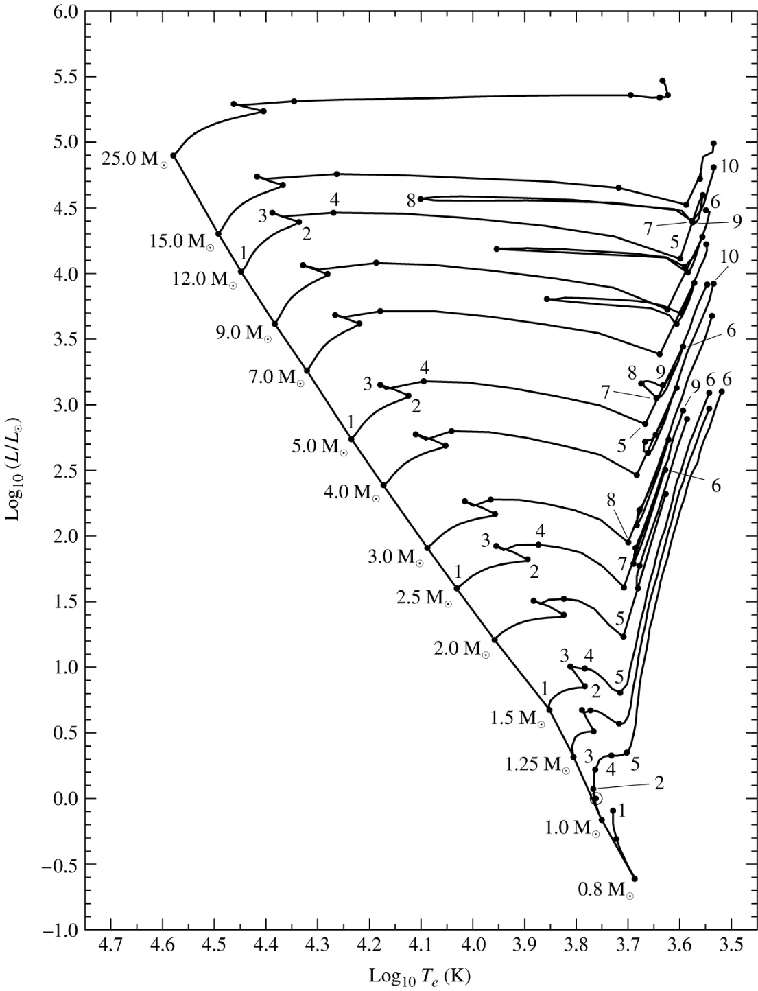
Stars evolve at nearly constant L in H-R diagram.
Evolution generally to redder color and larger radii.
Details are complex and not important: back and forth motion associated with establishment of new core fusion sources, and tracks are affected by rotation of star, mass loss via winds, degree of convection, etc.

Slide 5
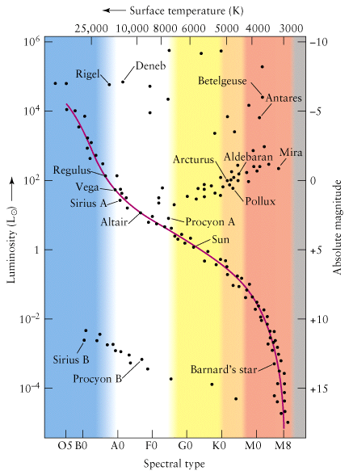

Slide 6
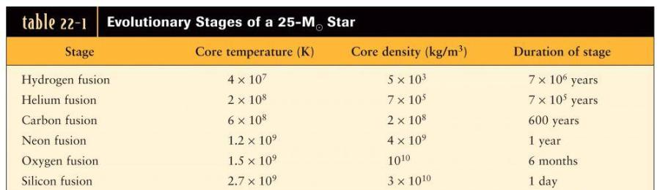
A massive red
supergiant.
The core has
an onion-layer
structure, with
shells of greater
radius fusing
heavier elements
(core)

Slide 7
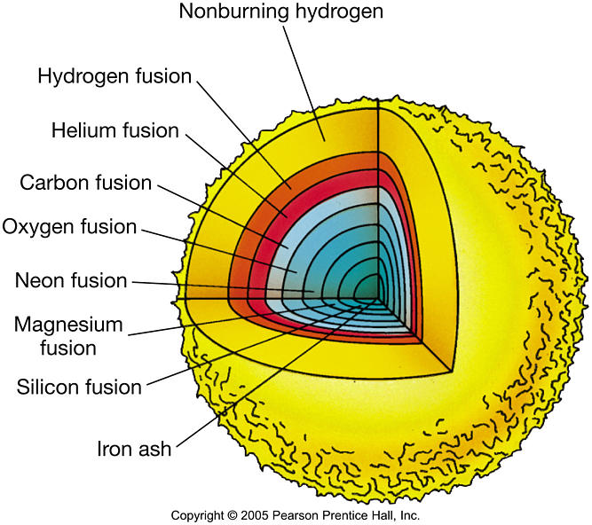
Where does it stop?
A very high mass star can process all the way to iron (⁵⁶Fe) by normal fusion.
Why? Fusion of Fe (and heavier nuclei) absorbs energy instead of liberating it. Fe core contracts, heats up: a catastrophic collapse is unavoidable.

Slide 8
Core collapse
Photodisintegration: For massive stars (>~ 8 M), when the core temp reaches 5 x 10⁹ K, γ-rays disintegrate Fe nuclei (1/10 s) => He => p, n
Neutronization: In another 1/10 s, core becomes so dense that electrons and protons are forced together to create neutrons via
e⁻ + p⁺ → n + ν
Energetic neutrinos mostly escape, robbing the core of more energy so it collapses faster.
After 0.25s, core reaches nuclear density ∼10¹⁷ kg/m³ (from ∼10¹⁰ kg/m³). The neutrons resist further compression, i.e. neutron degeneracy pressure stops collapse and core becomes extremely rigid.
When collapse stops ⇒ overshooting causes a core bounce (launching a powerful shock wave outwards).
At the start of the iron core collapse, the core is ~6000 km. A second later it is ~50 km!

Slide 9
A Core-collapse Supernova
Outside the core, material is falling inward at about 0.15c. This is because the core is losing energy, catastrophically collapsing, and thus providing no support.
As this material crashes toward the core, the shock wave blasts it outwards.
In a few hours the shock gets to the outer layers and breaks out from the surface at about 0.1c. Fast ejection of the entire envelope, blast of radiation. At peak brightness, L ~ 10⁹ L .
This is a core-collapse or Type II (why? later…) supernova.

Slide 10
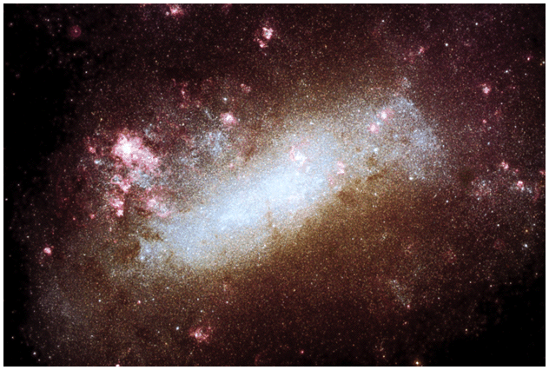
Thus far, theory. In 1987 light from a supernova in Large Magellanic Cloud (dwarf galaxy near Milky Way) reached us, providing a good test.
Notes:
Halpha + continuum image. 55kpc away. The MW has a Snrate of about 2 per century. Harmful ones would be closer than 10pc, for which the rate is less than 1 per 100Myr.

Slide 11
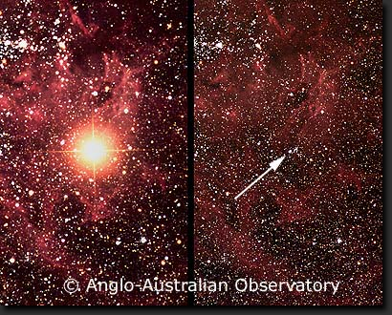

Slide 12
Neutrinos and supernovae
About 98% of the energy of a supernova comes out in the form of neutrinos, which are formed in the neutronization process.
From SN1987A we detected burst of neutrinos at 2 different neutrino detectors. They arrived 3 hours before the visible light.
Why before? Light emitted only when shockwave gets out of core, reaches surface layers of star.

Slide 13
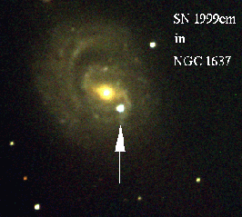
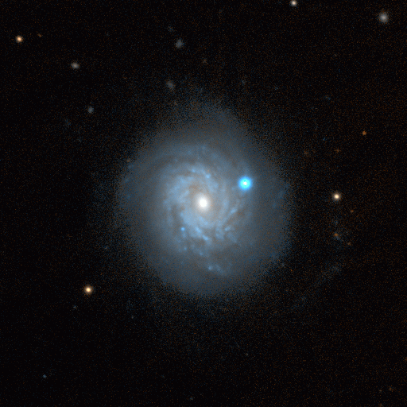
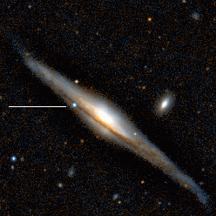
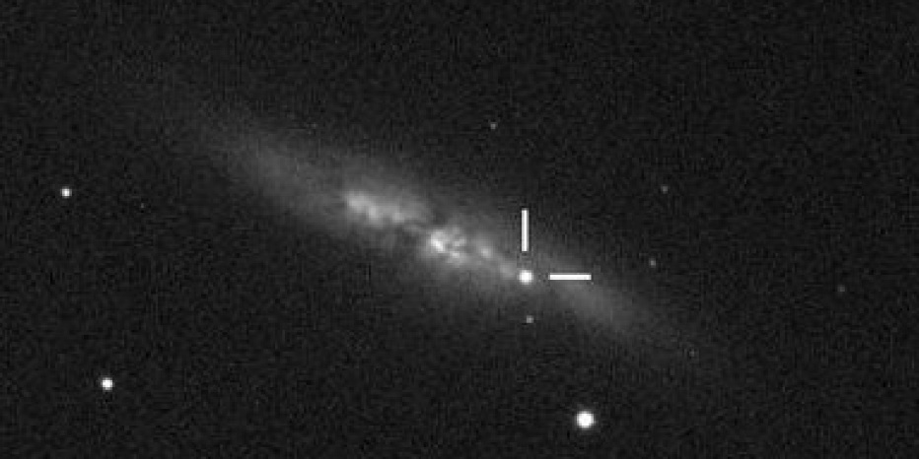
Supernovae can rival brightness of their host galaxy, and we can see them across the Universe.
NGC1637, 1999 (9Mpc)
NGC3982, 1998 (23Mpc)
NGC5965, 2001 (50Mpc)
M82, 2014 (6Mpc)

Slide 14
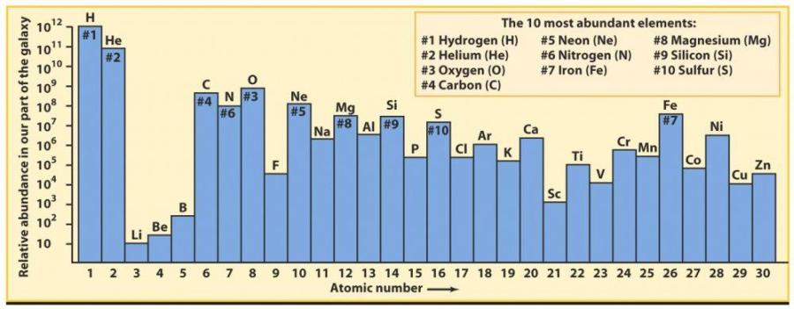
Remaining Nucleosynthesis
Some elements not yet mentioned, such as Al, P, made by rare fusion reactions in normal stellar evolution.
Elements beyond iron in the periodic table created during late evolution of massive stars (lead, gold, copper, silver, etc.) and SN explosion itself (thorium, uranium, plutonium, etc.), by “neutron capture”: some reactions create free neutrons – many more created in supernova. These can be absorbed by other nuclei. If nucleus now unstable, n decays into p => new element.
This enriched material is eventually available for the formation of the next generation of stars and planets.

Slide 15
Types of supernovae
Supernova classified observationally by spectra of debris. Then must relate to progenitor properties.
“Type II” supernovae show hydrogen emission lines in their spectra.
Why? These highly massive stars still have H in their atmospheres while exploding due to core collapse.
Type I supernovae show no hydrogen lines. They divide into Type Ia, Ib and Ic. Last two are special cases of core collapse in massive star. Type Ia is quite different.

Slide 16
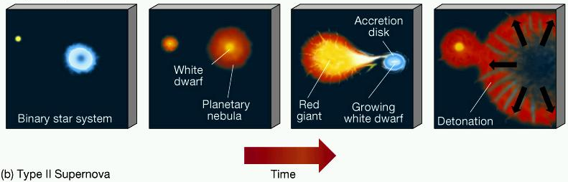
Type Ia or Carbon-detonation supernovae
Consider white dwarf in close binary system.
Mass transfer pushes white dwarf toward “Chandrasekhar limit” of 1.4 M. Here gravity overwhelms degeneracy pressure, star contracts and gets very hot.
Carbon suddenly ignites in core, because it is degenerate the fusion rate increases rapidly: the star blows up.
Thermonuclear runaway

Slide 17
Iron in universe generally comes from this runaway
fusion in WDs
Type Ia SN have critical importance in understanding the Universe as a whole: they are standard candles.
No matter where in the Universe they happen, they are physically similar: WD with about 1.4 M (the Chandrasekhar limit), so they produce similar explosions.
Why is this useful? Would Type II's be as good as standard candles?

Slide 18
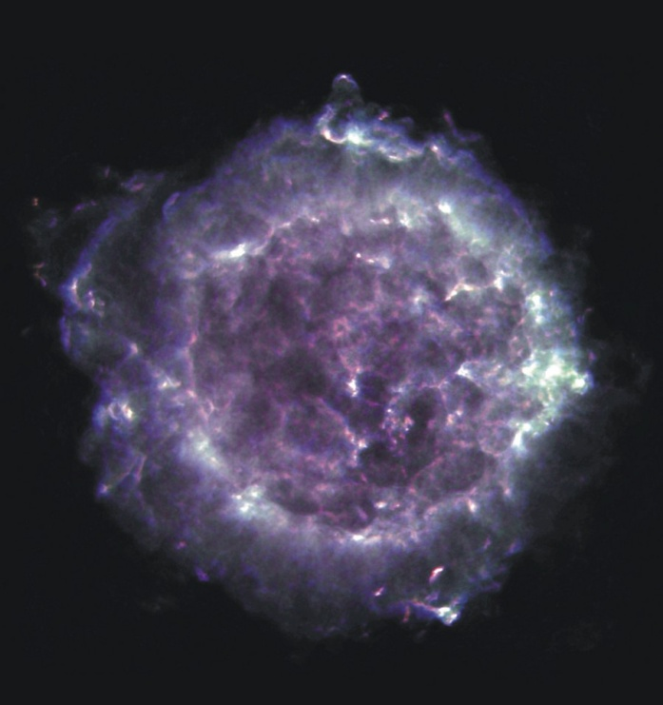
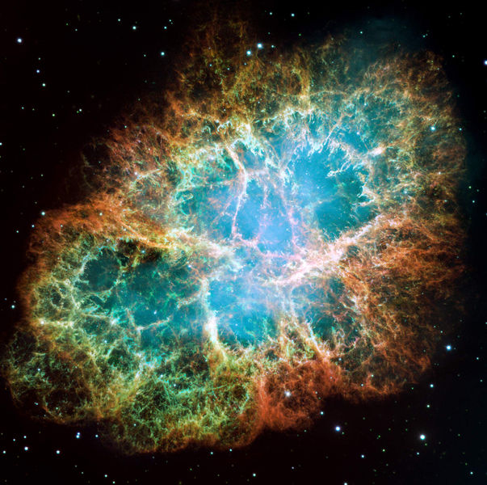
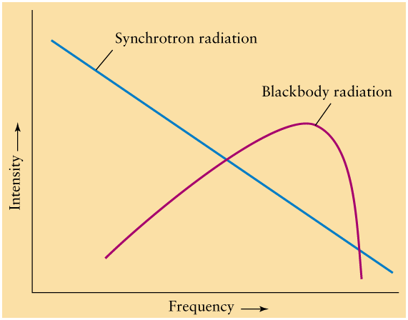
Supernova remnants (SNRs)
The extreme violence of a supernova blasts the outer layers of the star into the ISM.
This enriches the ISM with heavy elements and accelerates atomic nuclei and electrons to speeds near c, travel across the Galaxy and are called cosmic rays when they hit the Earth.
In addition, the collision between the shock and the ISM excites the gas and makes it glow: supernova remnants
Cassiopeia A in radio waves (VLA)
Crab Nebula (optical)
Radio waves from
“synchrotron” emission
of electrons

Slide 19
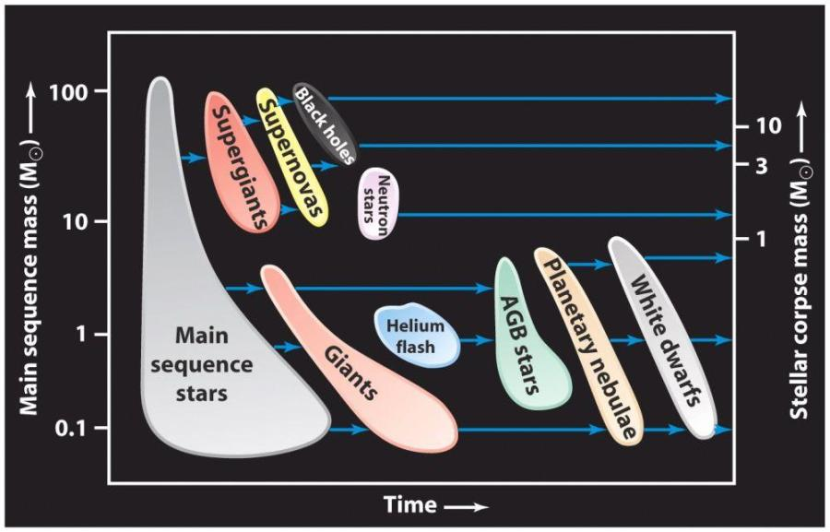
Summary of star deaths

Slide 21
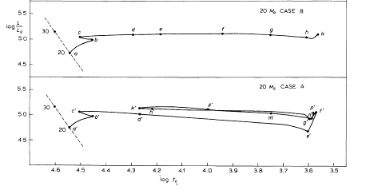
Evolution during He core fusion of a 20 Msun star with two different assumptions about how convection works (Chiosi & Summa 1970).
“Blue loops” are very sensitive to treatment of convection, rotation, mass loss and metallicity and the models are very uncertain.

Slide 22
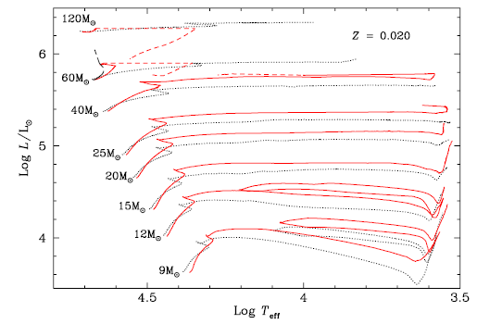
Evolution during He core fusion for models with rotation (red) and without (black), (Maeder & Meynet 2000). Blue loops appear for both models at 9 Msun, only rotating models at 12 Msun, and neither model at 15-25 Msun.

Slide 23
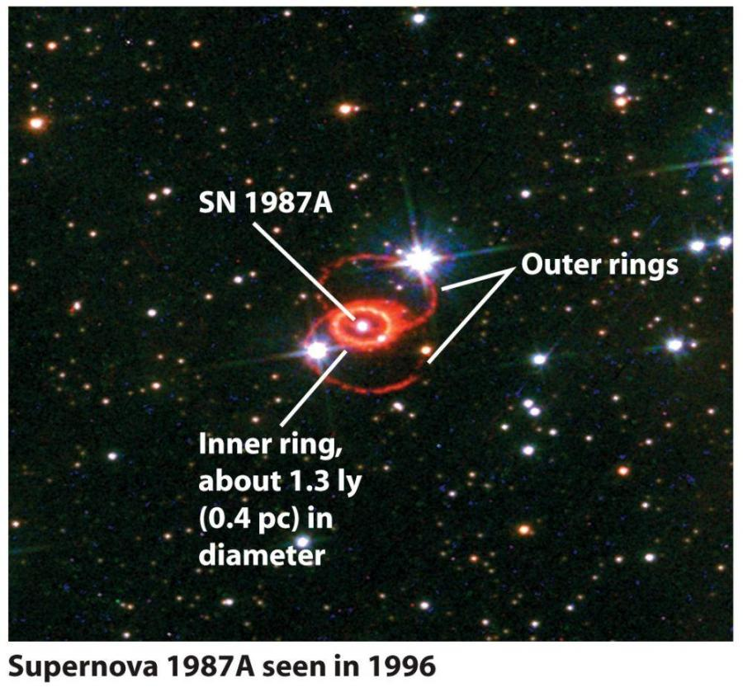
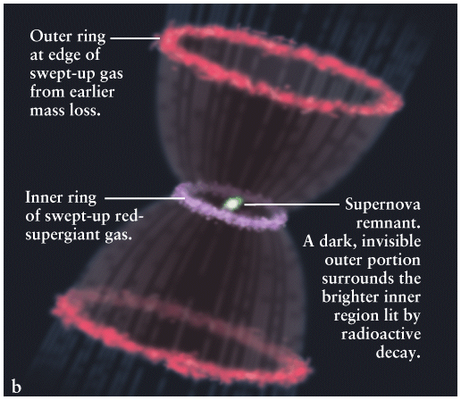
Outer rings lit by UV radiation from explosion.

Slide 24
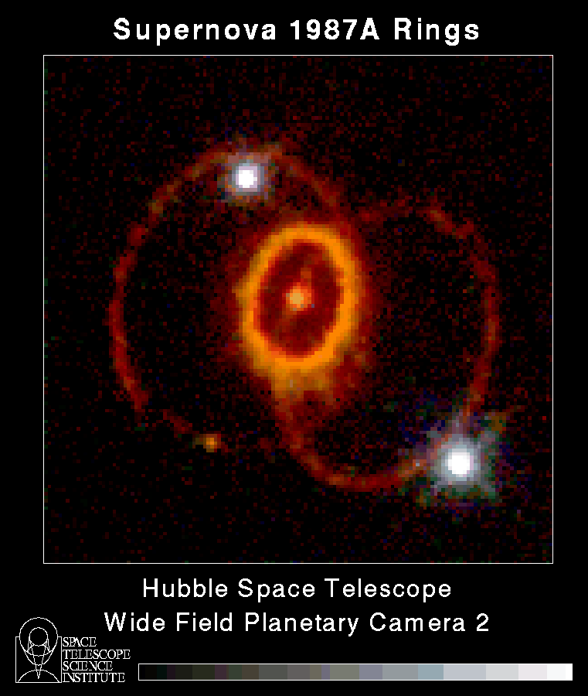
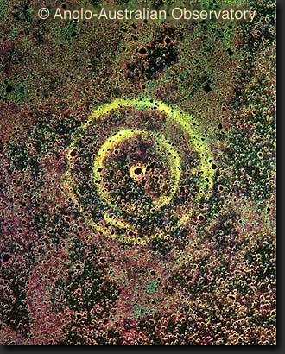
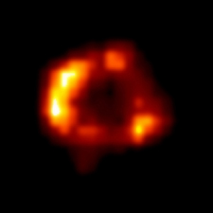
Light from SN bounces off interstellar dust - "light echoes".
Chandra X-ray image

Slide 25
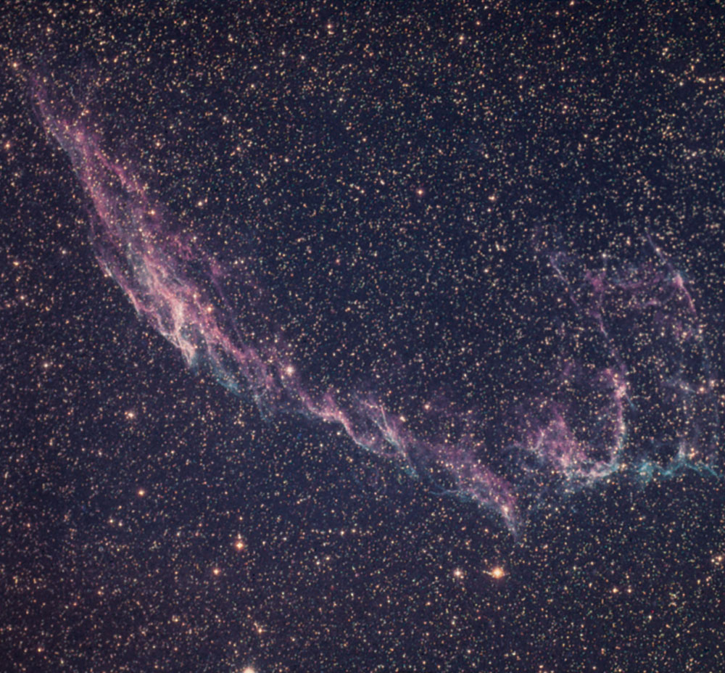
Problem 20.55
Fig. 20.23 shows a portion of the Veil Nebula in Cygnus. Use the caption to find the average speed at which material has been moving away from the site of the SN explosion over the past 15,000 years. Express in km/s and as a fraction of the speed of light.
Fig. 20.23: This SNR is a roughly spherical remnant of a SN that exploded about 15,000 years ago. The distance to the nebula is about 800 pc (2600 ly), and the overall diameter of the loop is about 35 pc (120 ly).

Slide 26
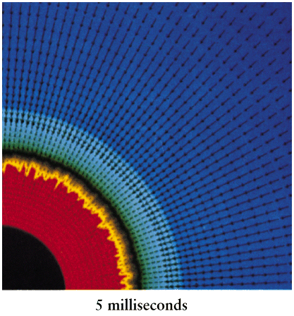
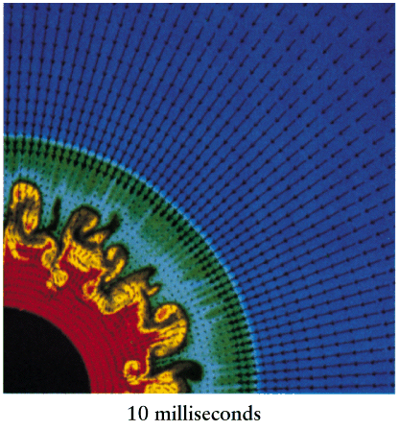
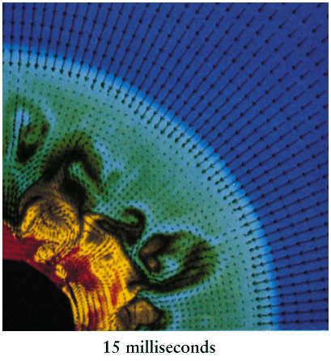
Simulations of supernova explosions:

